Slide 1
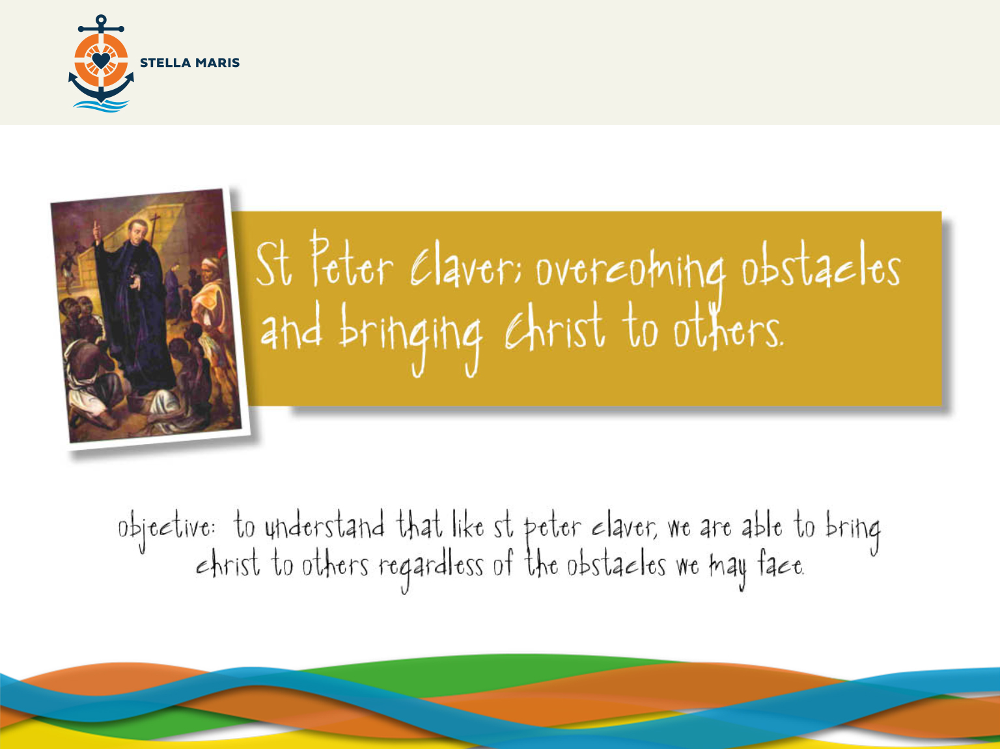
Notes:
OBJECTIVE:
To understand that like St Peter Claver, we are able to bring Christ to others regardless of the obstacles we may face.

Slide 2
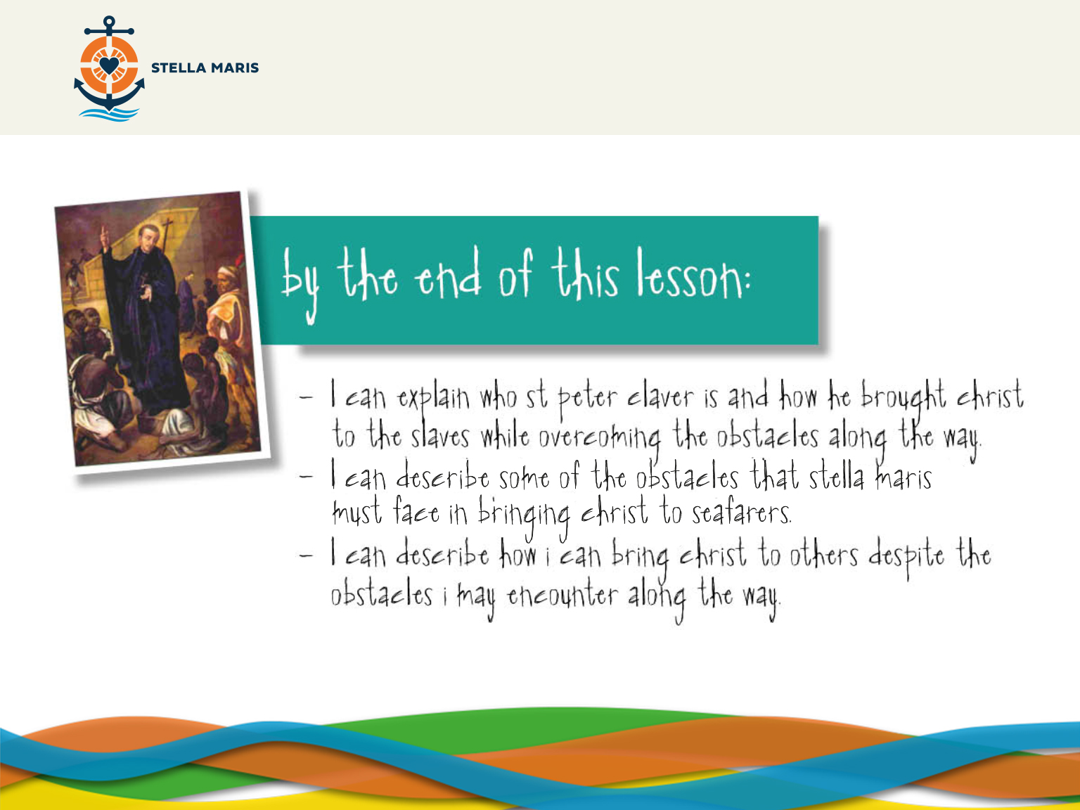

Slide 3

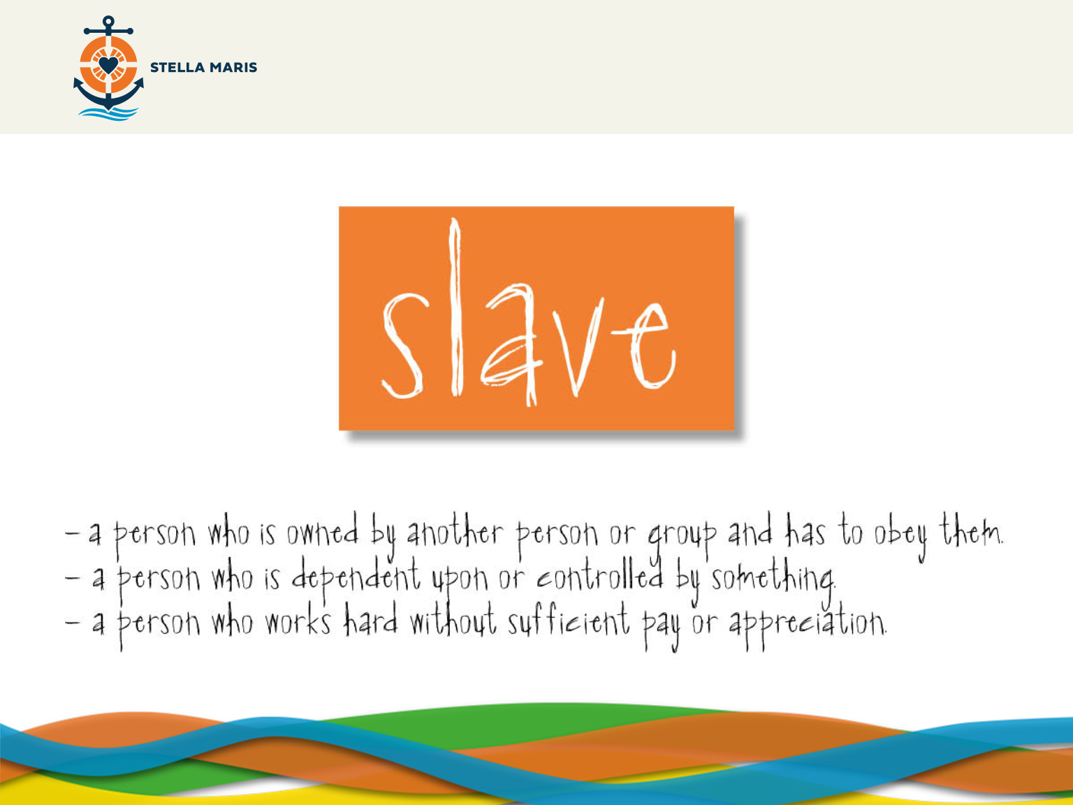
Notes:
Divide the students into groups of 4-5.
You will clearly see the word slave on the screen, I’d like you to work in your groups and come up with a concise definition of the word slave.
(2 minutes)
Take feedback
(2 minutes)
(CLICK)
‘Slave’ could be defined as:
- A person who is owned by another person or group and has to obey them.
- A person who is dependent upon or controlled by something:
- A person who works hard without sufficient pay or appreciation

Slide 4

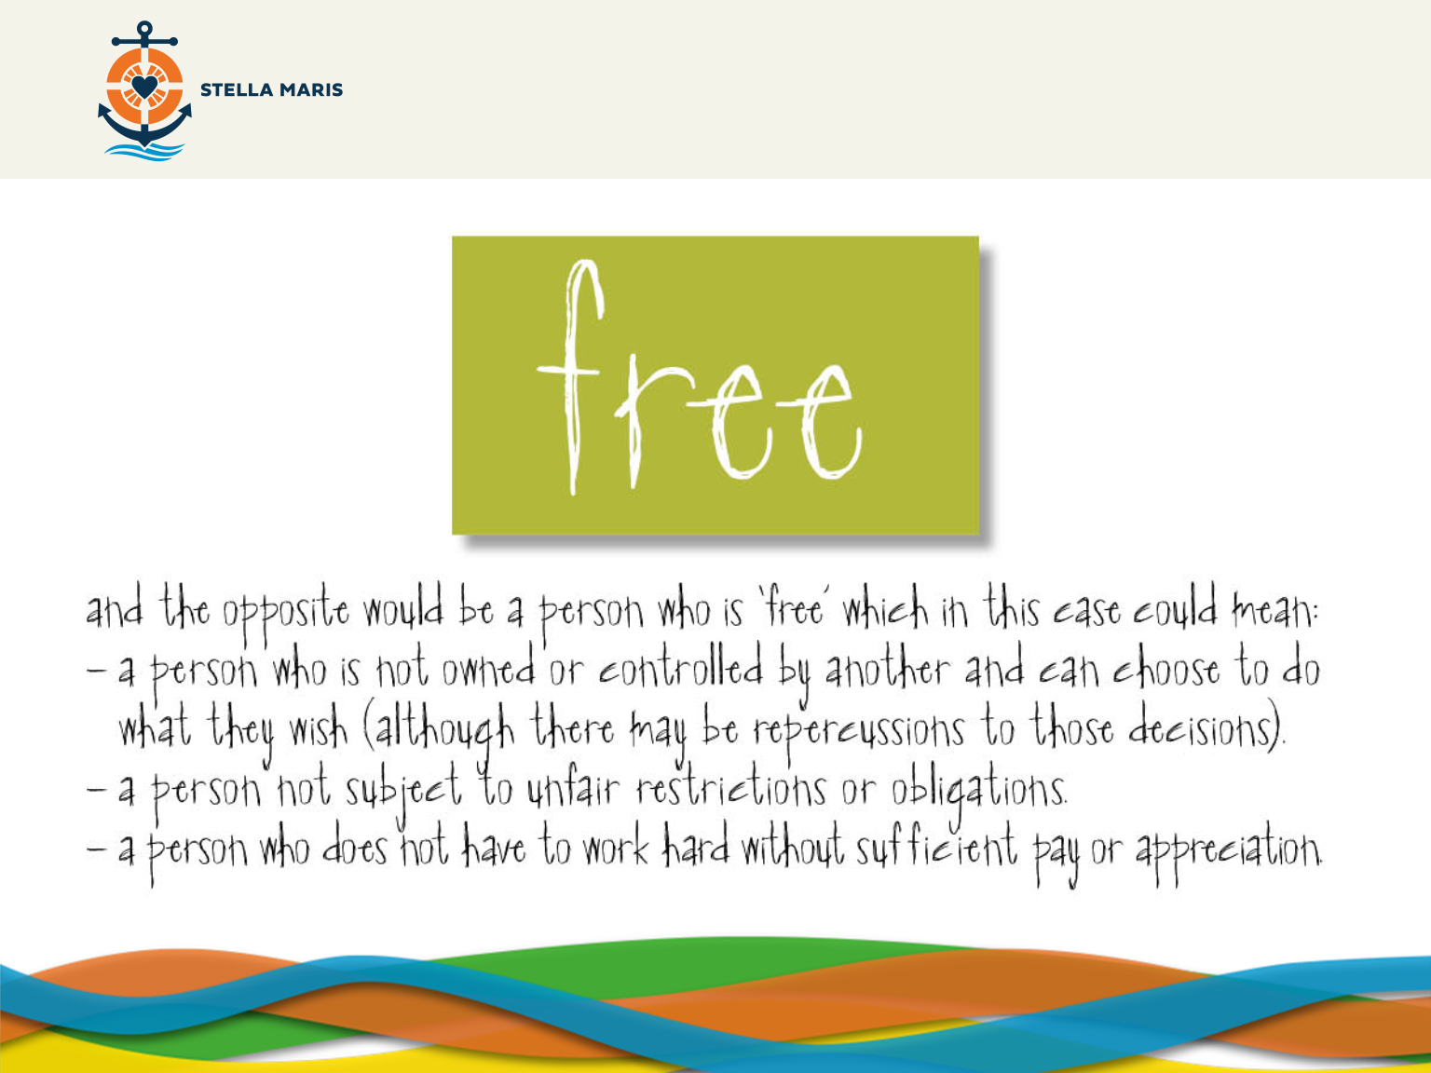
Notes:
And the opposite would be a person who is ‘free’ which in this case could mean:
•A person who is not owned or controlled by another and can choose to do what they wish (although there may be repercussions to those decisions).
•A person not subject to unfair restrictions or obligations
•A person who does not have to work hard without sufficient pay or appreciation.

Slide 5
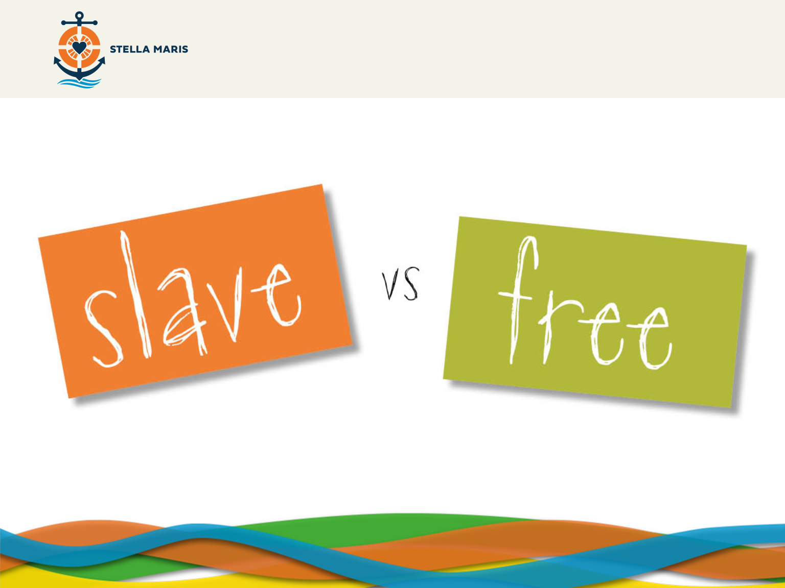
Notes:
APPENDIX 1
I am going to give you each a card saying ‘Free’ or ‘Slave’ (with their respective definitions) and you are going to see some images and I’d like you to decide whether or not the person shown is free, or is in some way a slave. You will need to discuss it as a group and come to a decision together.
Give them enough time after each image to discuss as a group. When the groups seem to have decided then ask the class to show the relevant card. The first few images may need less time than the later ones.
It is important to know that there aren’t right or wrong answers in this session but the aim is for the students to discuss and debate what it means to be free or have that freedom limited by others, one’s own decisions or circumstances beyond one’s control.

Slide 6


Slide 7


Slide 8
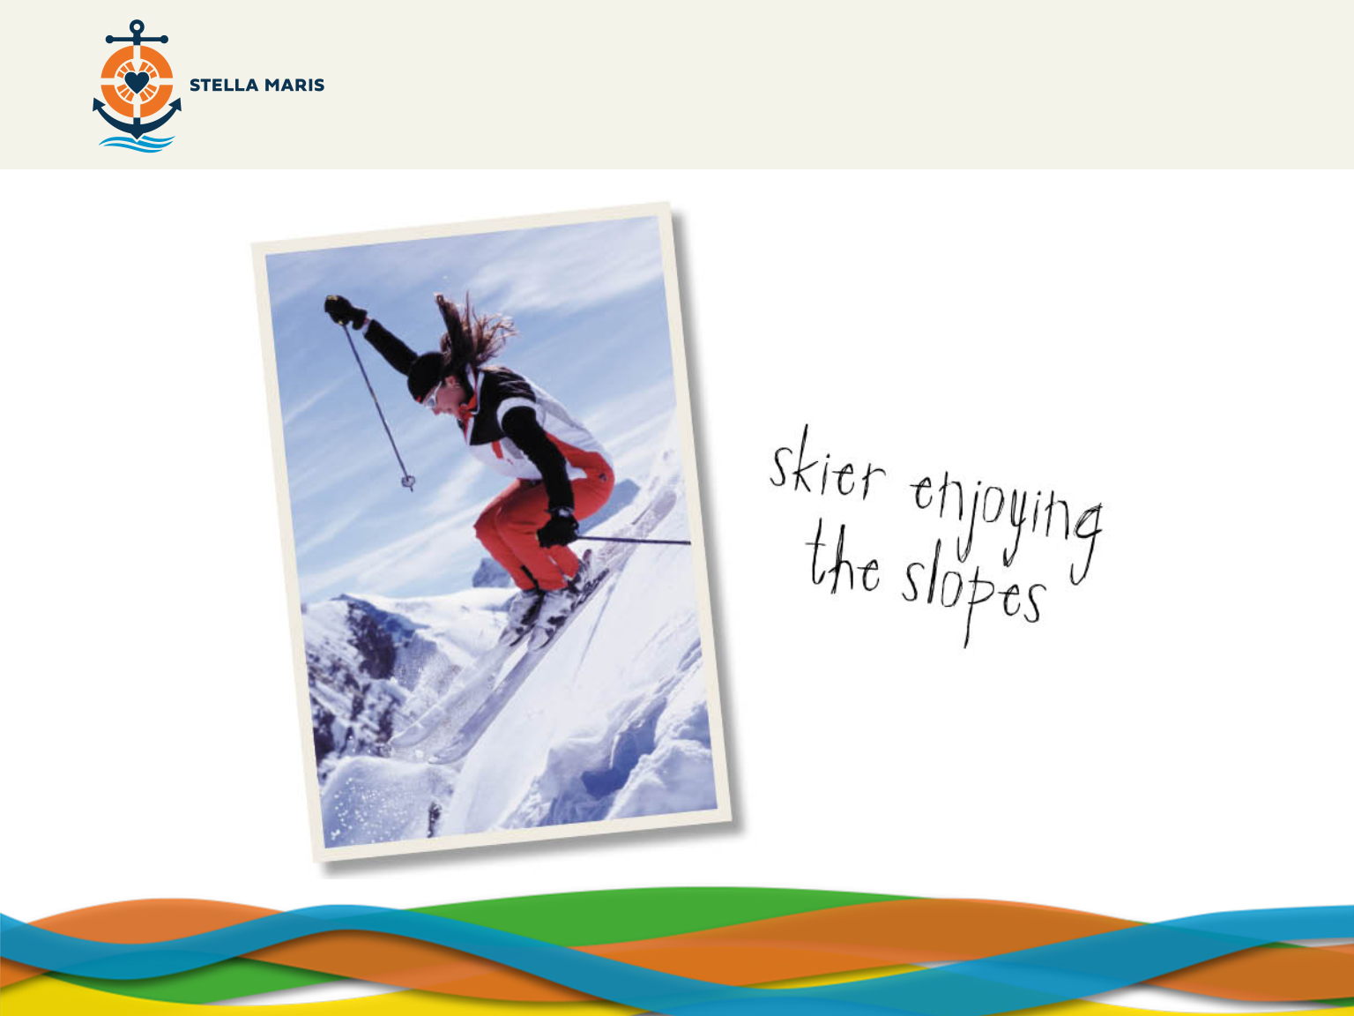

Slide 9
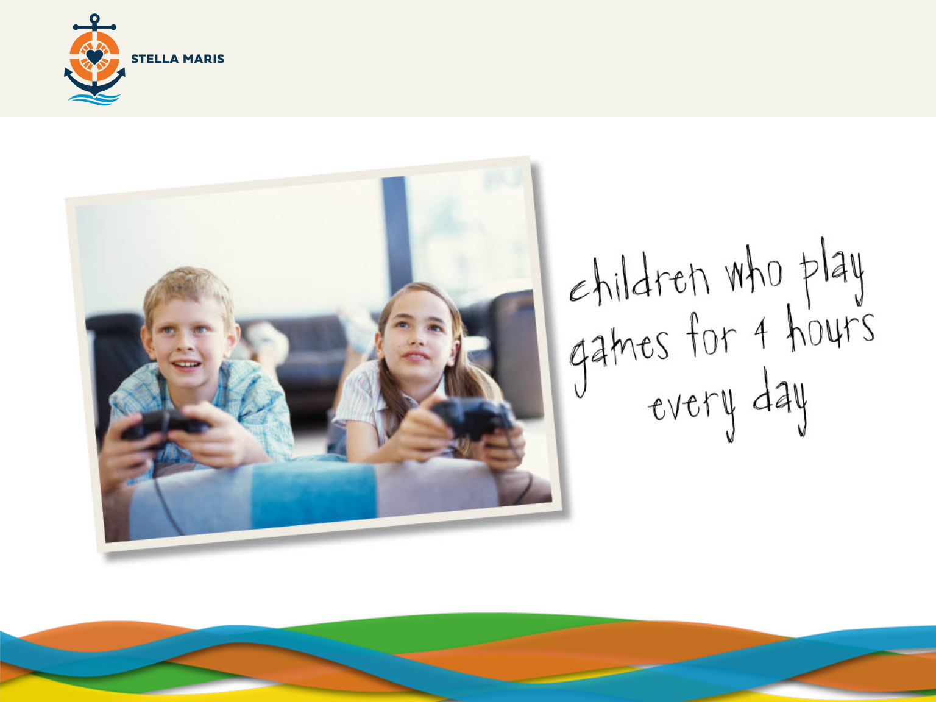

Slide 10


Slide 11
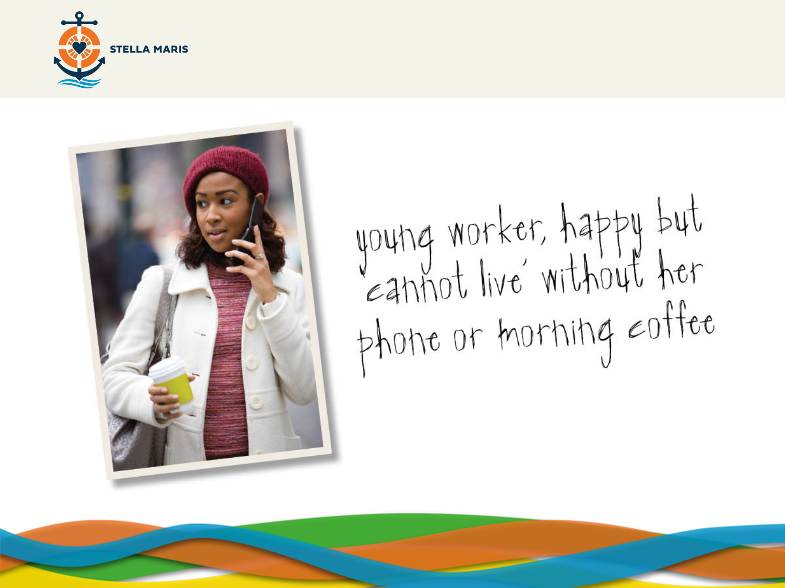

Slide 12


Slide 13
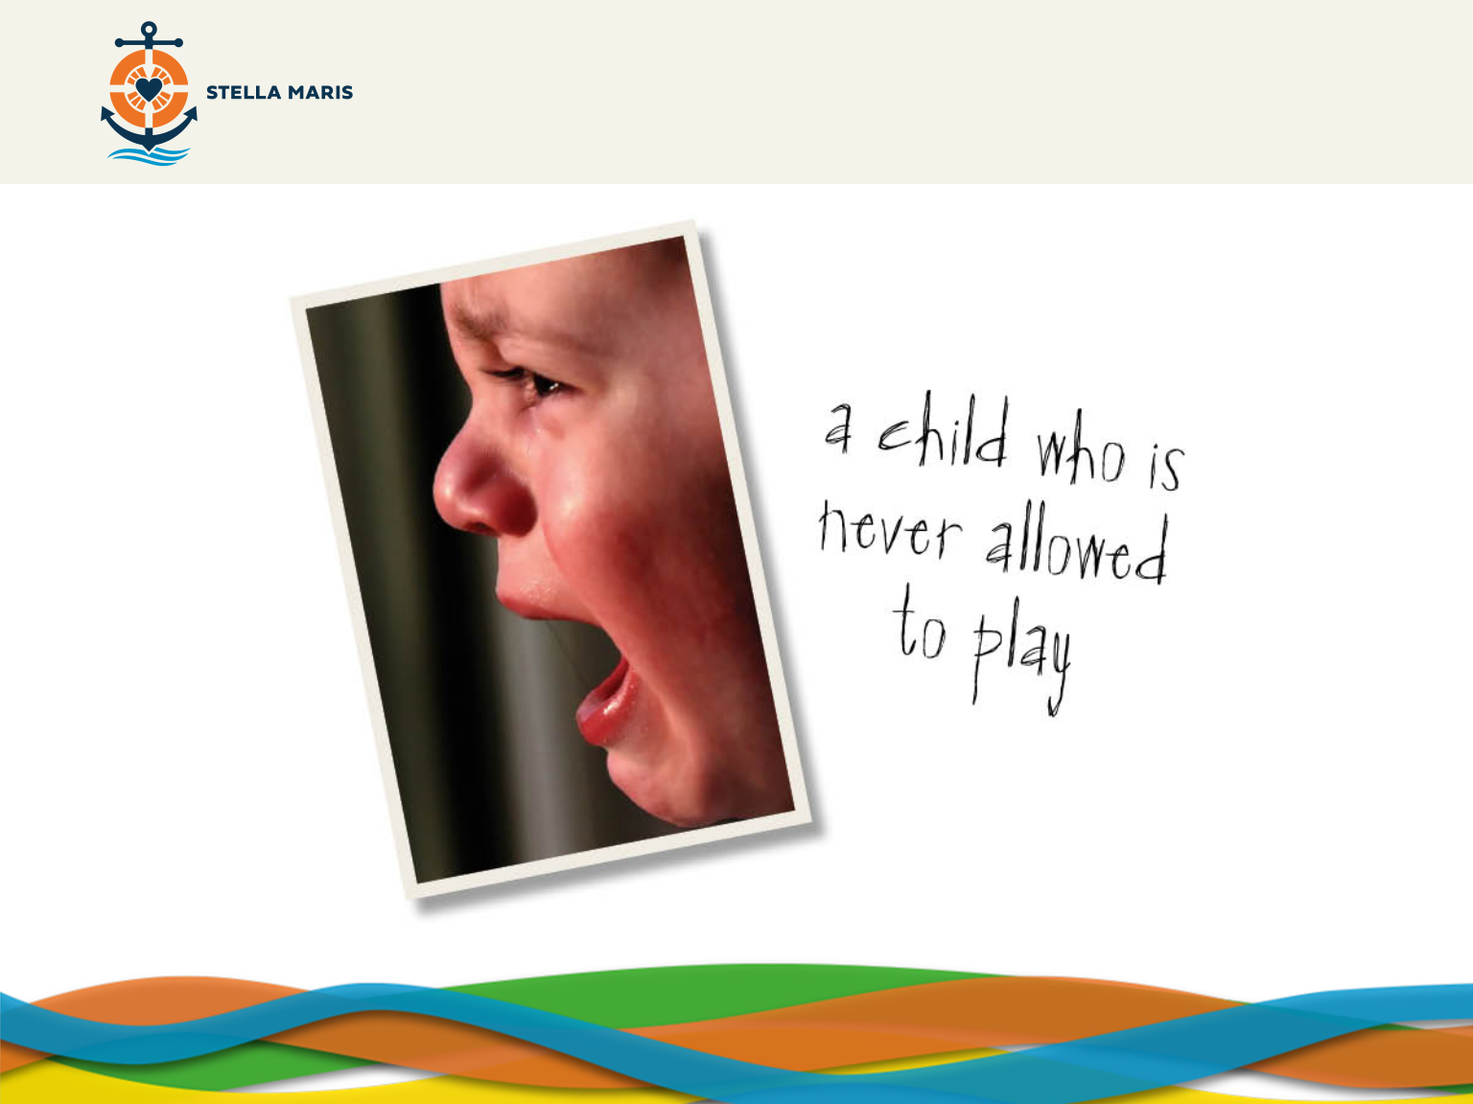

Slide 14


Slide 15
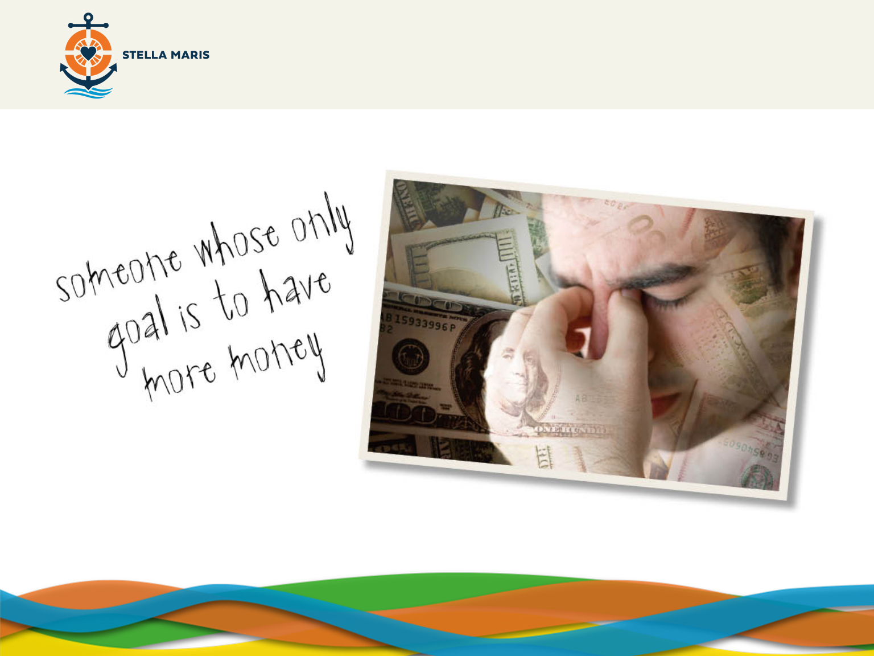

Slide 16
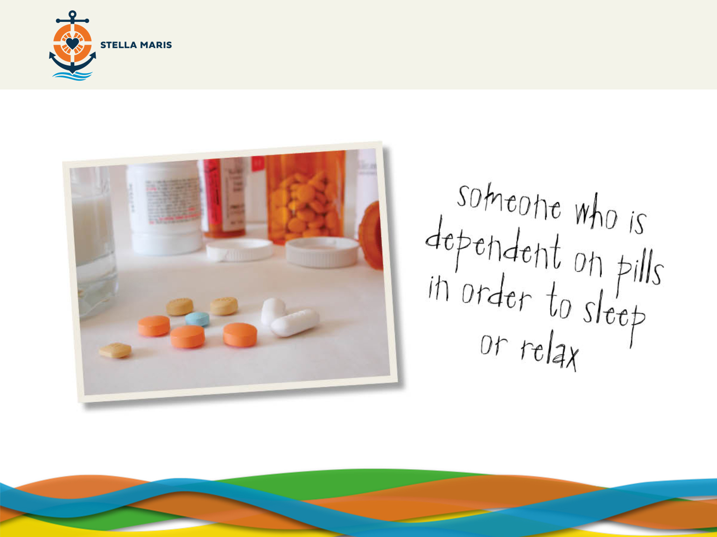

Slide 17


Slide 18
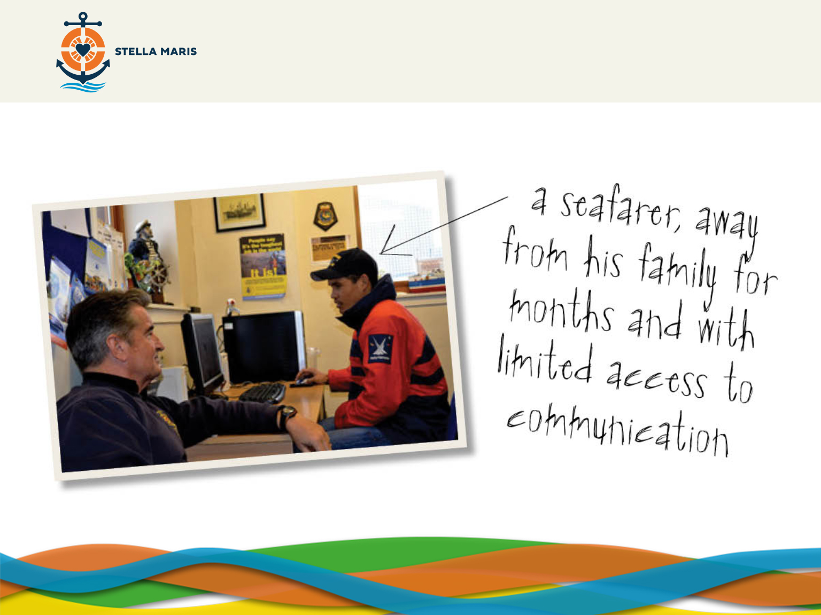

Slide 19
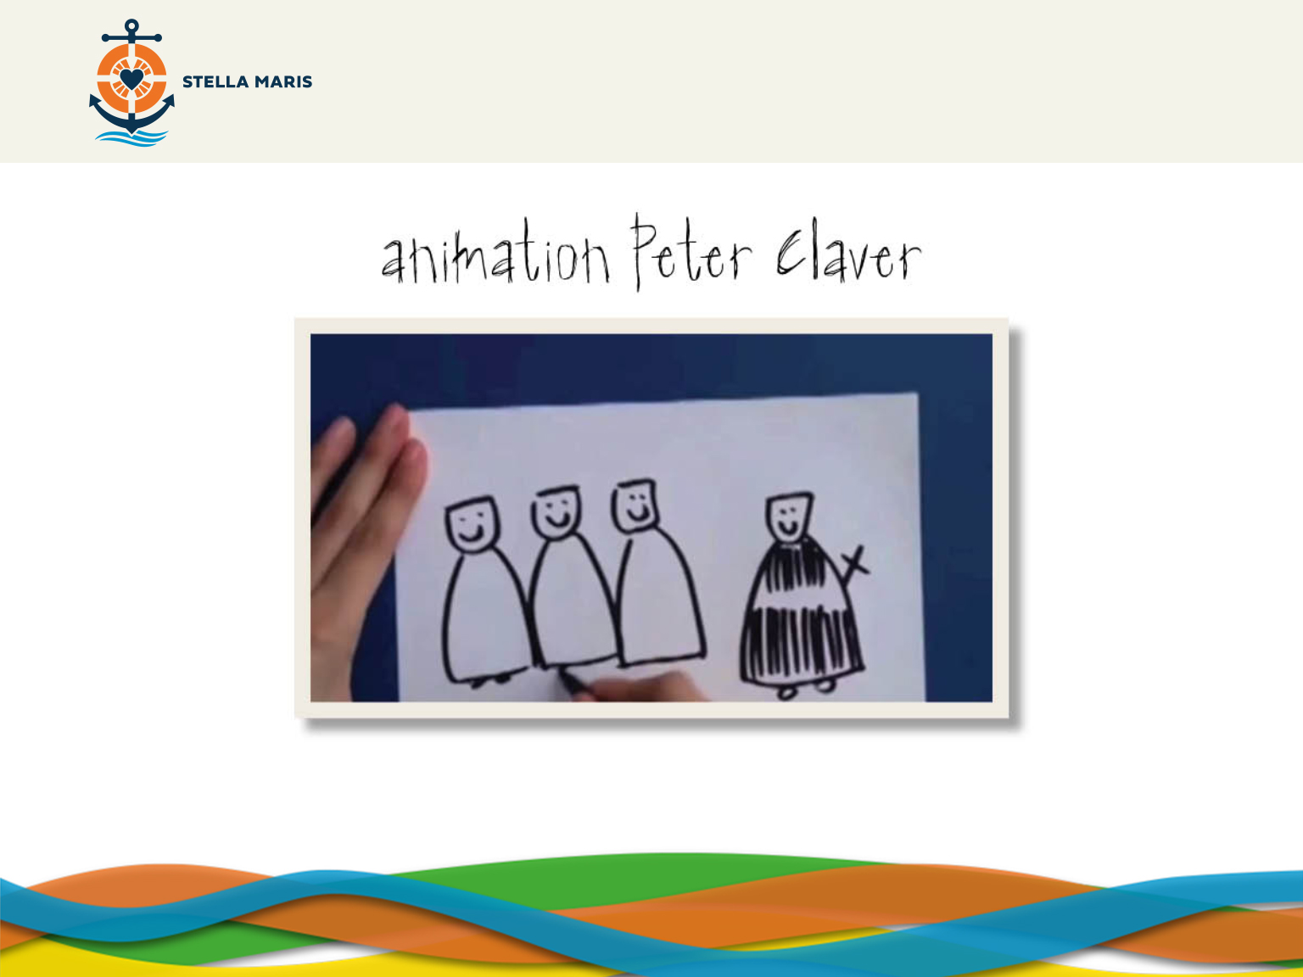
http://www.youtube.com/watch?v=wTD6Osryn8I
Notes:
Watch this video unless the students have seen it in the assembly just before the lesson.

Slide 20
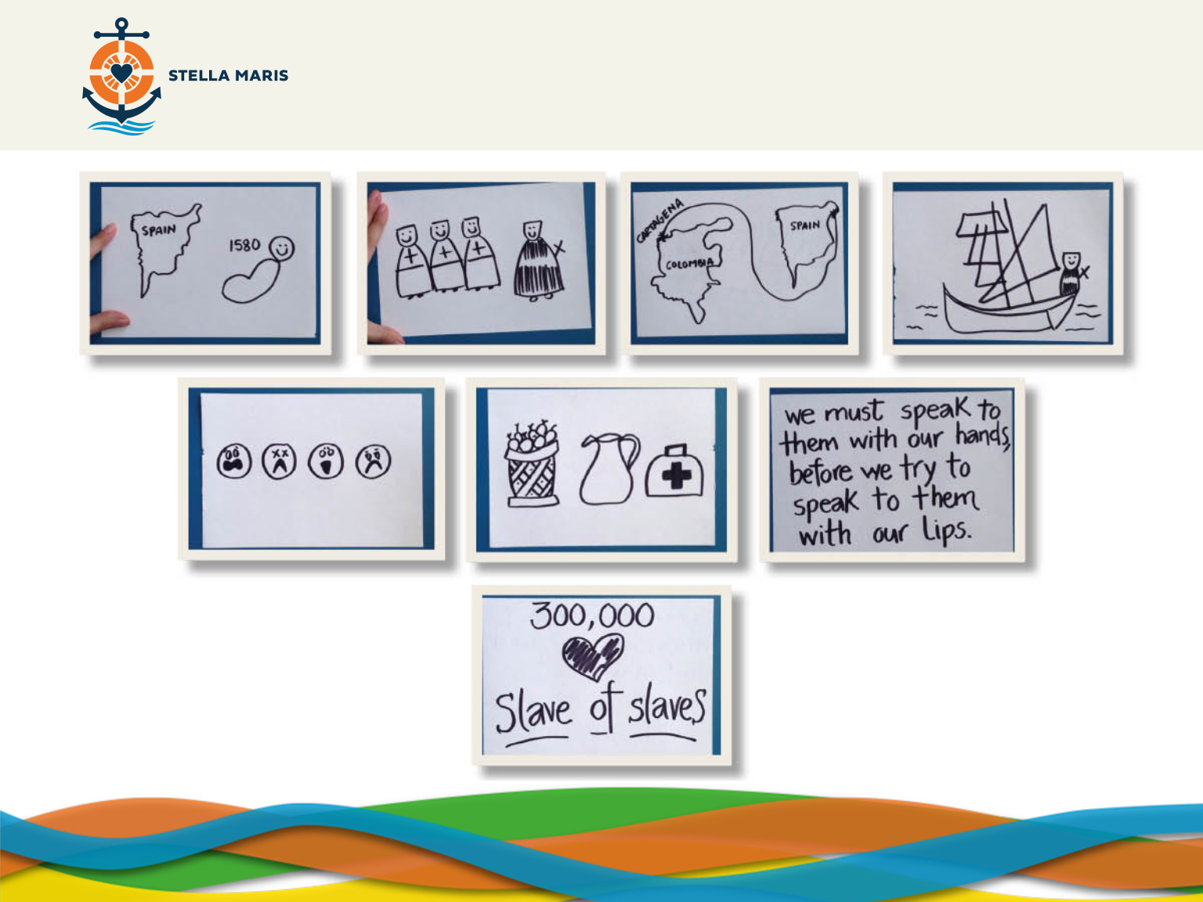
Notes:
We have just heard about the life of St Peter Claver. Here are some images that take us through his life story. Would anyone like to re-cap the story using these images?
Allow the volunteer to re-cap. If (s)he needs help ask if anyone would like to help him.
You may need to re-cap these main points afterwards if their explanation wasn’t clear or was insufficient.
St Peter Claver was born in Spain (Verdu in 1580) and became a Jesuit Priest.
He was sent to Colombia where he was ordained.
He ministered to the slaves who arrived from Africa, looking after their material needs (food, drink, dressing their wounds) and spiritual needs (evangelised them, assured them of God’s love for them).
Before his death he nursed and baptised over 300,000 slaves. He was known as the Slave of Slaves.
Peter Claver is a Saint. The word ‘Saint’ comes from the Latin word ‘Sanctus’ meaning holy which means ‘dedicated to God’.
We are all called to holiness – to being holy; every single one of us.
And holiness means being who we were created to be. Many things can stop us from being holy, from being who we were made to be and the journey to holiness involves us overcoming these obstacles and being freed from the things which stop us journeying to God and becoming who we were created to be,
This journey to holiness is different for each of us – there is a different path for each one of us. This is God’s call for us, unique and personal.

Slide 21
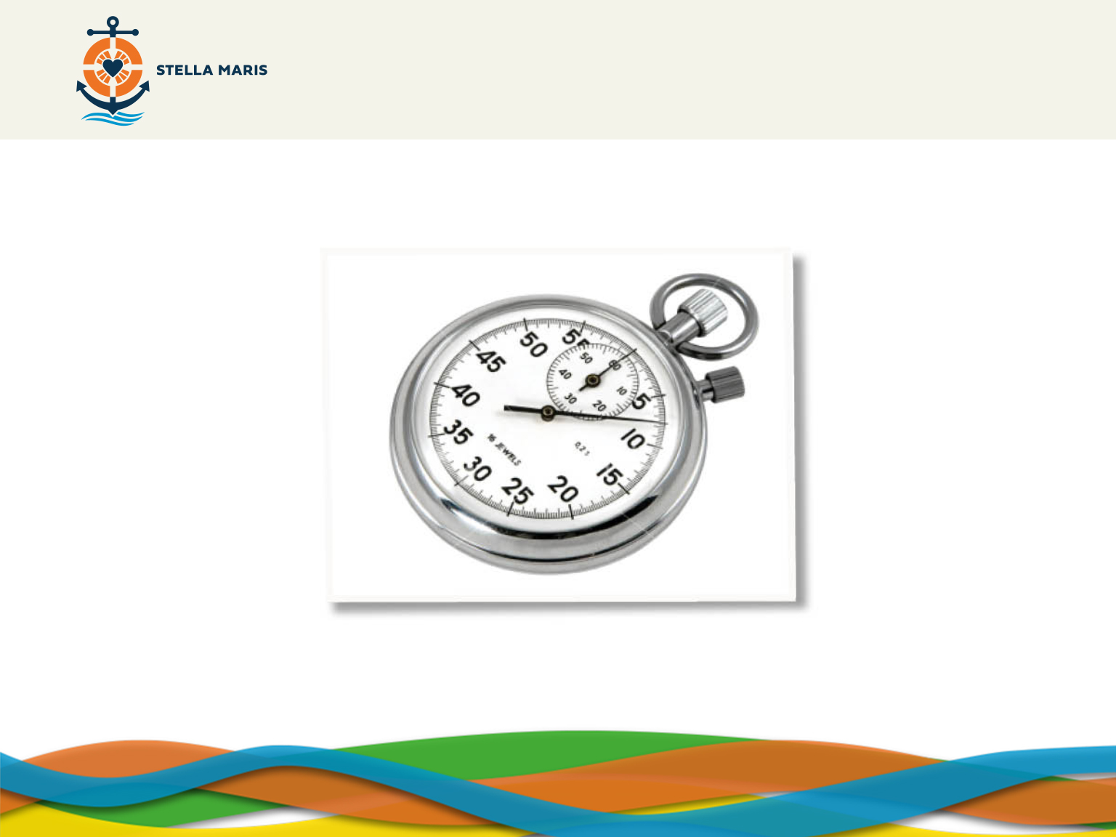
Notes:
APPENDIX 2
St Peter Claver is a great example of someone who listened to the call of God and responded to the needs of the time by taking care of the needs of the slaves. He shared with them the love of God by what he did and what he said.
I’d like you to read this bio and underline any sentences which mention the obstacles which St Peter Claver had to overcome and circle the ways in which you think he overcame them.
Take feedback from the students on both questions.
Teacher draws out that God gives us strength.
The bible is a great place which many Christians turn to as it gives us many reassuring lines. There are some things that Jesus said to give encouragement to us and help us overcome obstacles. Let us have a look at three of these now.

Slide 22
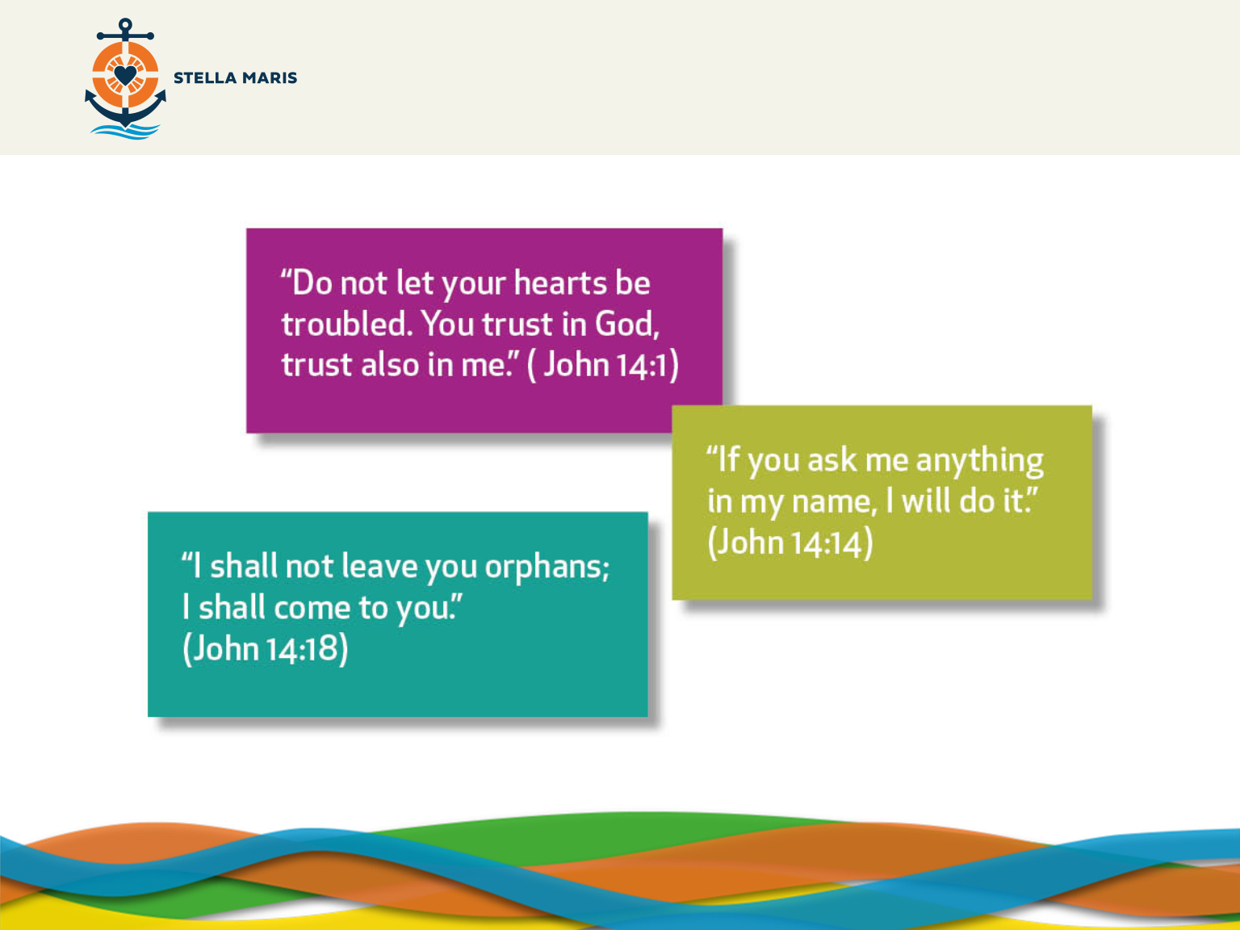
Notes:
St Peter Claver put his trust in God and in the promises that God made and this gave him the strength and determinations to overcome the obstacles which he faced as he tried to share the love of God with others.

Slide 23
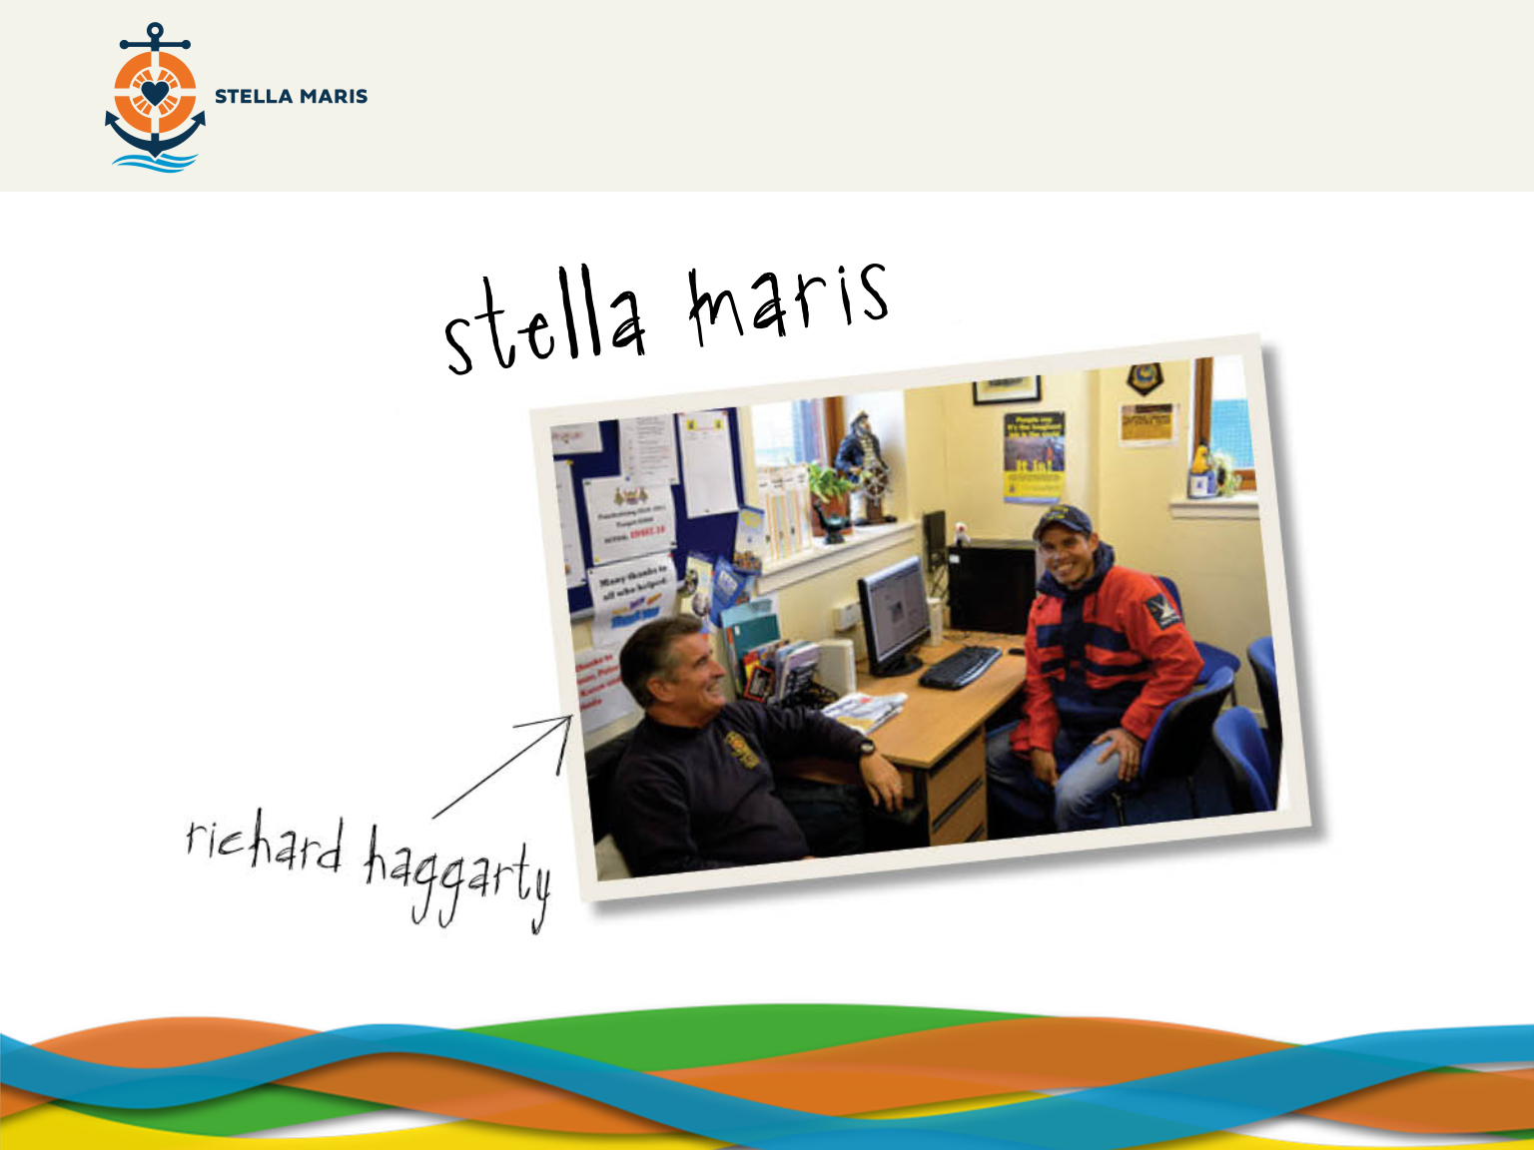
Notes:
We have seen these people before. Sitting on the left we see a man called Richard Haggarty; we’ll talk a little bit more about his work in a moment. But to the right; does anyone remember what we said about him?
That’s right, he is a seafarer. Does anyone have any idea what seafarers do?
Seafarers are really important because they bring so much to our country. Without them we wouldn’t have fish but also most of our clothes are made abroad and brought to us by seafarers along with many of the things we sometimes take for granted like TVs and mobile phones.
What might be the challenges of this type of work?
Many seafarers are away from home for a long time and work very long days often in dangerous conditions.
Many of them work on ships because they need to feed their families or pay for their children to go to school and while they are at sea they miss their families a lot.
What do you think their needs might be? Think about material, spiritual and emotional needs?
Sometimes seafarers get sick which isn’t nice when you are away from home. In many ways they can feel trapped, a little like the slaves did in the time of St Peter Claver.
Going back to the smiley man on the left, his name is Richard Haggarty and he is a chaplain who works for an organisation called Stella Maris which helps seafarers around the world.
We are going to take a look at a quick video where we can see Richard talking about his experience in reaching out to the seafarers.

Slide 24

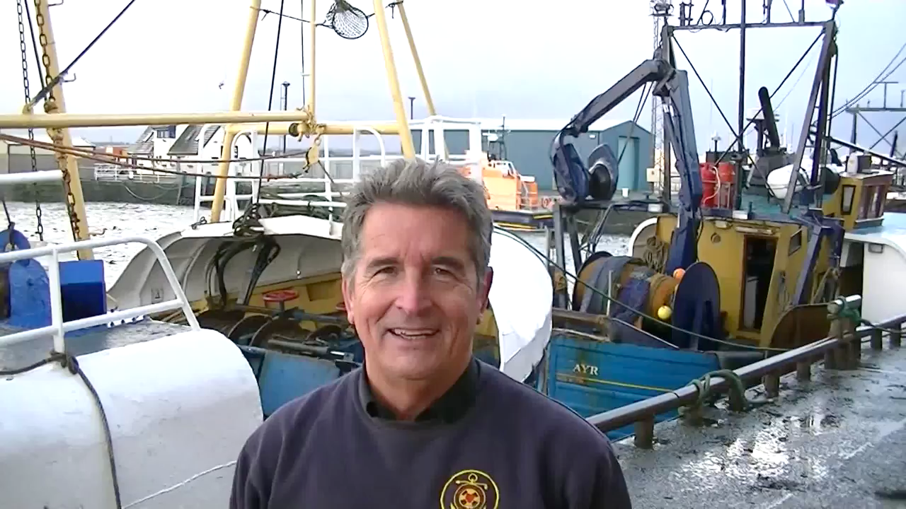

Slide 25
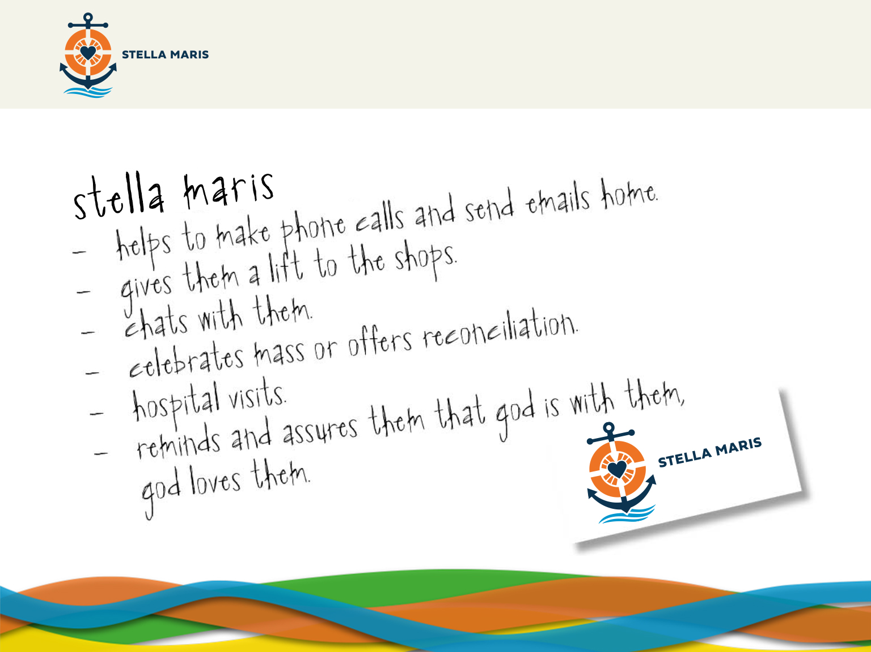
Notes:
We can see that Stella Maris try to look after the seafarers. They give them phone cards, internet access, take them to shops and in many other ways look after the seafarers needs. They also help them with their spiritual needs, being available to chat to them and share with them the love of God. This won’t always be easy though.
What do you think are some of the obstacles chaplains may face in their work with Stella Maris ?
Problems which the chaplains face include not being able to provide everything they would like to provide because they don’t have enough money, not having enough time to spend with all the crews of all the of ships, being tired when the ships have arrived, sometimes not being welcomed by people on the ship, not knowing what to say to the seafarers or not understanding the languages very well.
The chaplains know that they are not alone in the work that they do. Jesus said that ‘where two or three meet in my name, I am there among them’ (Matthew 18:20) and so the chaplains can be certain that God is supporting them as they serve the seafarers.
COMPLEMENTARY VIDEOS: These are two other videos of other chaplains which further explain the types of work that Stella Maris do. They will help paint a better picture about the work of and the people who work with Stella Maris.
http://www.youtube.com/watch?v=8np45Vh4ZLQ
http://www.youtube.com/watch?v=zS7GI3HGYS0

Slide 26
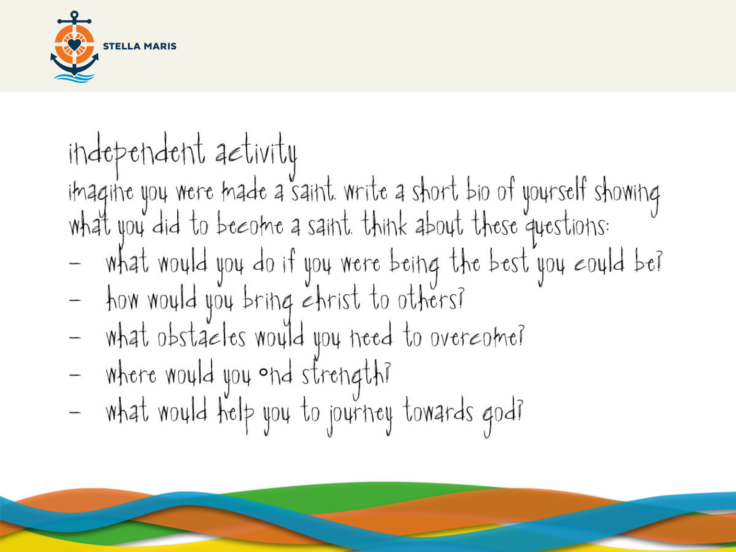
Notes:
I mentioned earlier that Peter Claver is a Saint – he is holy and that we are all called to holiness - being who we are created to be.
Imagine you were made a Saint in the future; write a short bio of yourself showing what you did to become a Saint. Think about these questions:
-Try to think about what you might be able to do if you were being the best you could be.
-In drawing close to God and following your own call you will bring Christ to others.
-Think about what obstacles you might need to overcome – what might stop you being holy, being who you are meant to be?
-Think about where you might find strength to keep going in difficult moments.
-Being holy means journeying to God, how might you journey towards God?
APPENDIX 3

Slide 27

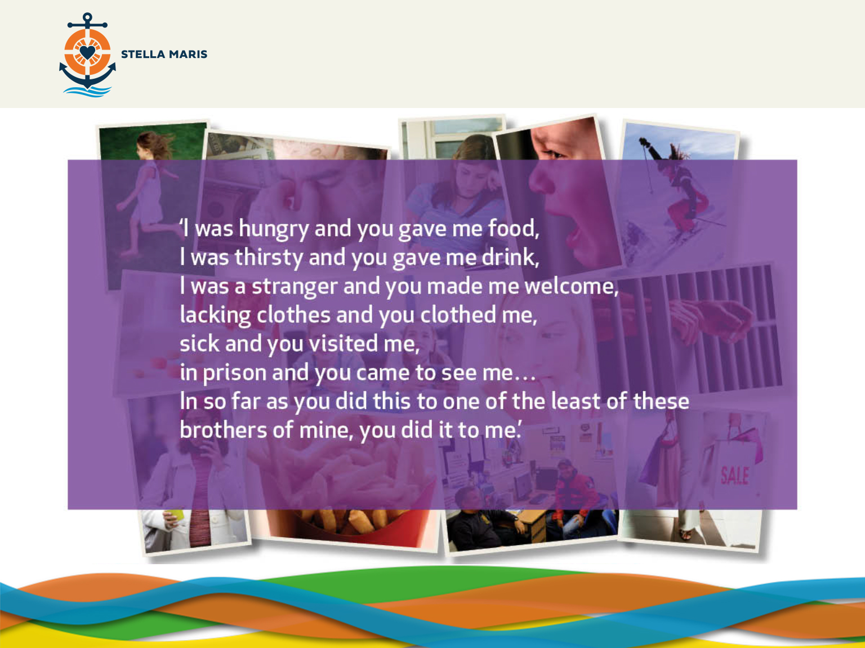
Notes:
BACKGROUND MUSIC SUGGESTION: God of Justice by Tim Hughes
We are going to take a moment to reflect for ourselves.
Christianity tells us to serve those in need, those who are around us, our friends and family. But more than that. Jesus calls us and will help us us to love those who aren’t in our friendship groups or families. Jesus challenges us to love our enemy, to give to people who aren’t able to give to us in return, help people who are sick, serve people who we don’t like, help to free people who are in some way enslaved by something. He asks us to feed the hungry, visit people who are lonely and to give without counting the cost to ourselves. Jesus asks us to use our resources – our money, our time, our efforts to help people who are in need of help. This is sometimes hard to do. Often we don’t feel like it. We would rather spend time with our friends having fun, or watching television or just buying what we want but Jesus encourages us and will give us His strength to do it. He said that whenever we show love to someone who really needs it; someone who is hungry, thirsty, sick or lonely then we are showing love to Jesus himself. When we show love to those in need, God is there.
(Click)
Here is the passage from the bible where Jesus us tells us this. Take a moment to read the passage and think about how you could put it into practice in your own life.
Leave 1-2 minutes so the students can reflect on the passage and their own lives.

Slide 28
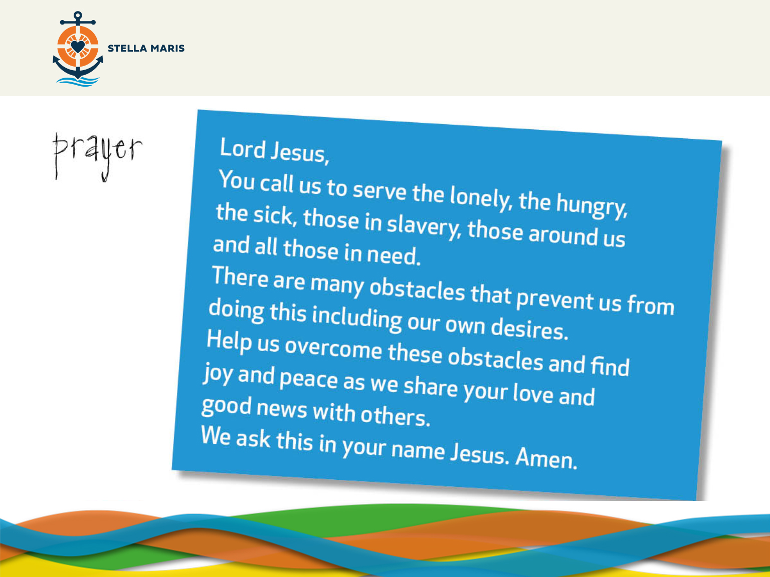

Slide 29
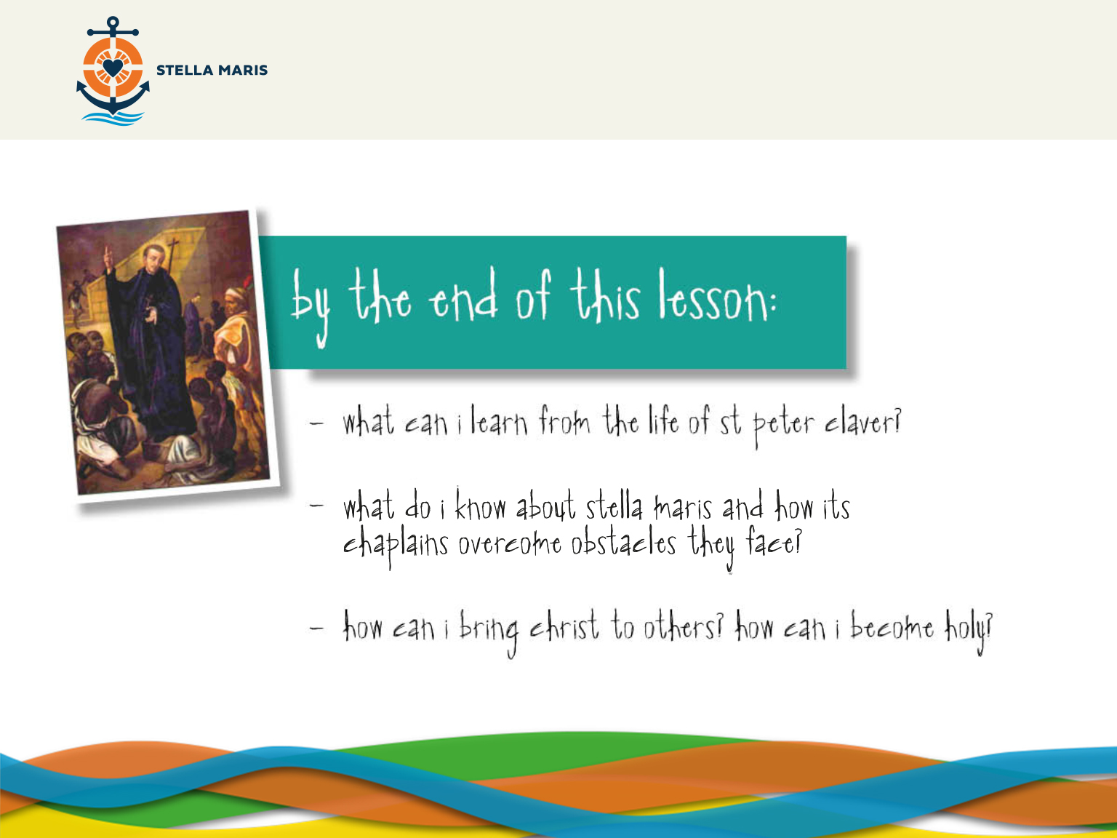
Notes:
Success Criteria.
Ask the students these questions to assess the learning.

Slide 30
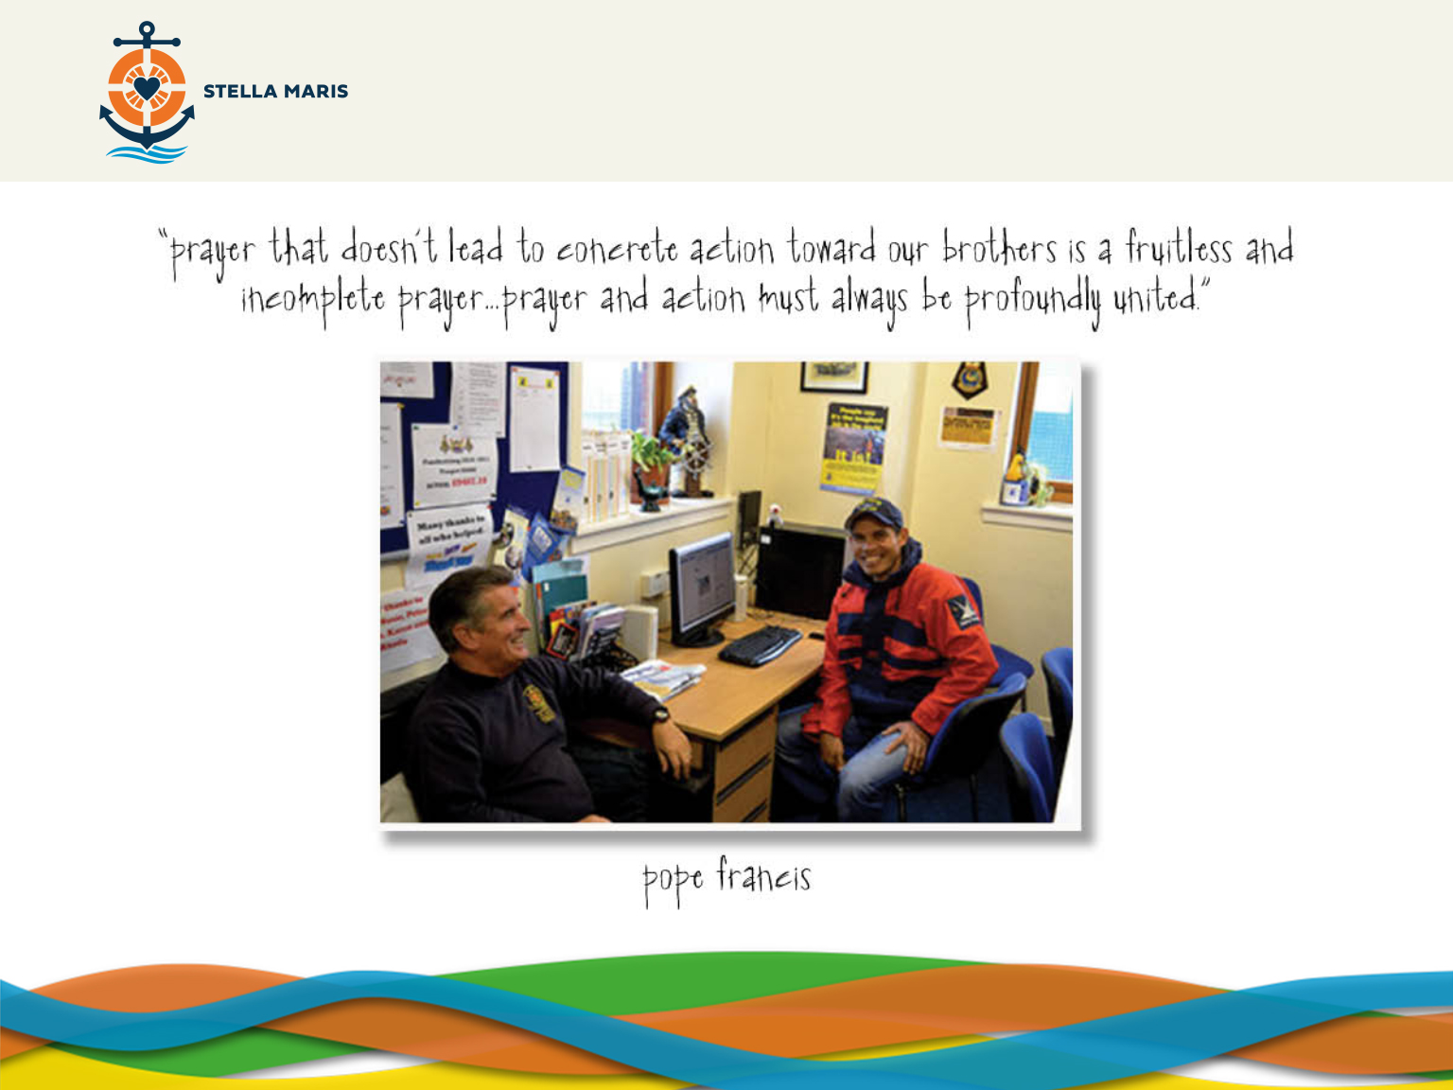
Notes:
Pope Francis said:
“Prayer that doesn’t lead to concrete action toward our brothers is a fruitless and incomplete prayer…prayer and action must always be profoundly united“
So for homework…
(Click)

Slide 31
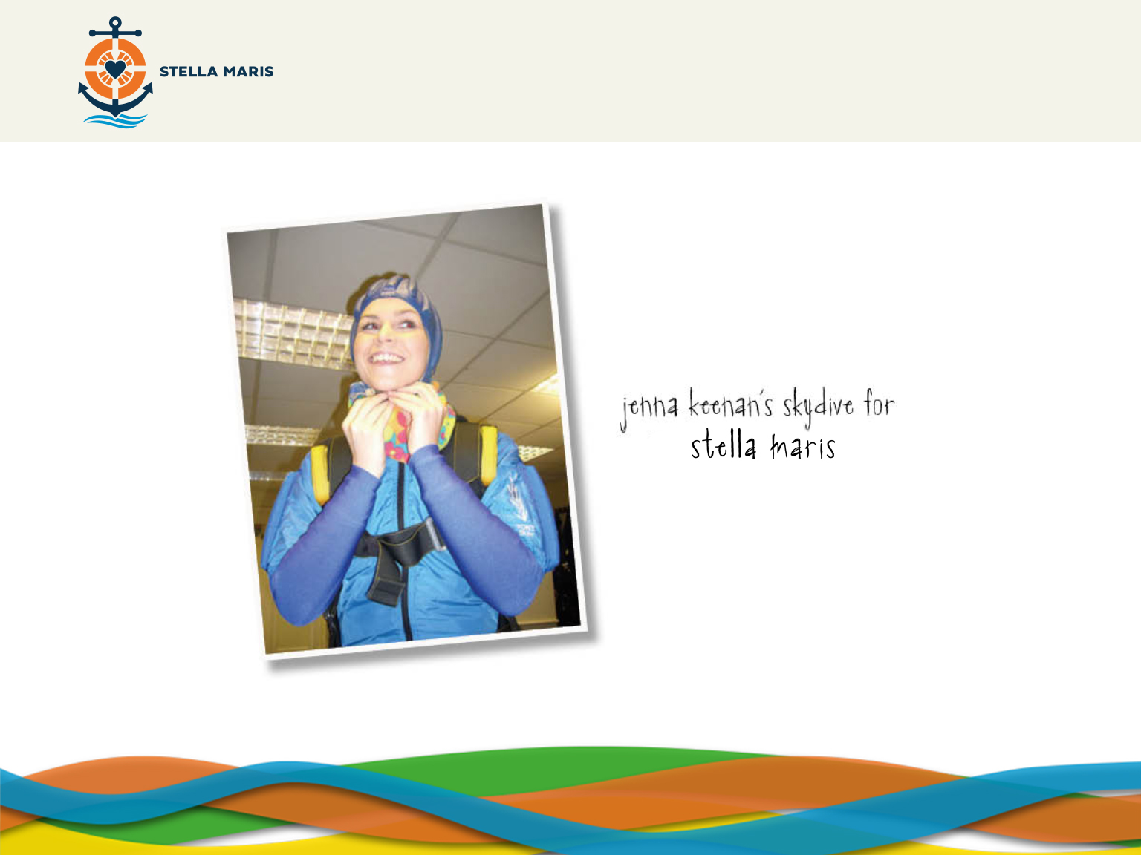
Notes:
Pope Francis said:
“Prayer that doesn’t lead to concrete action toward our brothers is a fruitless and incomplete prayer…prayer and action must always be profoundly united“
So for homework…
(Click)

