Slide 1
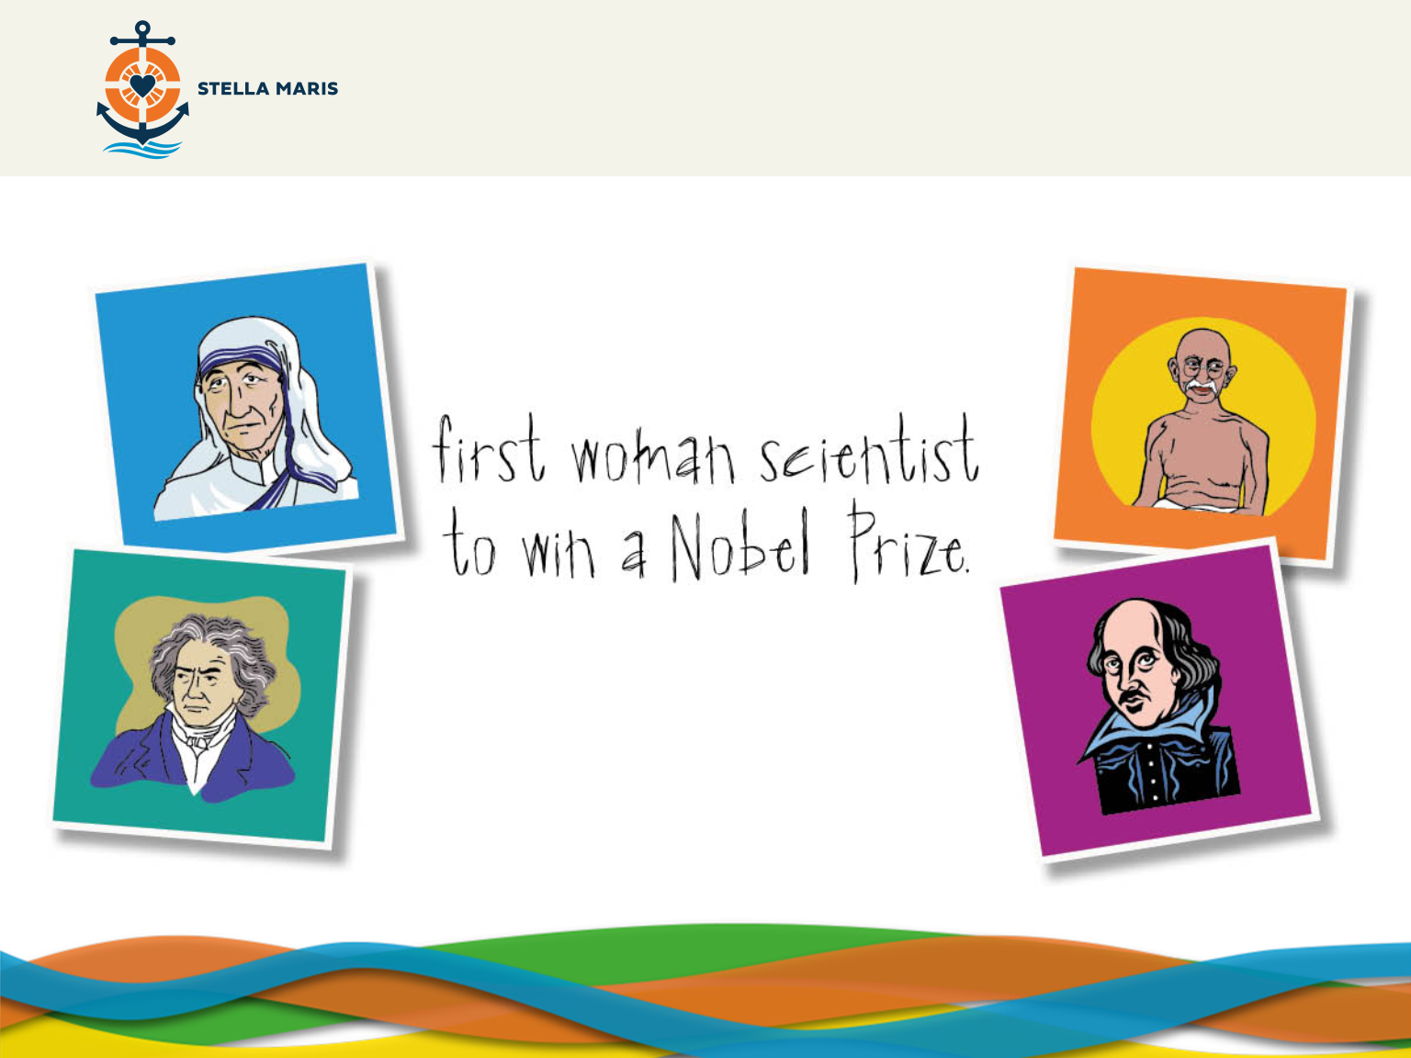

Notes:
Good morning, you will have seen on the screen there are a variety of famous people. Does anyone know who any of the people are?
• Mother Teresa, served the poor people of Calcutta in India.
• Ghandi, worked for peace and justice in India.
• Beethoven, composer of many inspiring pieces of classical music.
• Marie Curie, discovered polonium and radium and conducted much work on radioactivity.
• William Shakespeare, wrote many excellent works of English literature.
These are all people who have made a big difference in the world and changed the world for the better. Who else do you think should be up there on display, chat with the person next to you and let’s have a few suggestions.
Wait 30 seconds.
Suggestions include: Martin Luther King Jr, Maximilian Kolbe, Jesus or Pope Francis.
Take two or three suggestions from the students asking them why they are suggesting them.

Slide 2
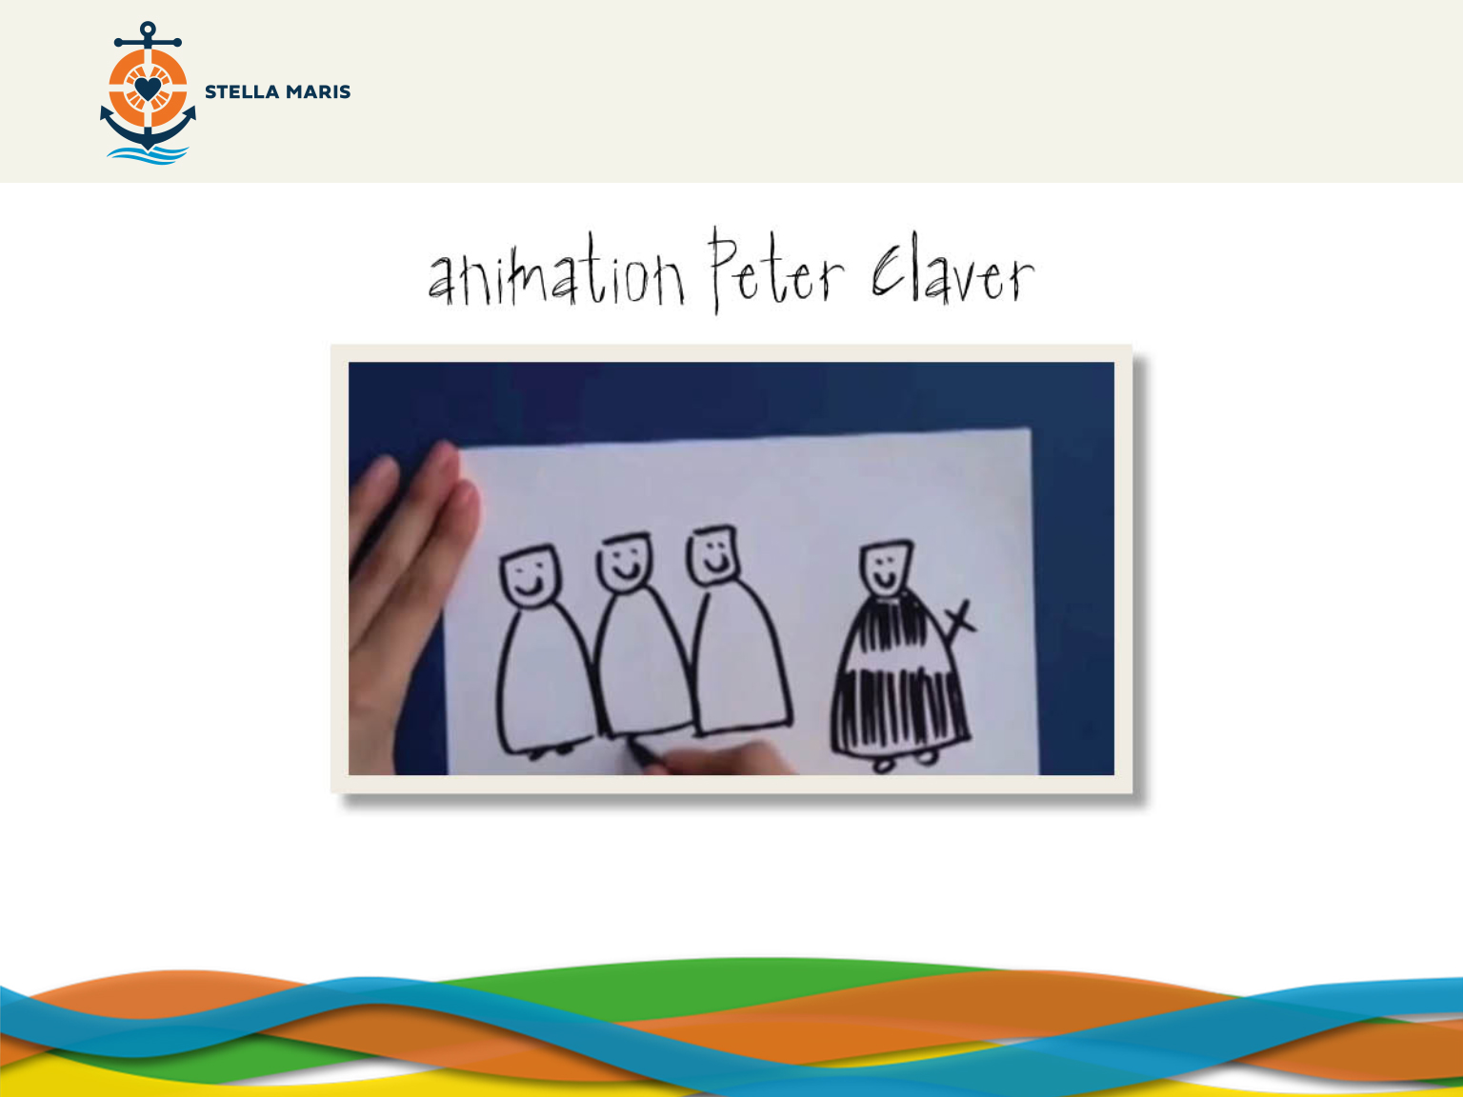
http://www.youtube.com/watch?v=wTD6Osryn8I
Notes:
We are going to hear about someone else who made a big difference called St Peter Claver.
The narration below is embedded in the animation
St Peter Claver was born in Verdu in Spain in the year 1580. As St Peter Claver grew, he discovered that he was called to be a Priest and joined a group of Priests called the Jesuits. During his studies he felt called to go to the West Indies and preach the Gospel. Eventually he was sent to South America and was ordained a Priest in a major Port city called Cartegena in (what is now) Colombia.
The journey across the ocean lasted many weeks and will have been hard and uncomfortable. St Peter felt strongly that he was called to make the journey and will have been happy to undergo the hardships.
Cartagena was a one of the world’s major ports for the transportation of slaves. At that time thousands of people were being taken from their homes in West Africa and transported to various parts of the Americas to be sold and made to work in slavery. It was in-humane and the slaves were transported in terrible conditions. Around a third of them died on the journey. They would arrive in Cartegena scared, hungry, thirsty and often sick.
Peter Claver had a desire to serve the slaves as they arrived into Cartagena and excelled in the love and care he showed to slaves. He would go down into the stinking slave ships and help them. He took on board food and drink which he had begged from people to give to the slaves and he dressed their wounds and as they were in a terrible condition this was a very unpleasant task. He was keen also to share the good news of God’s love but said that “We must speak to them with our hands, before we try to speak to them with our lips.” When he had dressed their wounds and taken care of their basic needs he would use pictures and interpreters to introduce them to a God who loved them and was outraged at what man was doing to them.
Peter Claver nursed and baptised over 300,000 slaves during his life. He also visited them at the plantations, supporting them and urging the slave owners to treat them well. He was happy to be known as the ‘Slave of Slaves’ and had promised to be so when he was first ordained.

Slide 3
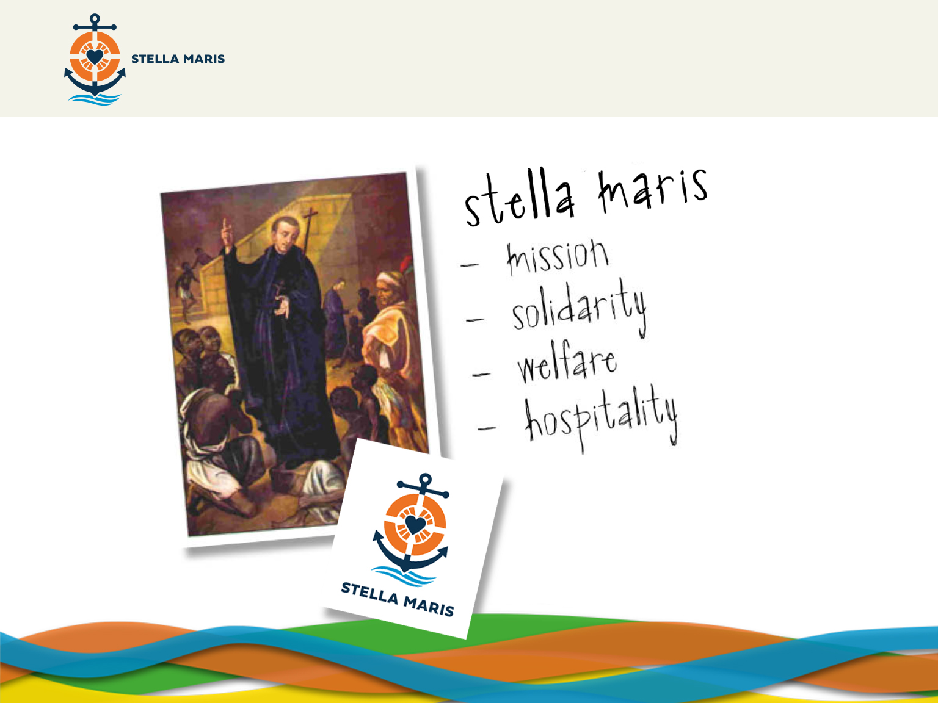
Notes:
God, through the life of St Peter, was able to show love in a very practical way to the slaves.
The life and witness of St Peter Claver still inspires many people to follow in his footsteps. One organisation which is inspired by his life and love is Stella Maris. They are a Catholic charity operating in 90 countries around the world. Their mission is to support the faith of seafarers and spread the Gospel among the maritime community. They stand alongside seafarers in solidarity, working to improve living and working conditions and also providing welfare and hospitality for the seafarers.

Slide 4

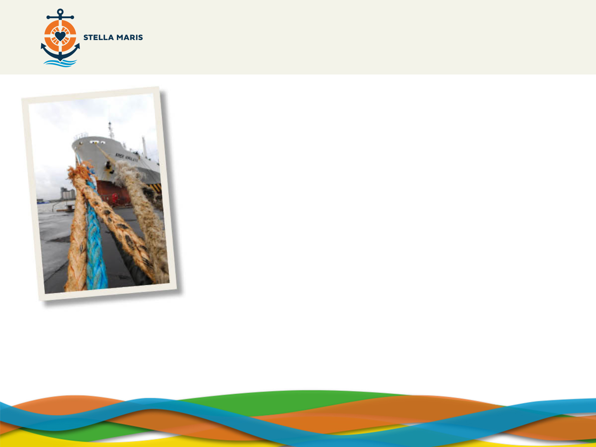
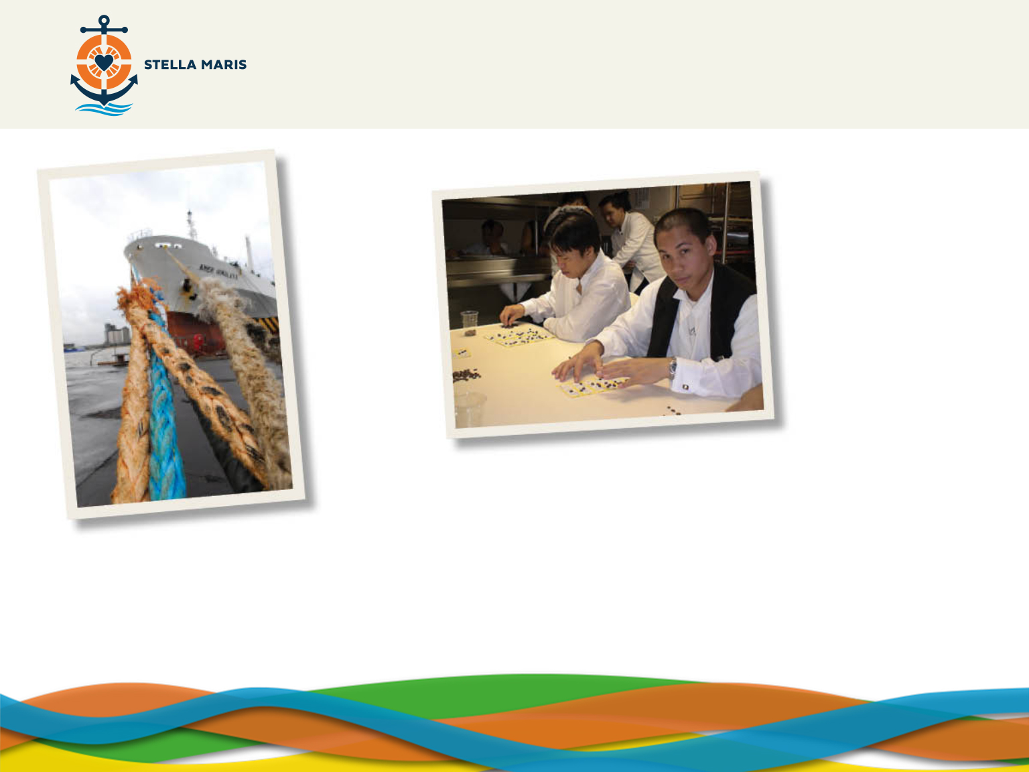
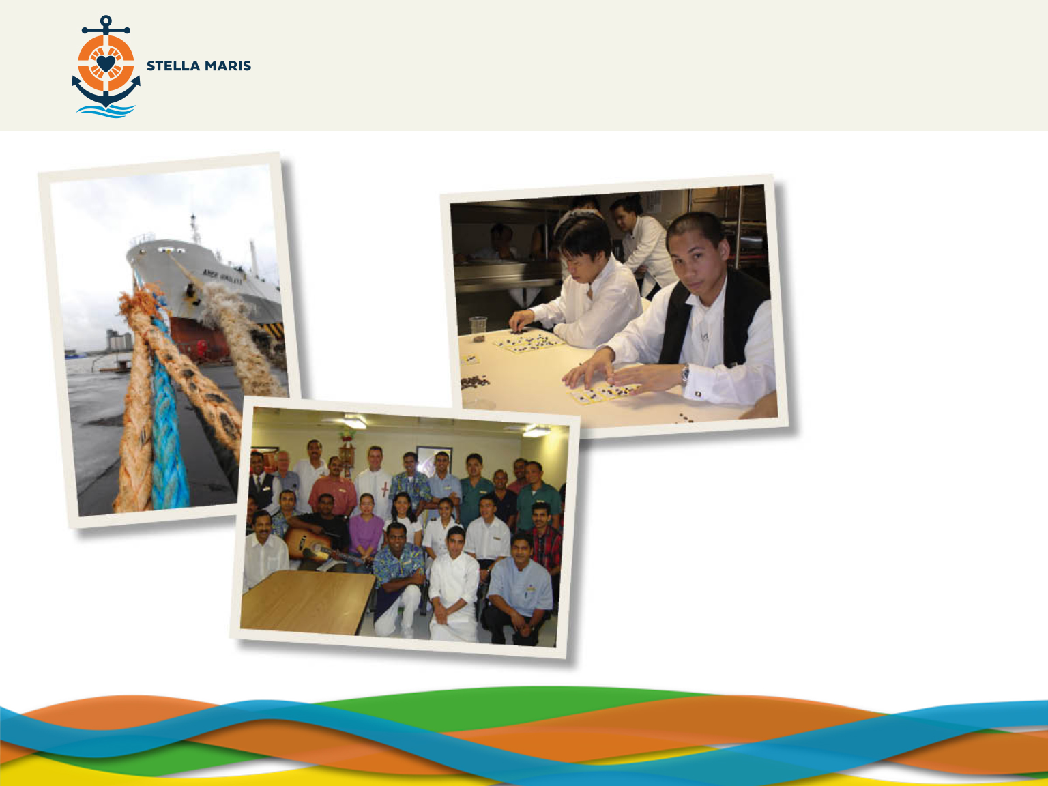
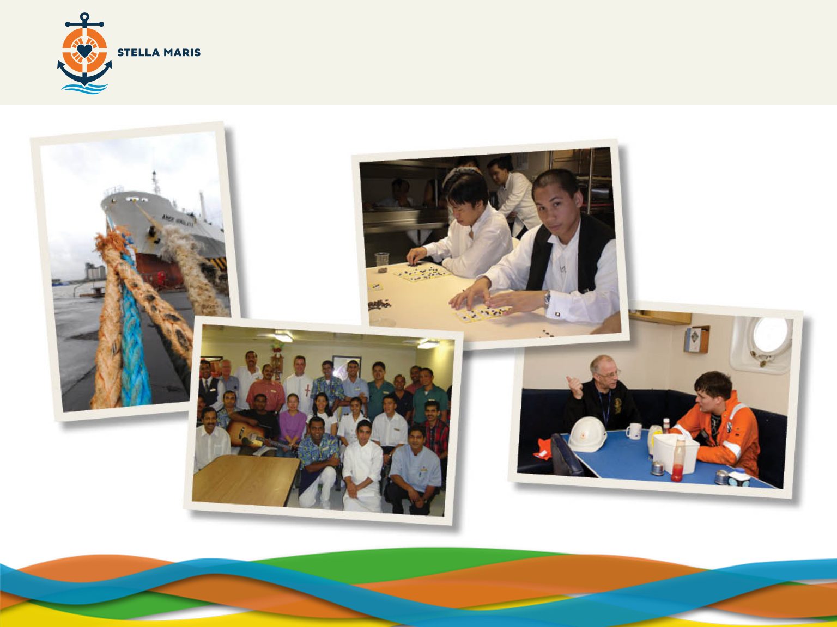
Notes:
The life of seafarers can be very demanding and difficult:
Pic 1: They work in difficult and dangerous conditions.
(CLICK)
Pic 2: They are separated from their family for many months at a time
(CLICK)
Pic 3: Those who are Catholic have few chances to go to Mass, confessions or speak to anyone about their faith.
(CLICK)
Pic 4: Seafarers can feel isolated and cut from normal life as the ports they visit are often far away from towns
Open questions
Does anyone know anything about people who work at sea today?
Do you know anyone who works at sea?
Do you know any important ports in the UK? (Answers include but aren’t limited to: Felixstowe, Southampton, Immingham, London (Tilbury), Milford Haven in West Wales)

Slide 5
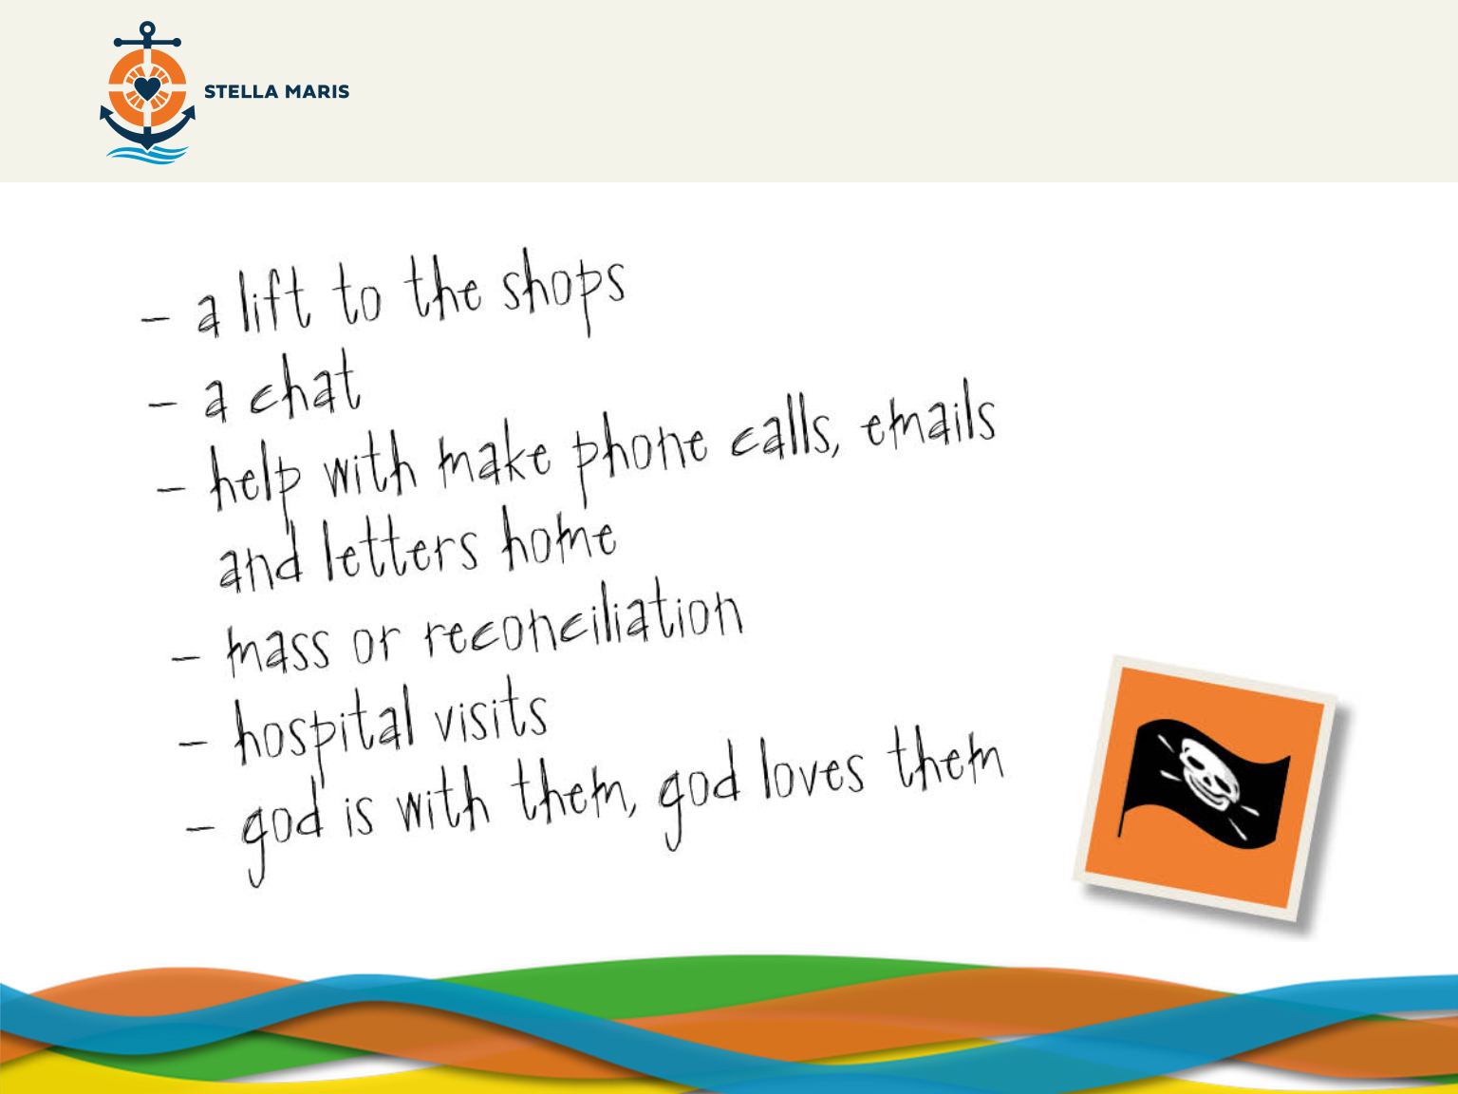
Notes:
Stella Maris have chaplains who visit seafarers when they are in port and help to provide practical, emotional and spiritual support for the seafarers. The chaplains do many things for seafarers, helping them with whatever they need. They:
Give them a lift to the nearest shop to buy some much needed items.
Talk to them, understanding that they miss home.
Help to phone or email home.
Arrange to say Mass for the seafarers or hear their confessions.
Visit them in nearby hospitals when they are sick.
Remind them that God is with them, that God loves them even when they are struggling.
Piracy, for example, is another thing that some modern seafarers now have to deal with.

Slide 6
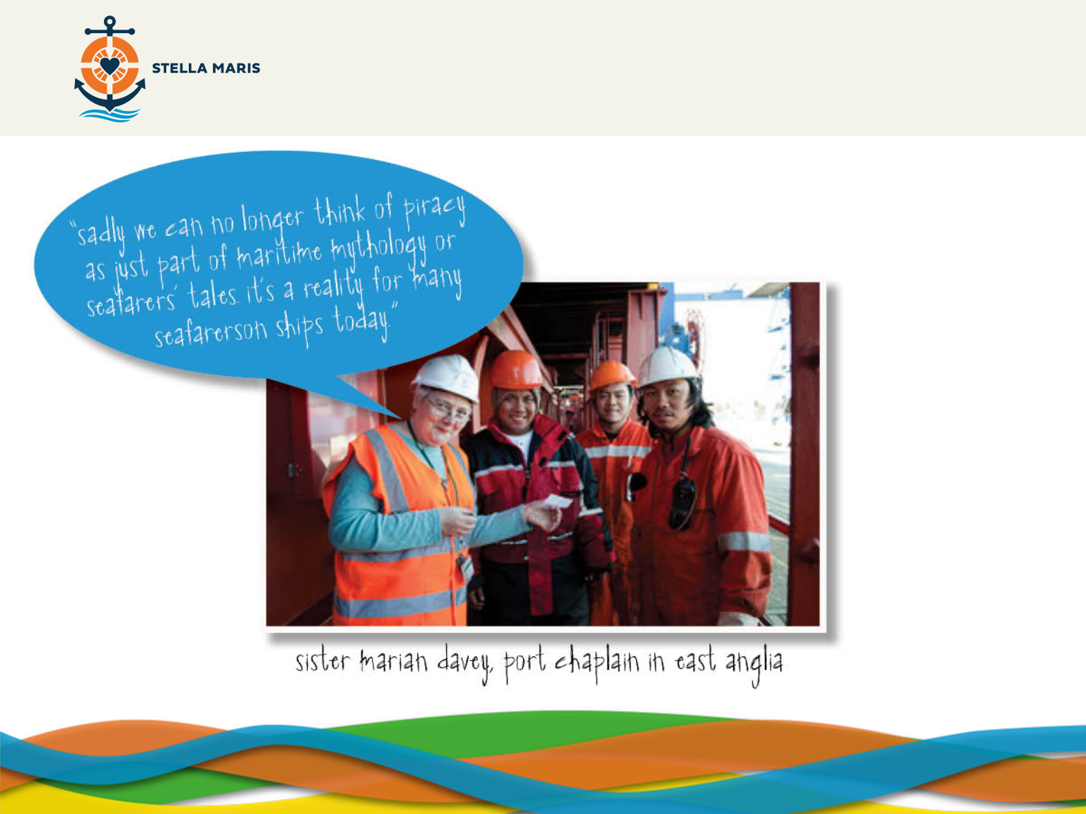
Notes:
Sister Marian Davey was a port chaplain in East Anglia. She says: “Sadly we can no longer think of piracy as just part of maritime mythology or seafarers’ tales. It’s a reality for many seafarers on ships today. I once spent some time with a crew in Felixstowe whose ship had been threatened by pirates. One pirate attempted to climb on board, but fell off, as the captain made a series of movements with the ship, causing him to lose his grip. Meanwhile there was a speedboat full of pirates with a lot of weapons ready to fire at the ship. In this case, it ended well, as the ship was able to speed away from the scene and out of reach of their guns.”
Some of you may have seen the film ‘Captain Phillips’ with Tom Hanks. This was based on a true story and tells of a ship which is boarded by pirates. It is a very scary thing for a crew of a ship to have to face.
(NB, Captain Phillips was given a rating of 12A when it was released in 2013)

Slide 7
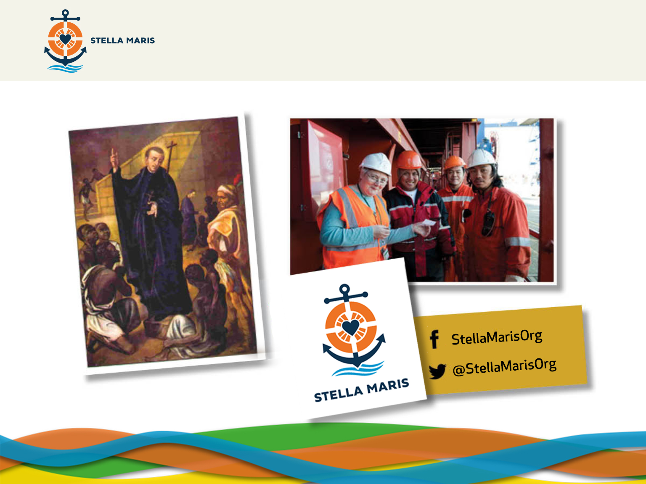
Notes:
The work of Stella Maris is a lifeline to them. Just as St Peter Claver wanted to share God’s love for the slaves and minister to their physical and spiritual needs, the chaplains of Stella Maris want to share God’s love with the seafarers, tend to their materials and spiritual needs and help them live life to the full.
Just like St Peter Claver needed food and drink for the slaves, Stella Maris also needs donations to help them cover the costs of their work. If you would like to know more about how you can help, I would encourage you to have a look at their website and find out how you can get involved. You can also Like their Facebook Page and follow them on Twitter @StellaMarisOrg

Slide 8
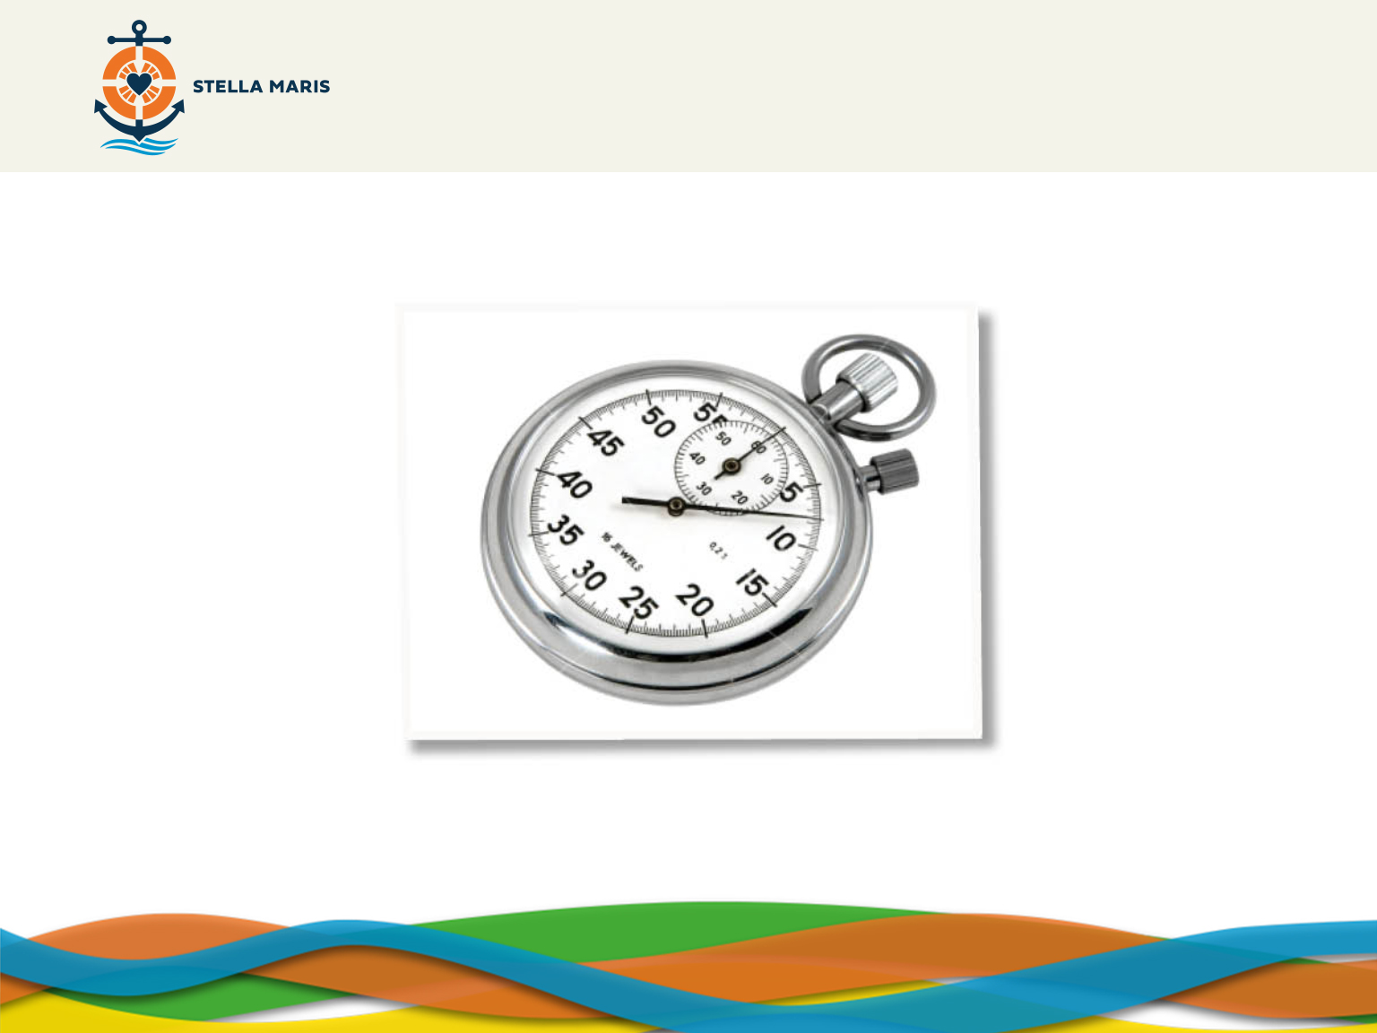
Notes:
The slaves were trapped by the inhumane practise of slavery.
Seafarers can be trapped by their situations of isolation and a dangerous working environment
God wants to free us from situations that trap us and we ourselves can have things in our life where we feel trapped or unable to work our way out of situations.
We may not end up being seafarers feeling trapped and we may not know what it feels like to be a slave but we can probably all think of times when we don’t feel able to be ourselves. We can sometimes feel trapped – by the pressures of exams, by people we find difficult, by challenges we are facing, by sins that we are trapped in and can’t escape from like being angry with someone or resenting a job we often have to do.
Take a moment to speak with the person next to you about situations in our own lives where we may feel trapped and held back from living life to the full.
Take some feedback – examples will probably include information about exams etc. The answers might be more personal. You may want to summarise their contributions mentioning the following situations in which we may find ourselves trapped.
When facing difficult decisions.
When feeling guilty.
When feeling hurt or self-doubt.

Slide 9
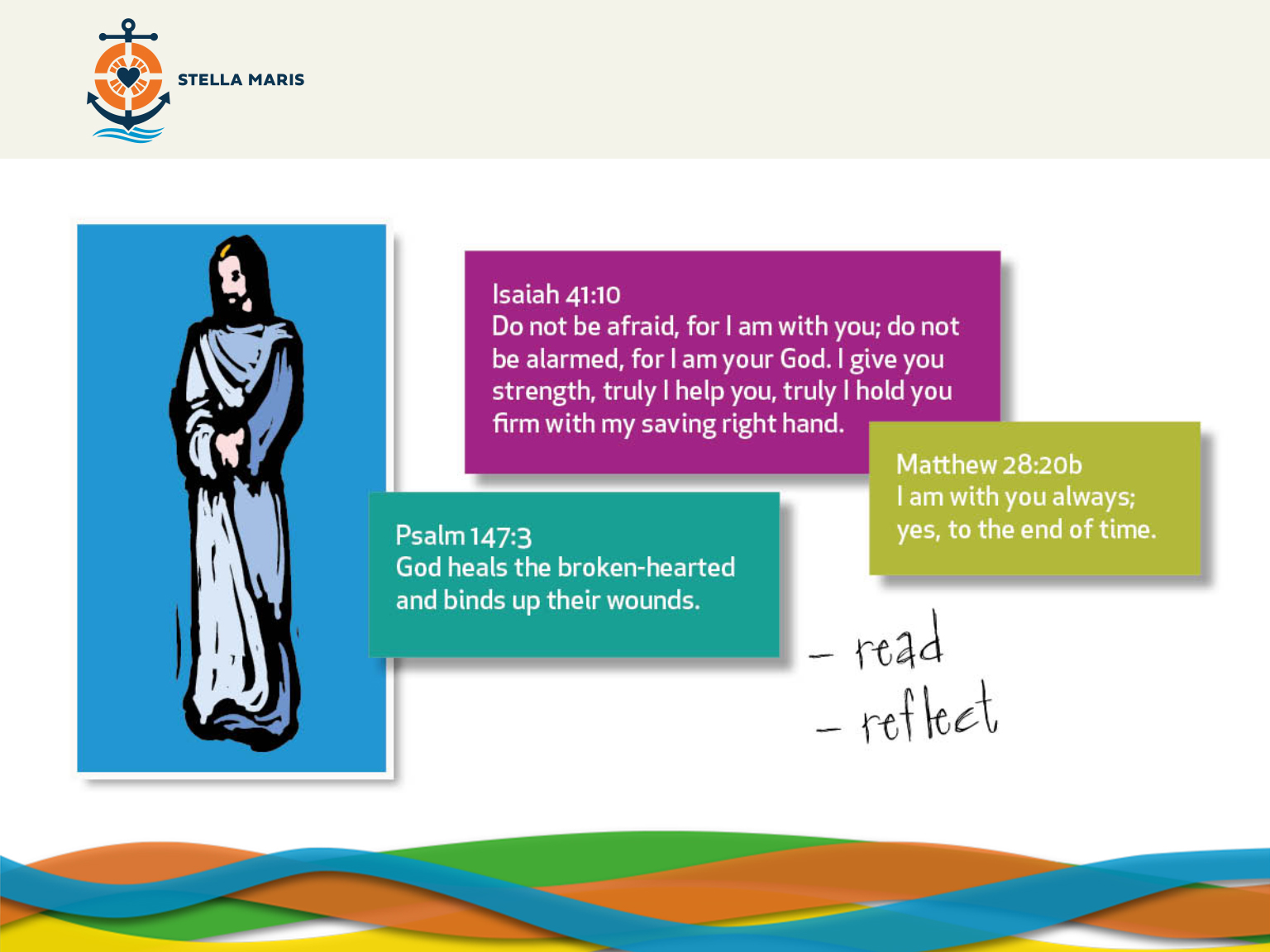
Notes:
Just as God wanted to make a difference in the lives of slaves through Peter Claver and in the lives of seafarers through Stella Maris, God wants to make a difference in your life, especially in situations where you might feel trapped.
God tells us in the bible that He is always with us, that he heals our hearts and binds up our wounds and that he will strengthen and help us. Being unable to accept Christ’s healing and peace can cause conflict within ourselves and others.
We are going to have a time of prayer where we can reflect on these bible quotes and think about our own lives and try to think of any situations where we feel trapped or are unsure of how we should deal with those situations.
Read the passages and think about them, trying to remember that God says them to us now. Choose one you like.
Think about any situations in your life where you might feel trapped or stuck and then when you have thought of one ask God to help you in that situation by repeating your chosen phrase a few times in your own mind.
Re-cap/repeat for the students:
We are going to choose one of the scripture quotes
Think about our own lives and any situations we might feel trapped in
In your own mind repeat the scripture quote as a way of asking God’s help
Start prayer with the sign of the Cross- In the Name of the Father and of the Son and of the Holy Spirit, Amen.
Leave the scripture quotes on screen and start the BACKGROUND MUSIC.
Beethoven Fur Elise is embedded
SUGGESTED MUSIC:
Ave Maria by Charles Gounod or J.S.Bach OR Canon in D by Pachelbel

Slide 10
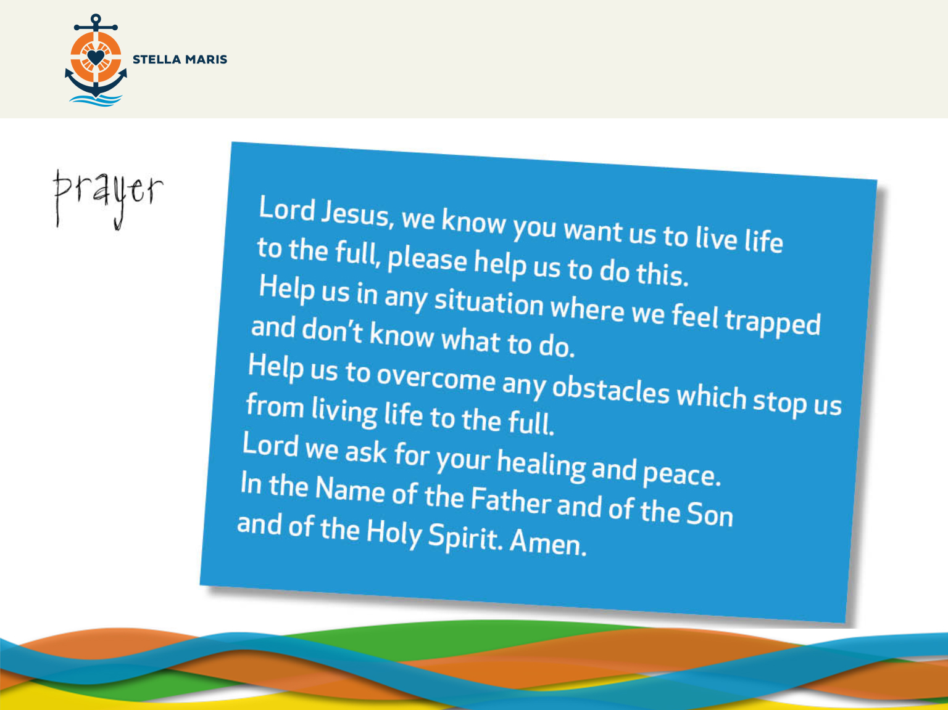
Notes:
Let us say this prayer together (on screen).
Suggested hymns (if times allows it) for after prayer:
Here I am to Worship by Tim Hughes, 2001
Oh, The Love of my Lord by Estelle White
CLOSING SUMMARY:
So, we’ve learned about St Peter Claver and how he helped the slaves and can inspire us now.
We have learned about Stella Maris and how they help seafarers.
We have learned that God loves us and wants us to live life to the full.

Slide 11
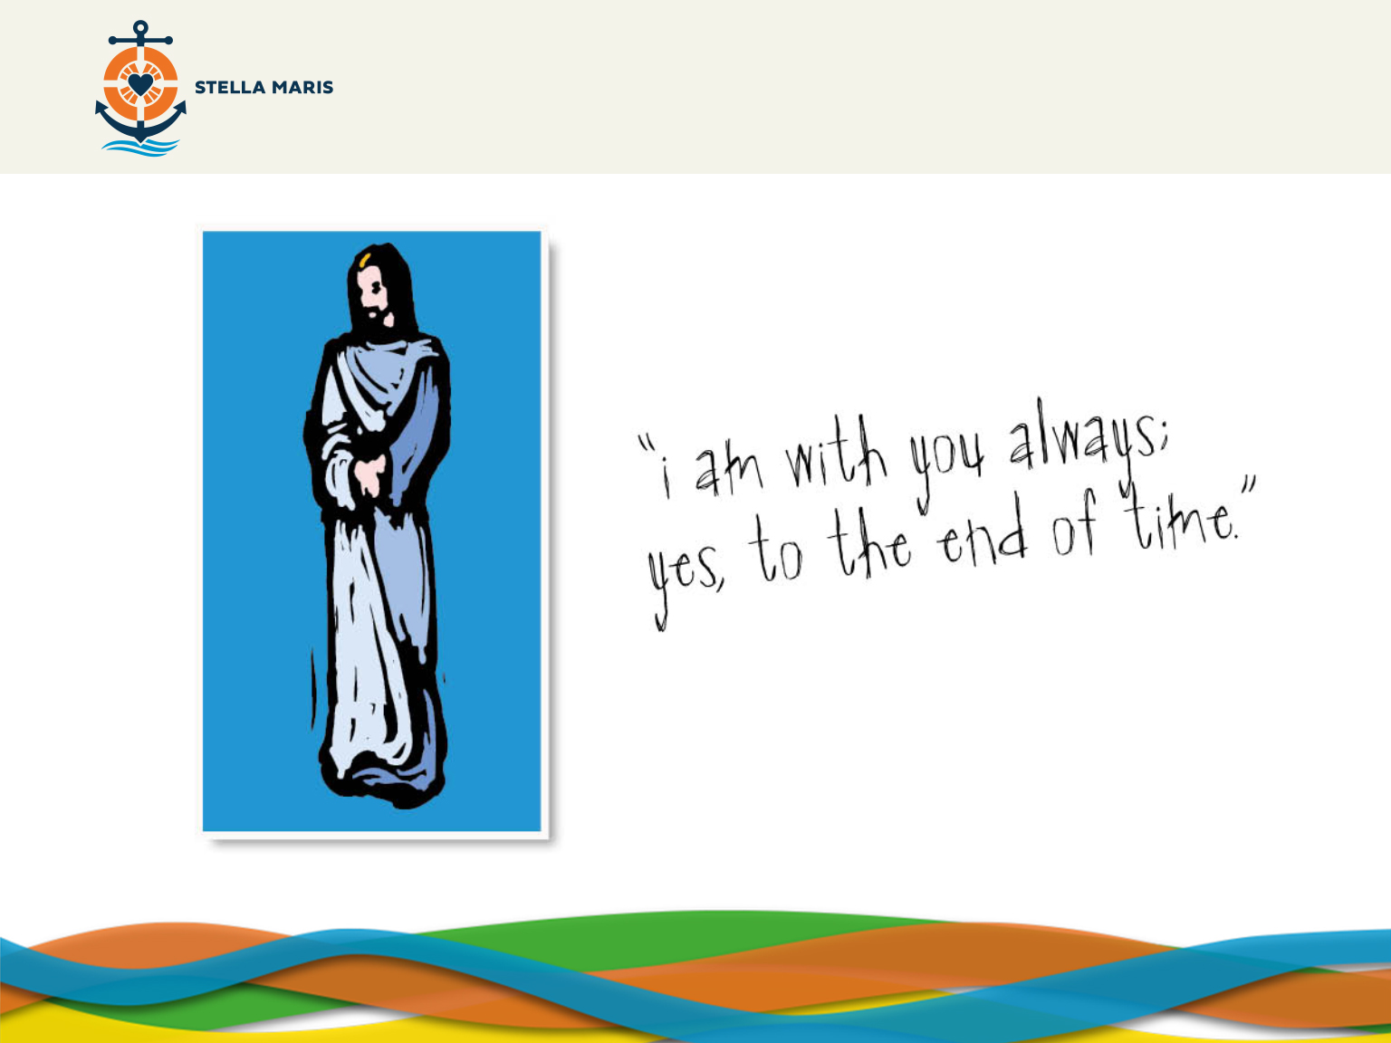
Notes:
Students exit with music playing in the background (embedded).
Bible quote on screen.
EMBEDDED MUSIC: Pulsing Intensity– Free Stock Music

