Slide 1
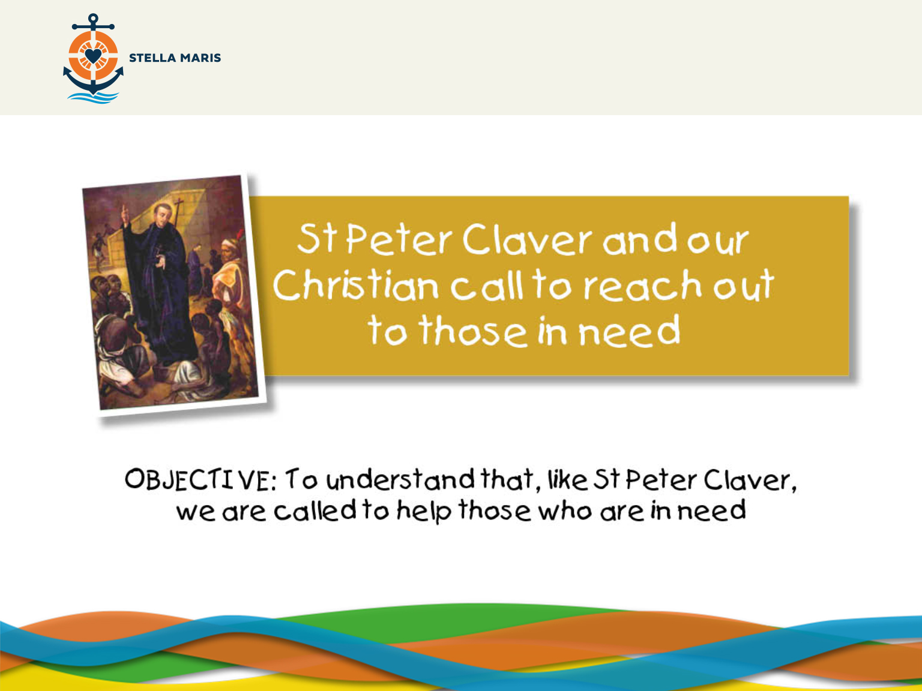
Notes:
EMBEDDED MUSIC: Oceanward Heroes – Free Stock Music (CLICK TO STOP when session starts)
Does anyone have any favourite super heroes?
Super heroes can do some amazing things.
What would superheroes do if you were falling from a tall building?
(They would fly and catch you.)
What would superheroes do if a giant rock was about to fall on your head?
(They would catch the giant rock.)
I don’t know about you but I’m not generally falling from a tall building or having a giant rock land on my head. What would superheroes do if you were really hungry?
(They would give you some food.)
What would they do if you were really thirsty?
(They would give you something to drink.)
What would they do if you were sad and lonely?
(They would stay with you and cheer you up.)
Superheroes do what is needed and sometimes the most amazing thing to do is a simple act of kindness because that is what is needed at the time.

Slide 2
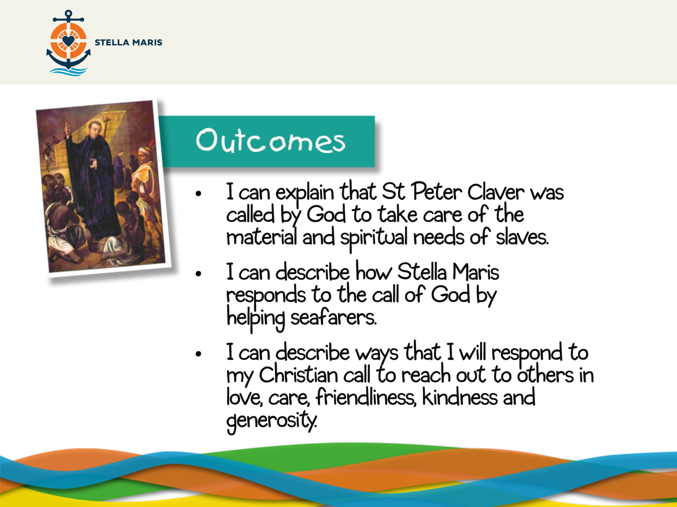
Notes:
Let me tell you about a great hero called Peter Claver.
Peter was born in Verdu, Spain in 1580, over 400 years ago. During his studies to be a Priest he was sent to South America and was ordained a Priest in a city called Cartegena (pronounced Car-ta-hen-a) in a country now called Colombia.
CLICK MOUSE FOR MAP ANIMATION
Peter Claver felt deep in his heart that he was loved by God and he wanted to share this love with everyone and let them feel in their hearts the happiness God wanted to give them.

Slide 3
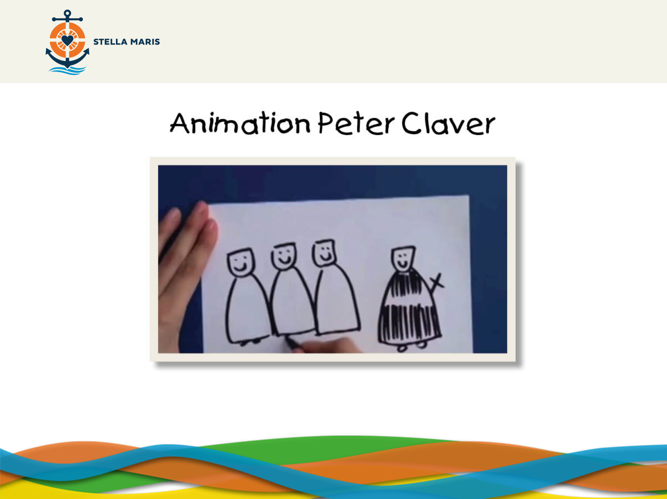
http://www.youtube.com/watch?v=wTD6Osryn8I
Notes:
Somebody very wise once said:
‘God made me to serve him in a particular way
He has given me some work. He has not given anybody else this work. I have my mission.’
Cardinal Newman (paraphrased).
We all have something which God wants us to do in our life, this is called our ‘call’. We are going to look at the example of St Peter Claver who knew that his call was to help a particular group of people. Let’s watch a small video about him.

Slide 4
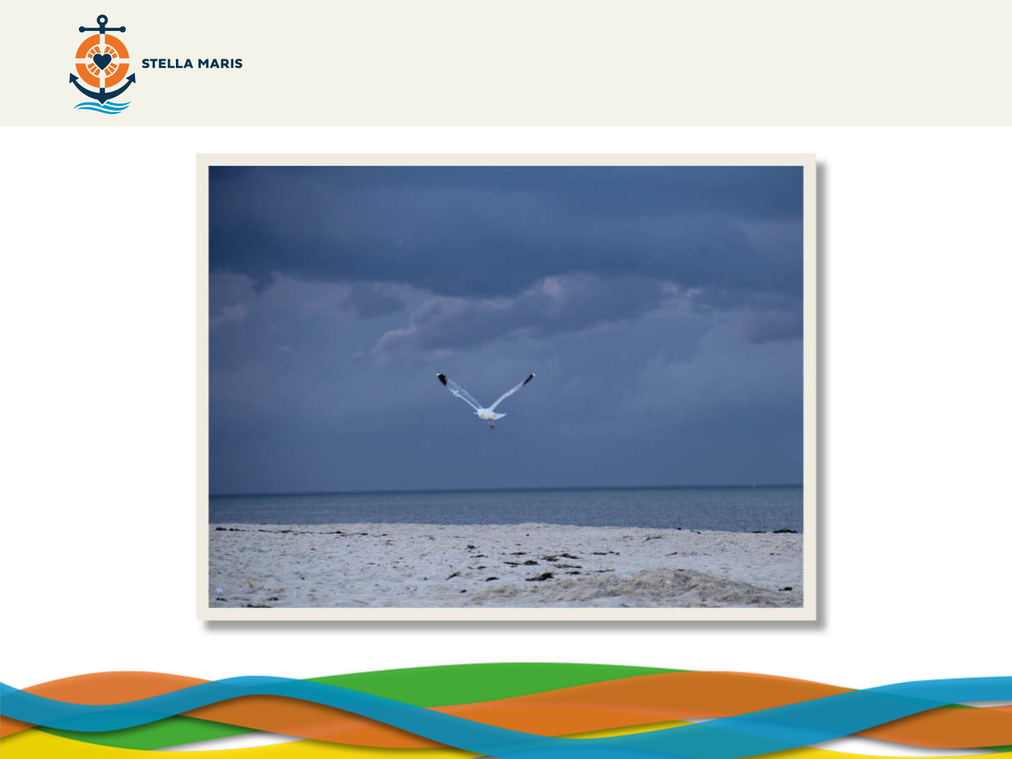
Notes:
The children should sit in a circle on the floor or somewhere they are going to be comfortable and pay attention.
We are now going to do something called a meditation and imagine that we were there when St Peter Claver was helping the slaves. In order to do this we are going to get comfortable and I will lead us and suggest things for us to imagine. I will ask you some questions and I don’t want anyone to say the answers to those questions but imagine them for yourself. I am going to play some music which will help us concentrate.
Start the music.
SUGGESTION: Adagio for Strings by Samuel Barber
So make sure you’re comfortable and close your eyes and lets begin.
APPENDIX 1 (Read by teacher)

Slide 5
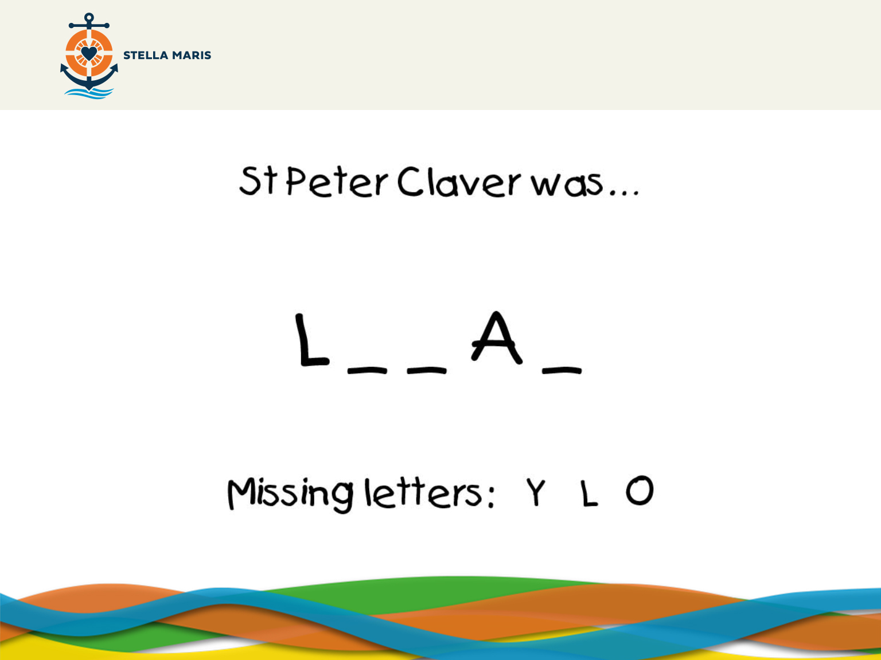
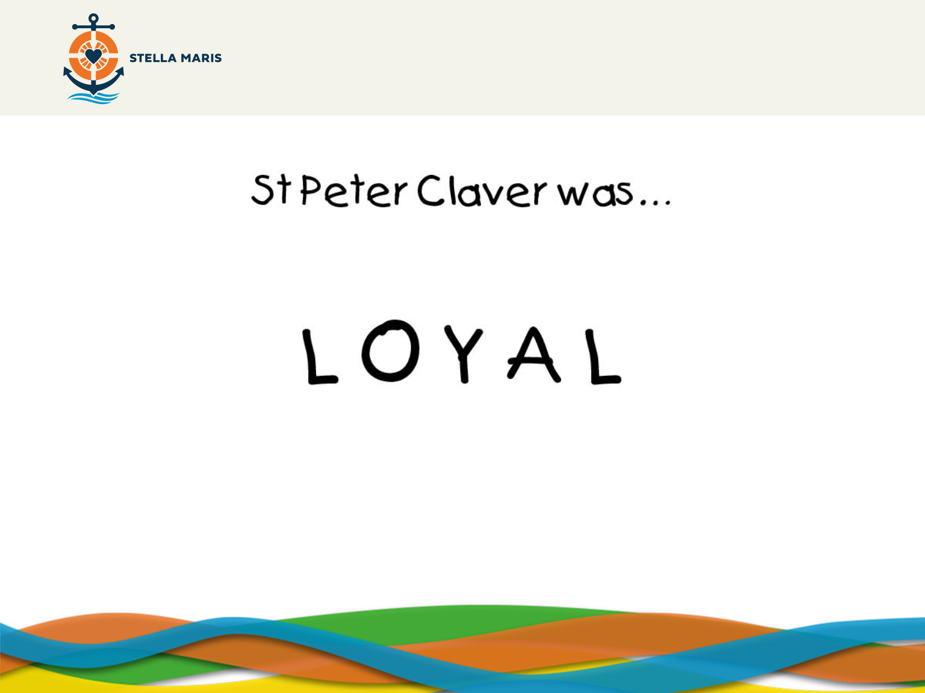
Notes:
PLEASE NOTE THAT THE FOLLOWING SLIDES ONLY WORK WHEN VIEWED IN PRESENTATION MODE
We are going to look at some adjectives (words which describe) St Peter Claver. The words will have letters missing and we want you to put the missing letters back into the words.
Here is an example. We have a word with these three missing letters. Does anyone know what the word spells?
Click to reveal the answer.
Correct, it spells loyal. Does anyone know what loyal means?
Staying faithful to a friend, group of people or country even when it’s difficult.

Slide 6
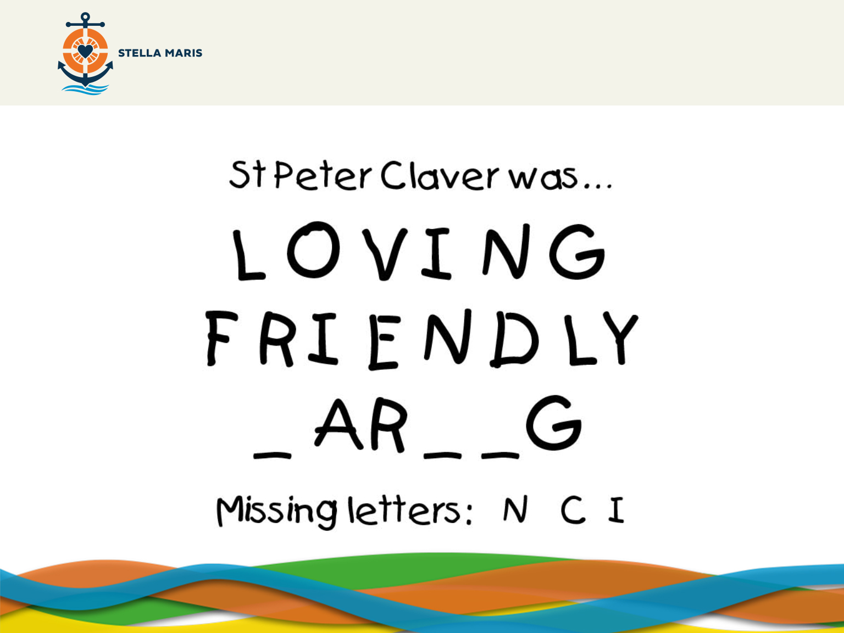
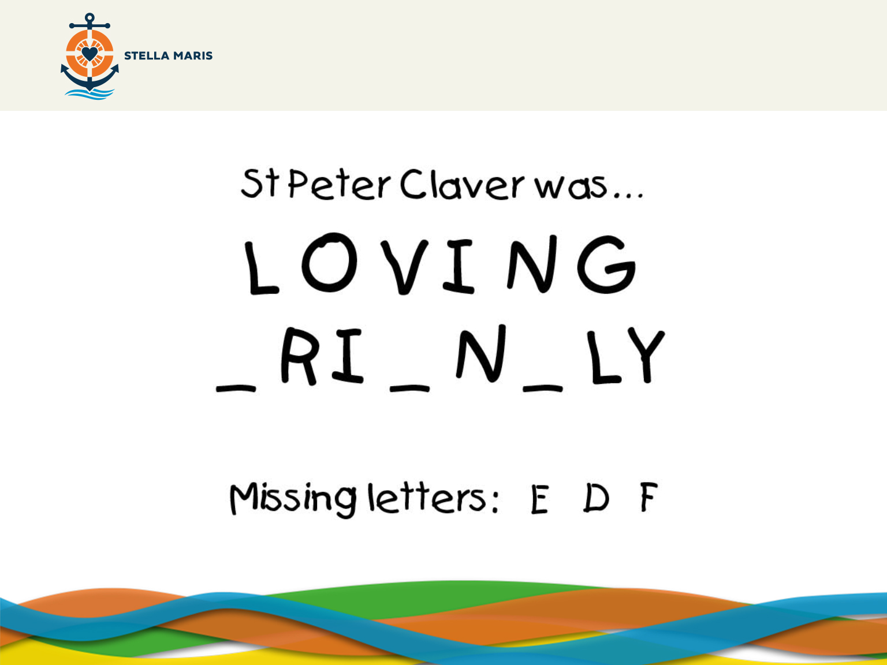
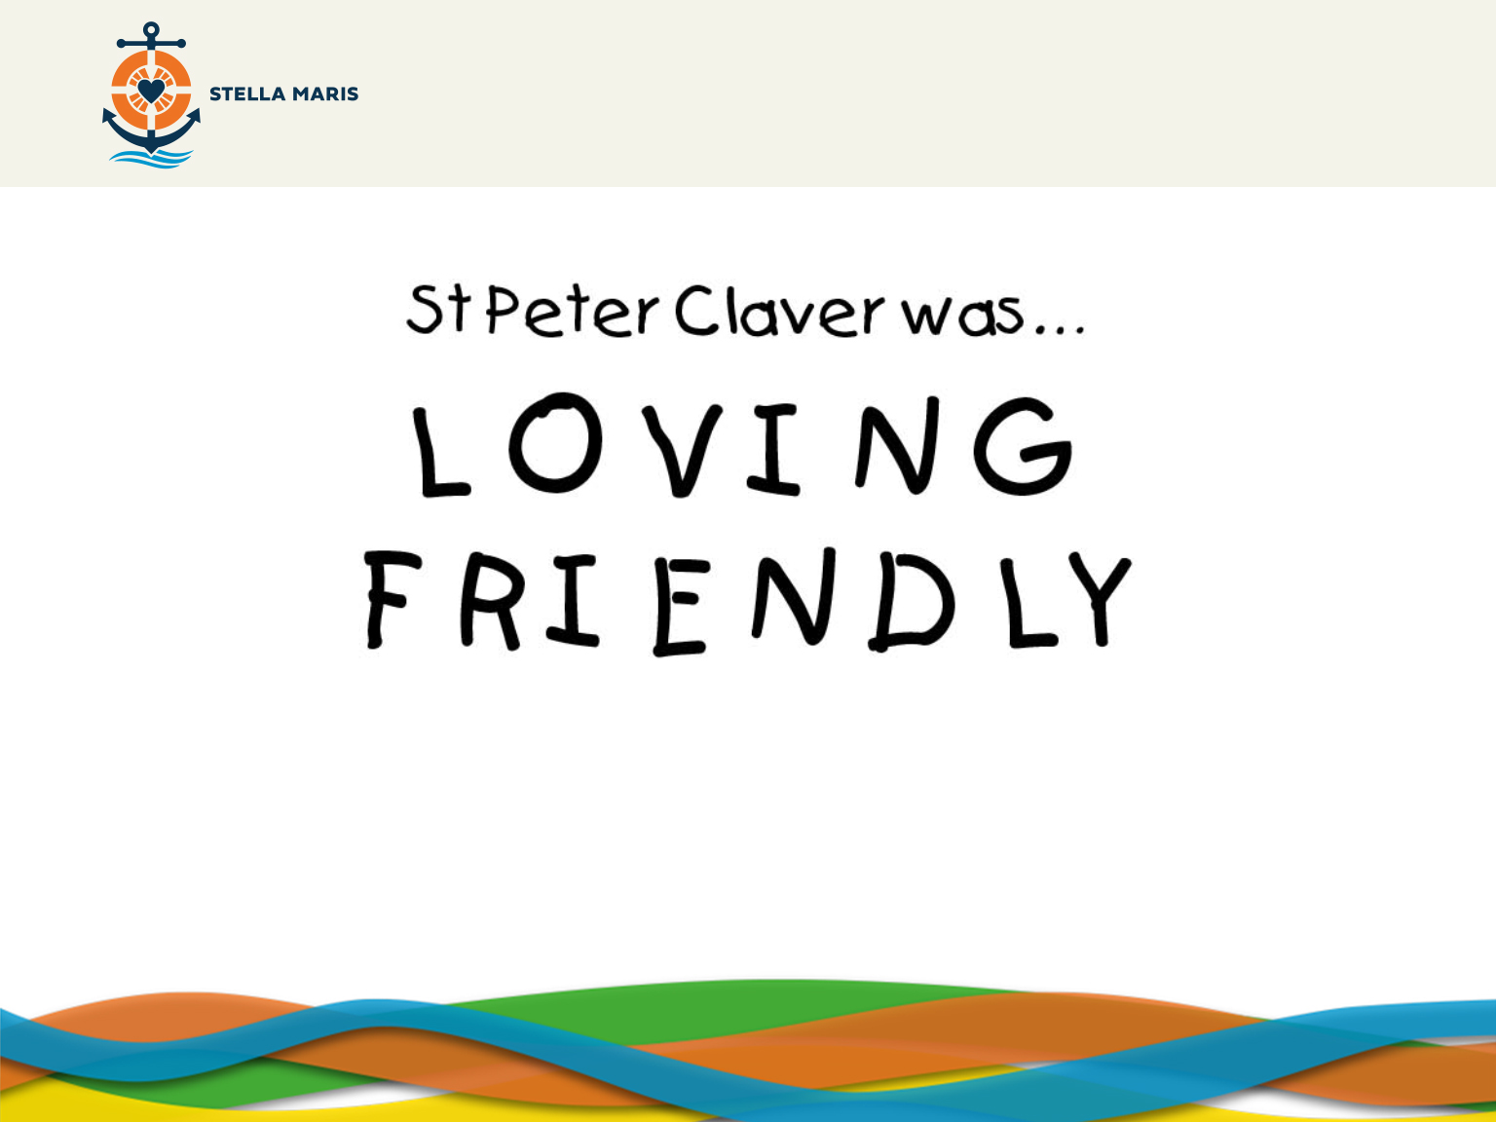
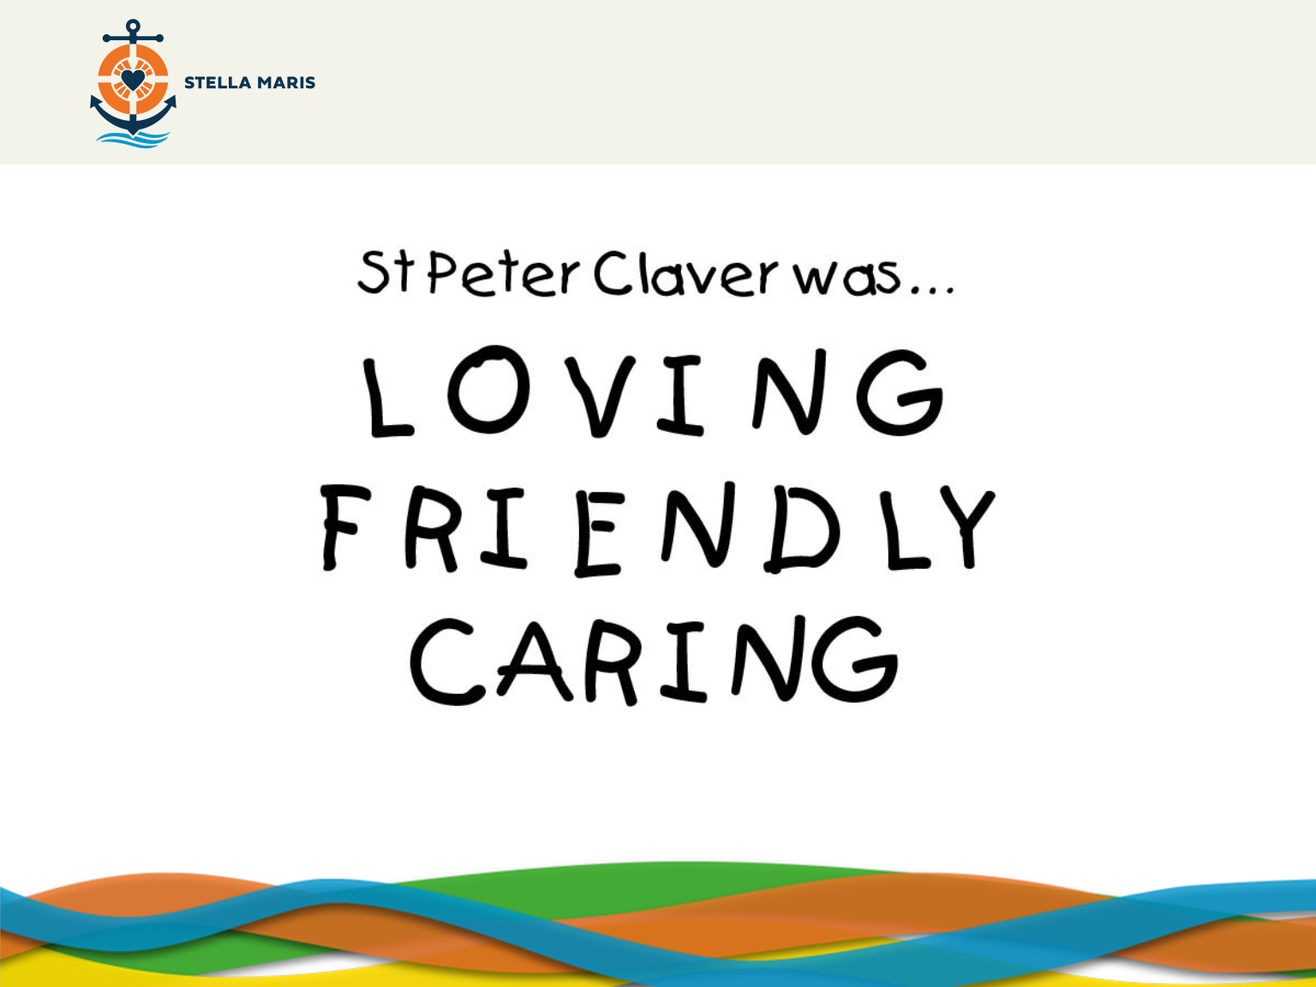
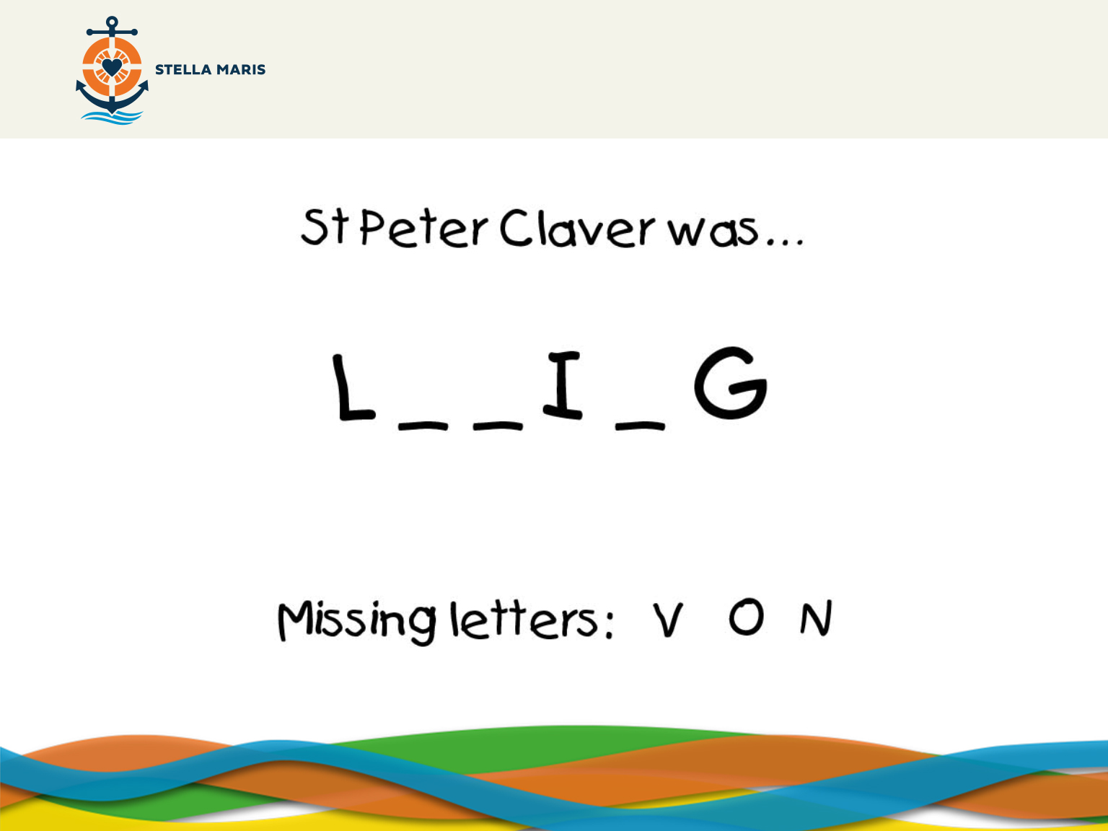
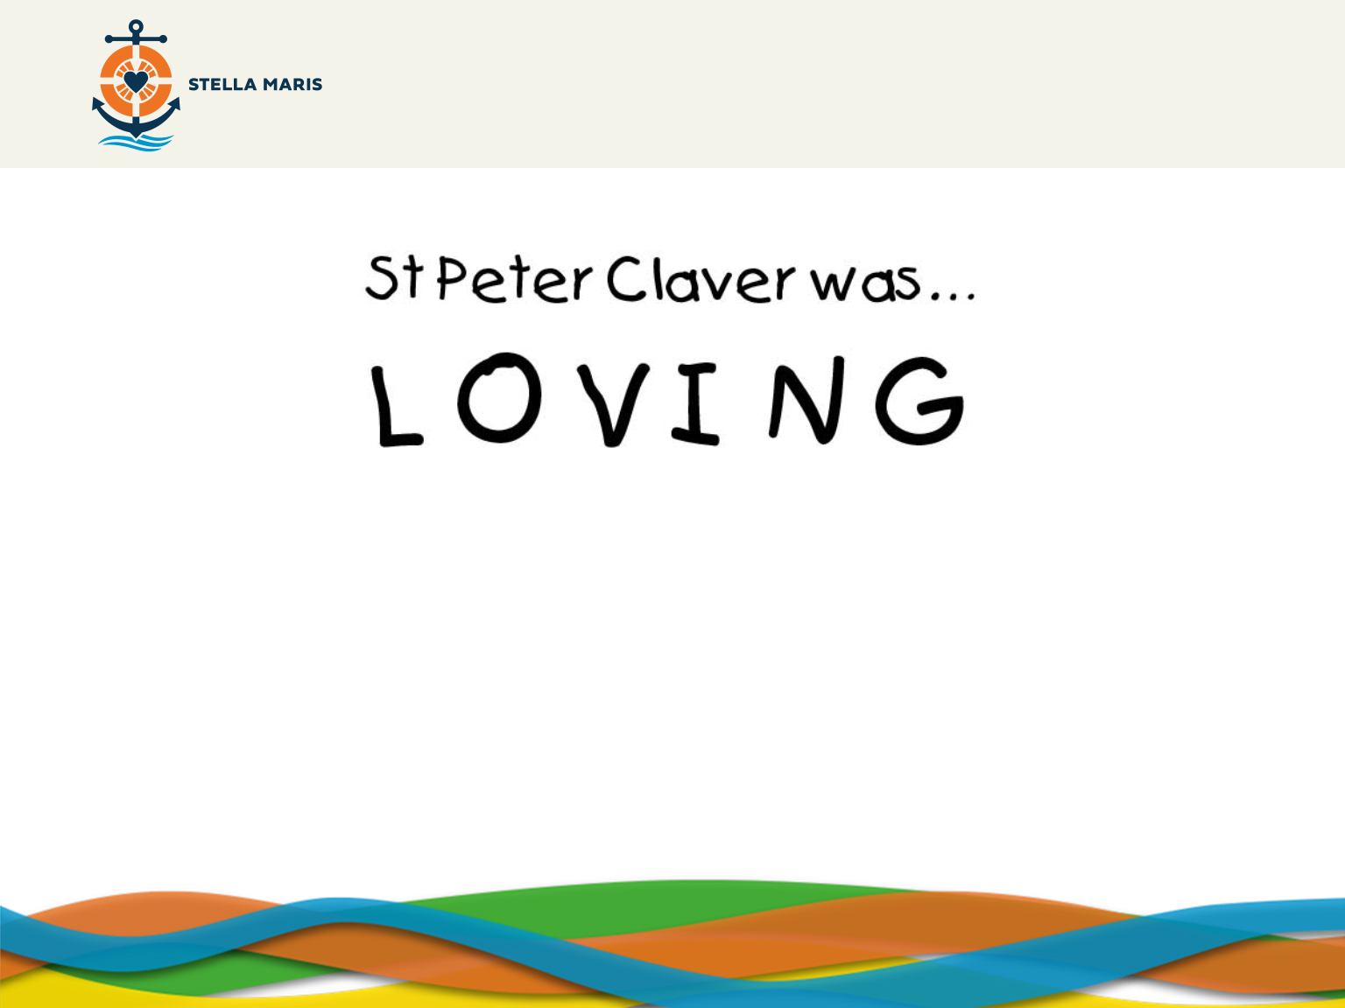
Notes:
Now, the next word. Put your hands up.

Slide 7
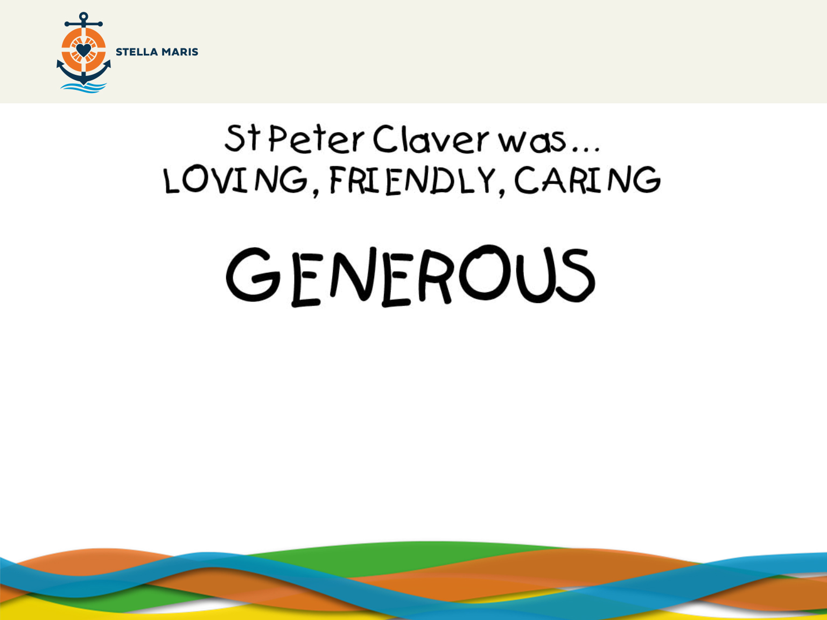
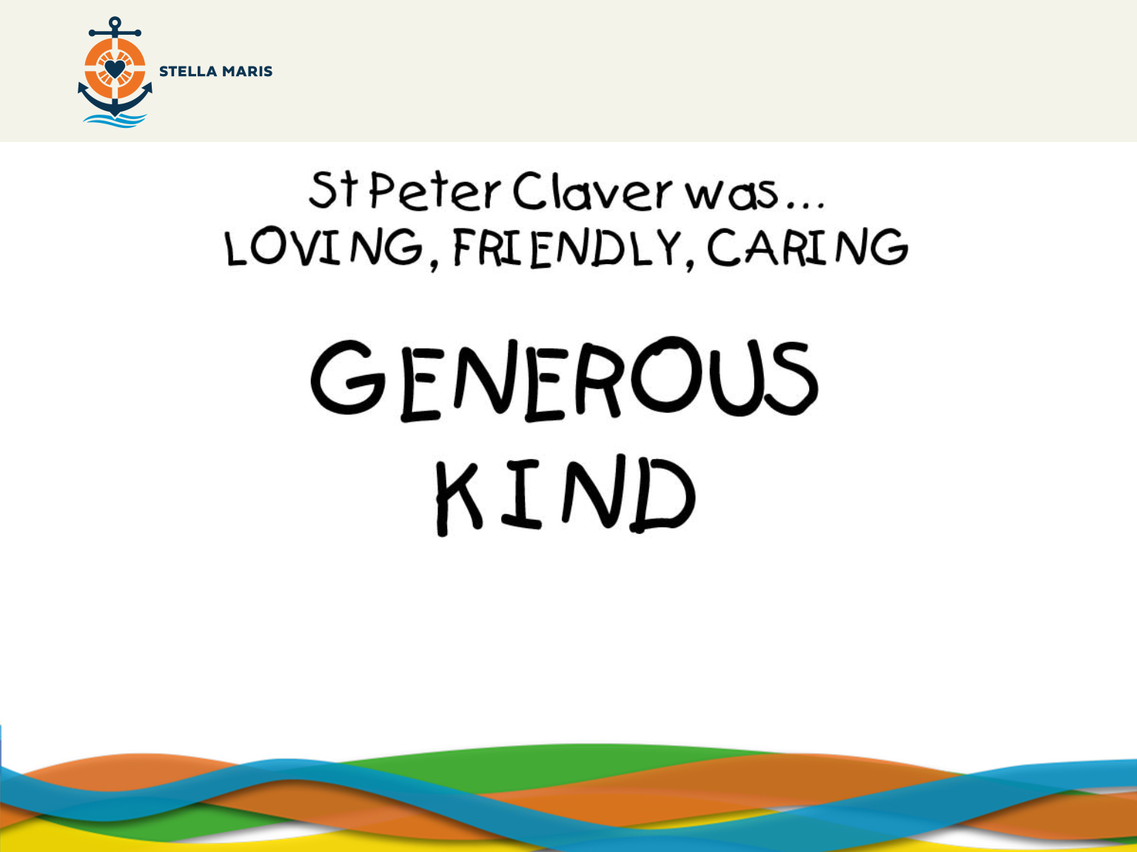
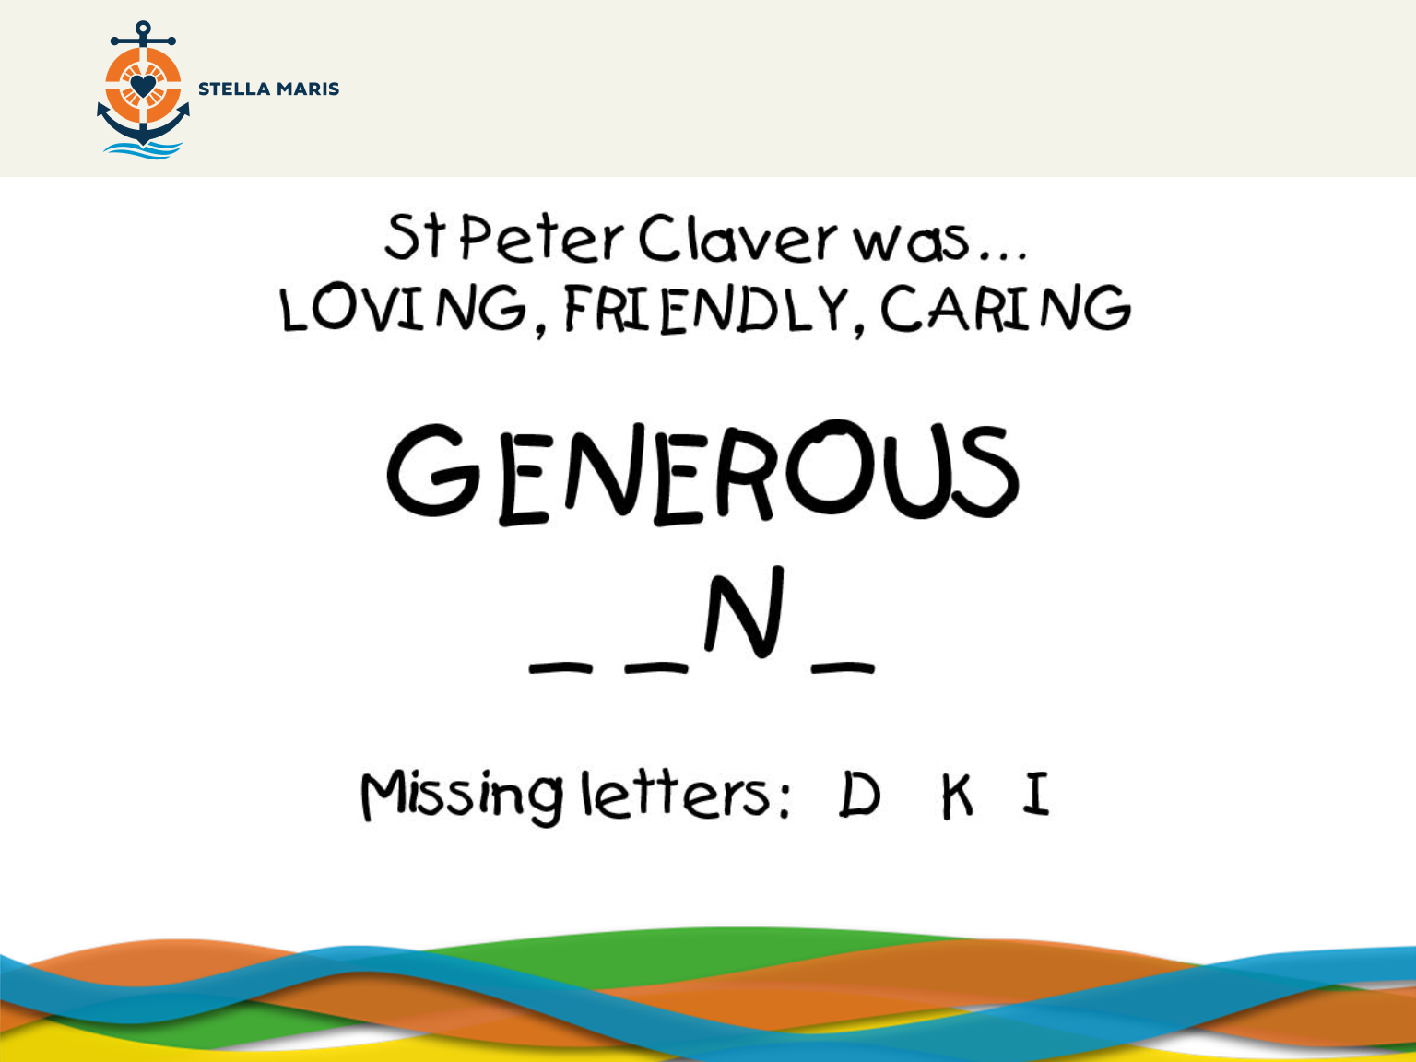
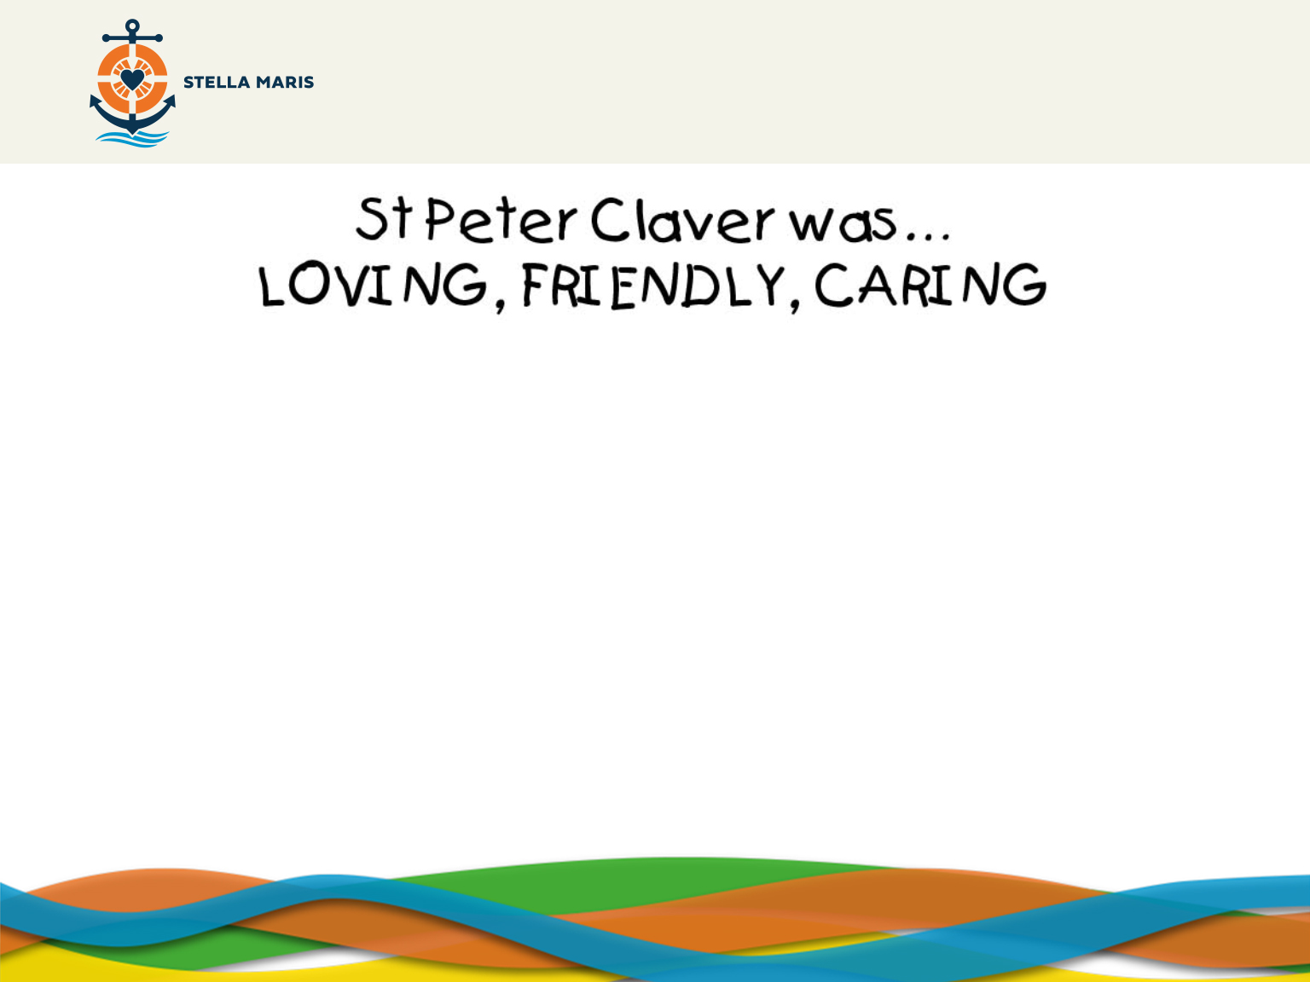
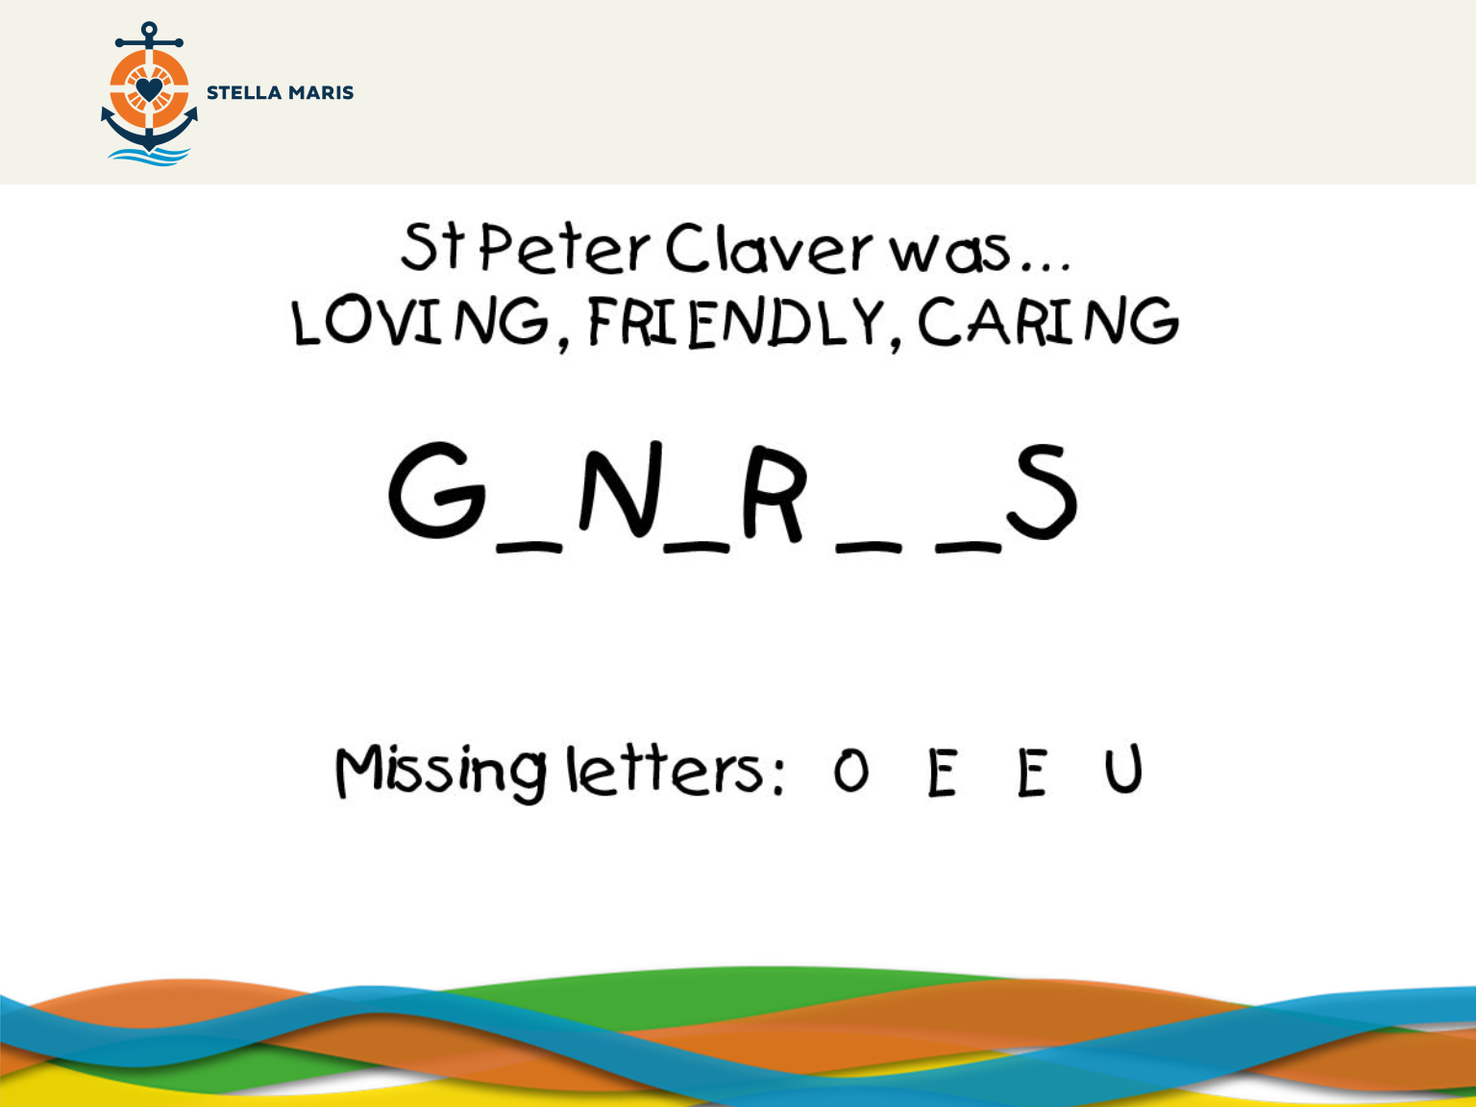
Notes:
Now, the next word. Put your hands up

Slide 8
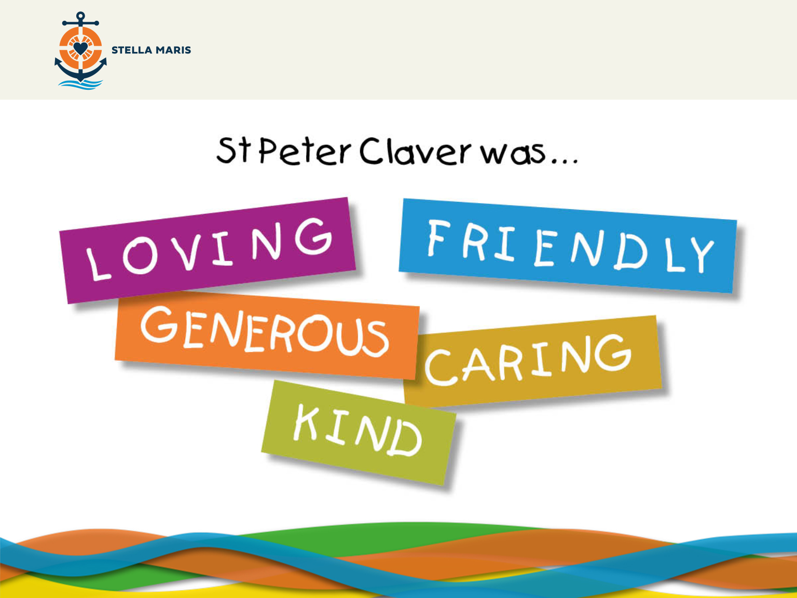
Notes:
So, St Peter was:
-Loving
-Generous
-Caring
-Friendly
-Kind
Why do you think St Peter Claver did all of this?
Answer: He knew God loved him and he wanted to share that love and use his talents
Peter Claver did great things. Who helped him to do great things?
Take feedback
Guide the students towards the answer ‘Jesus’

Slide 9
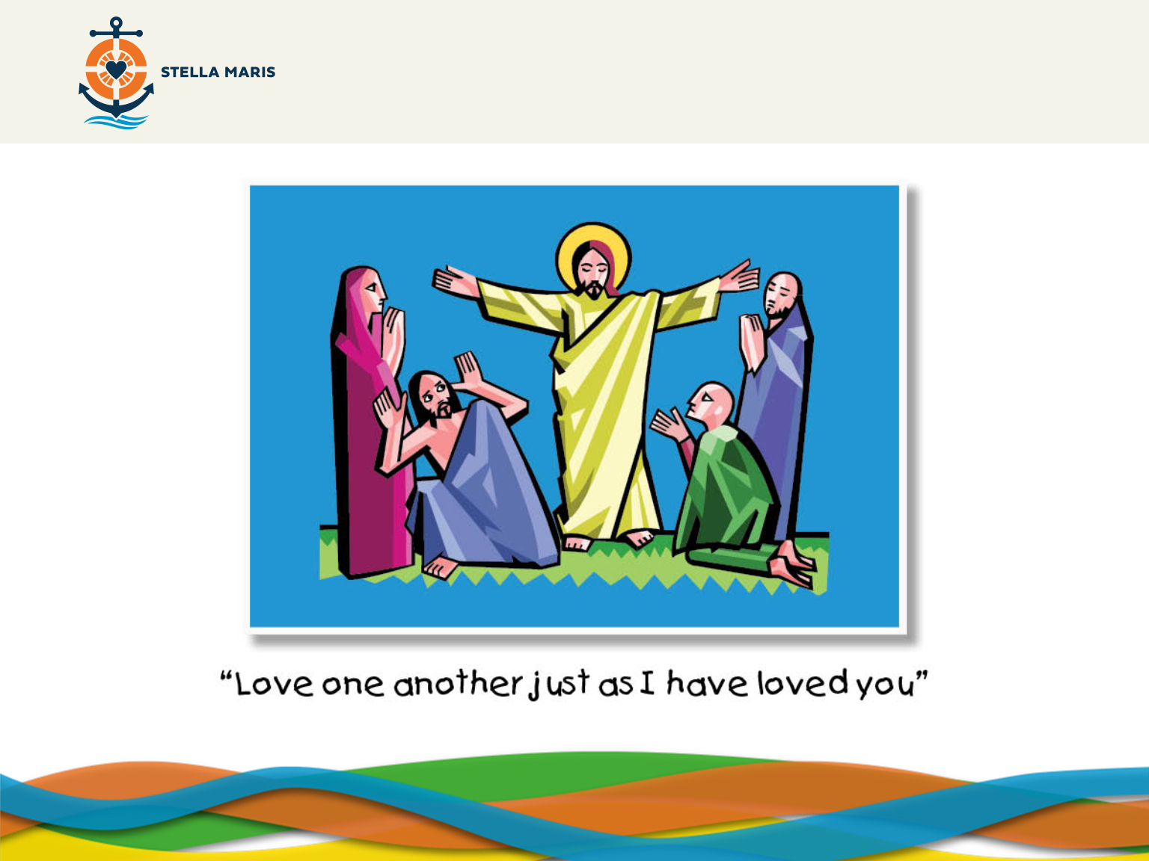
Notes:
St Peter Claver found inspiration in Jesus and chose to respond by following his call to help the slaves.

Slide 10
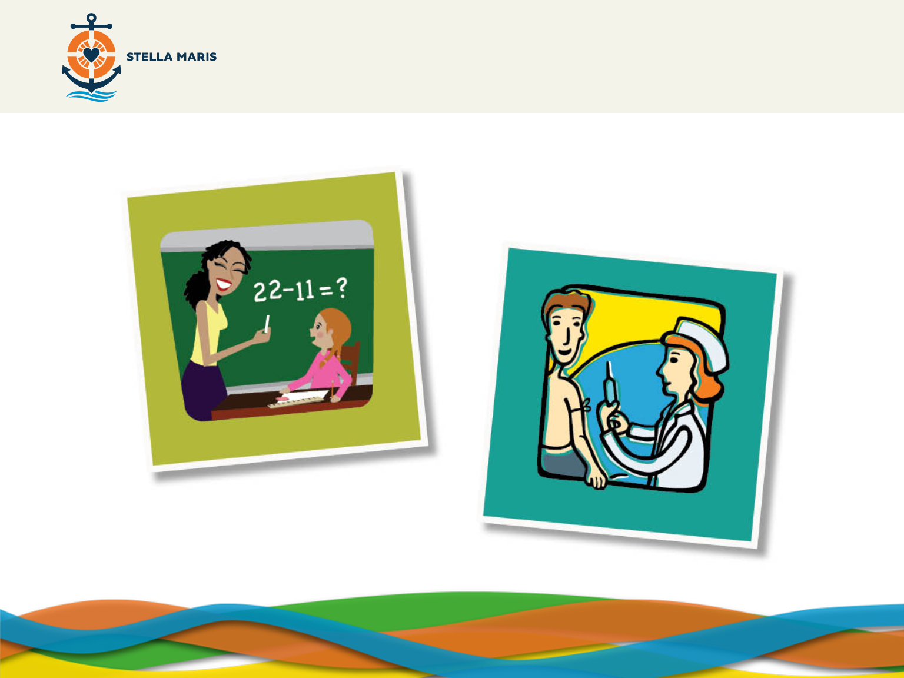
Notes:
Like Peter Claver, we all respond to God’s call to help others by using our talents:
Teachers – help us learn
Nurses – help us get healed

Slide 11
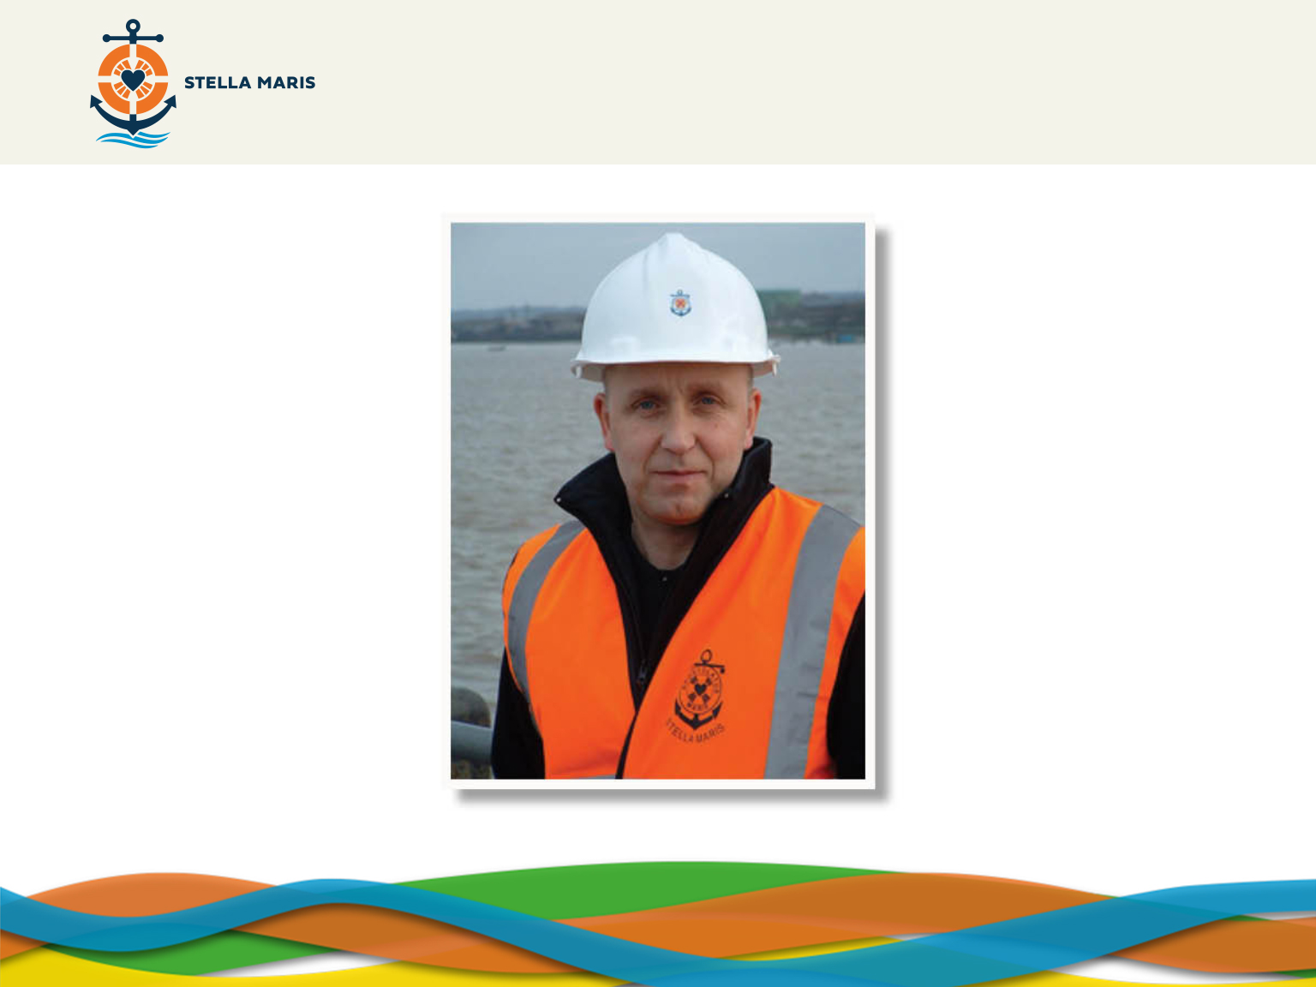
Notes:
What do you think this person does?
Children might say ‘builder’ for example.
Teacher may guide them by pointing at the sea.
He is a chaplain called Paul Atkinson. A chaplain is someone who cares for a group of people, supporting them in time of need and sharing God’s love with them. Paul works for an organisation called Stella Maris which helps seafarers, the people that work at sea such as fishermen or sailors. Working at sea is more dangerous and challenging than what we may imagine.

Slide 12
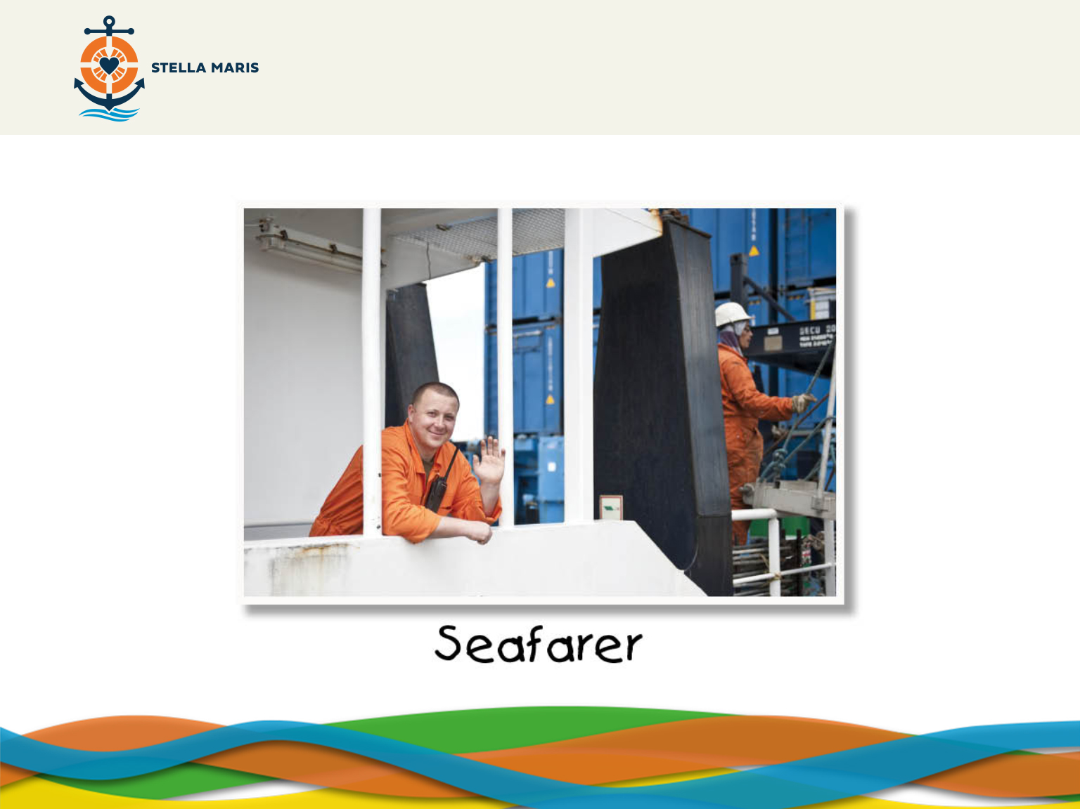
Notes:
Seafarers are really important because they bring so much to our country. Without them we wouldn’t have fish but also most of our clothes are made abroad and brought to us by seafarers along with many of the things we sometimes take for granted.
Many seafarers are away from home for a long time and work hard often in very dangerous conditions.
Many of them work on ships because they need to feed their families or pay for their children to go to school and while they are at sea they miss their families a lot. Sometimes seafarers aren’t paid properly and like us, sometimes seafarers get sick which isn’t nice when you are away from home.
In what can be a really hard job it’s understandable that sometimes they need help.

Slide 13
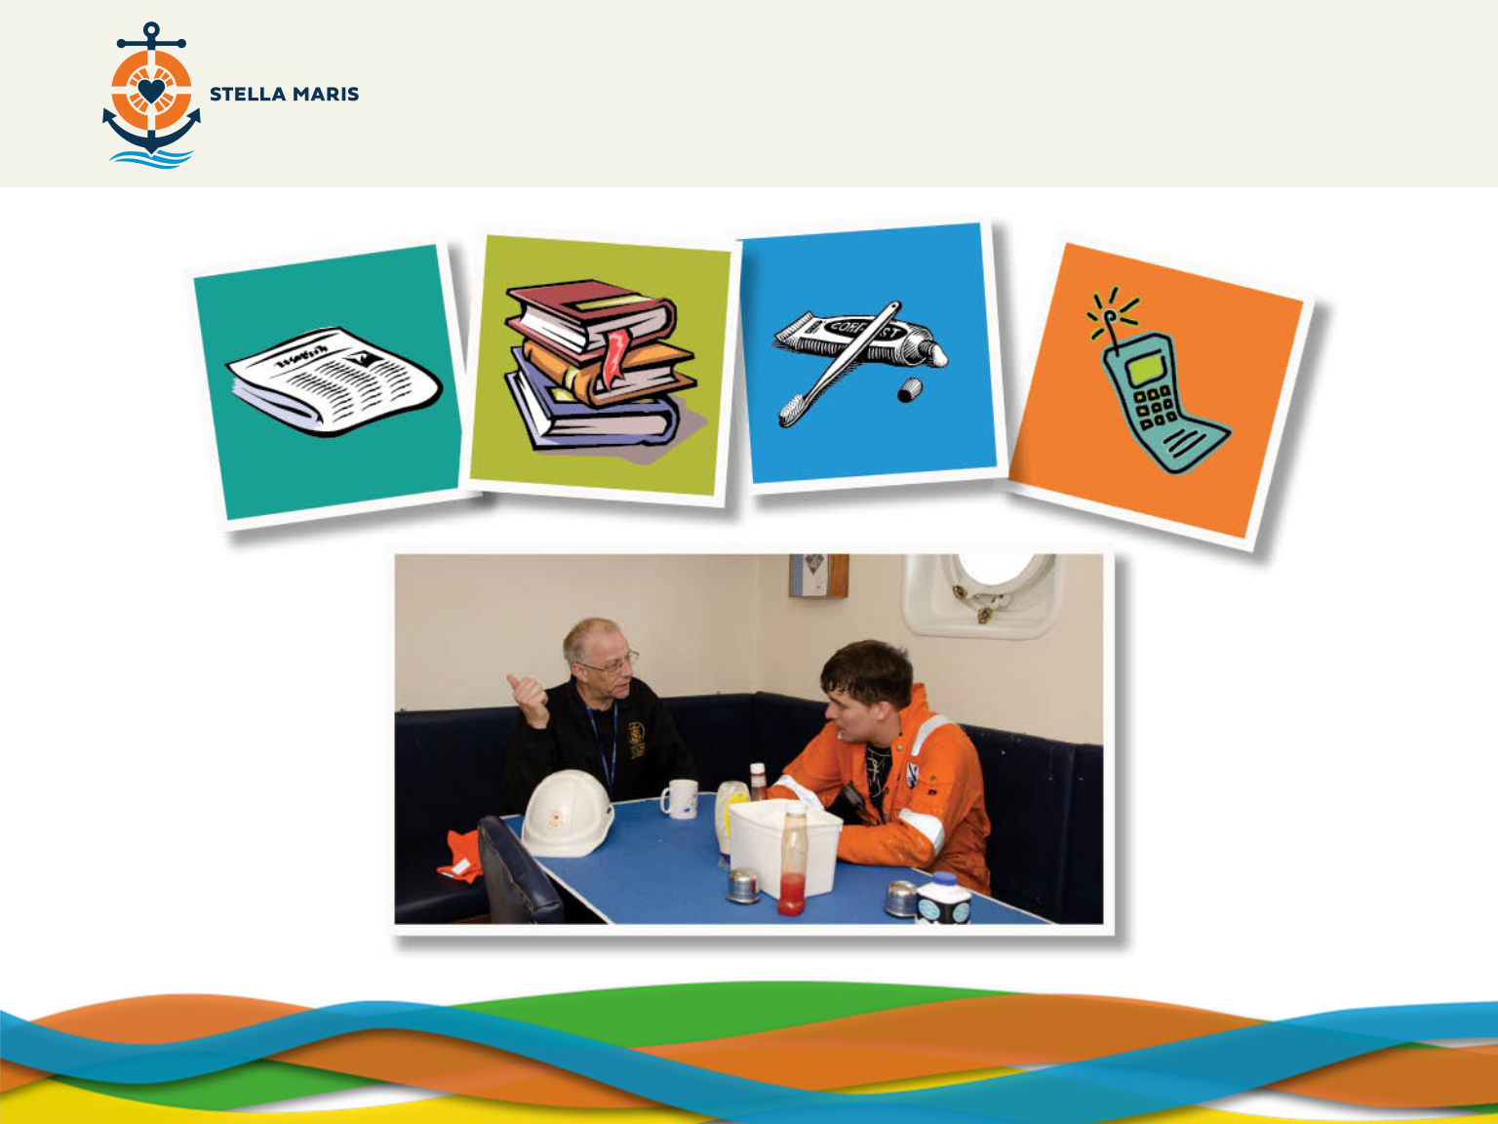
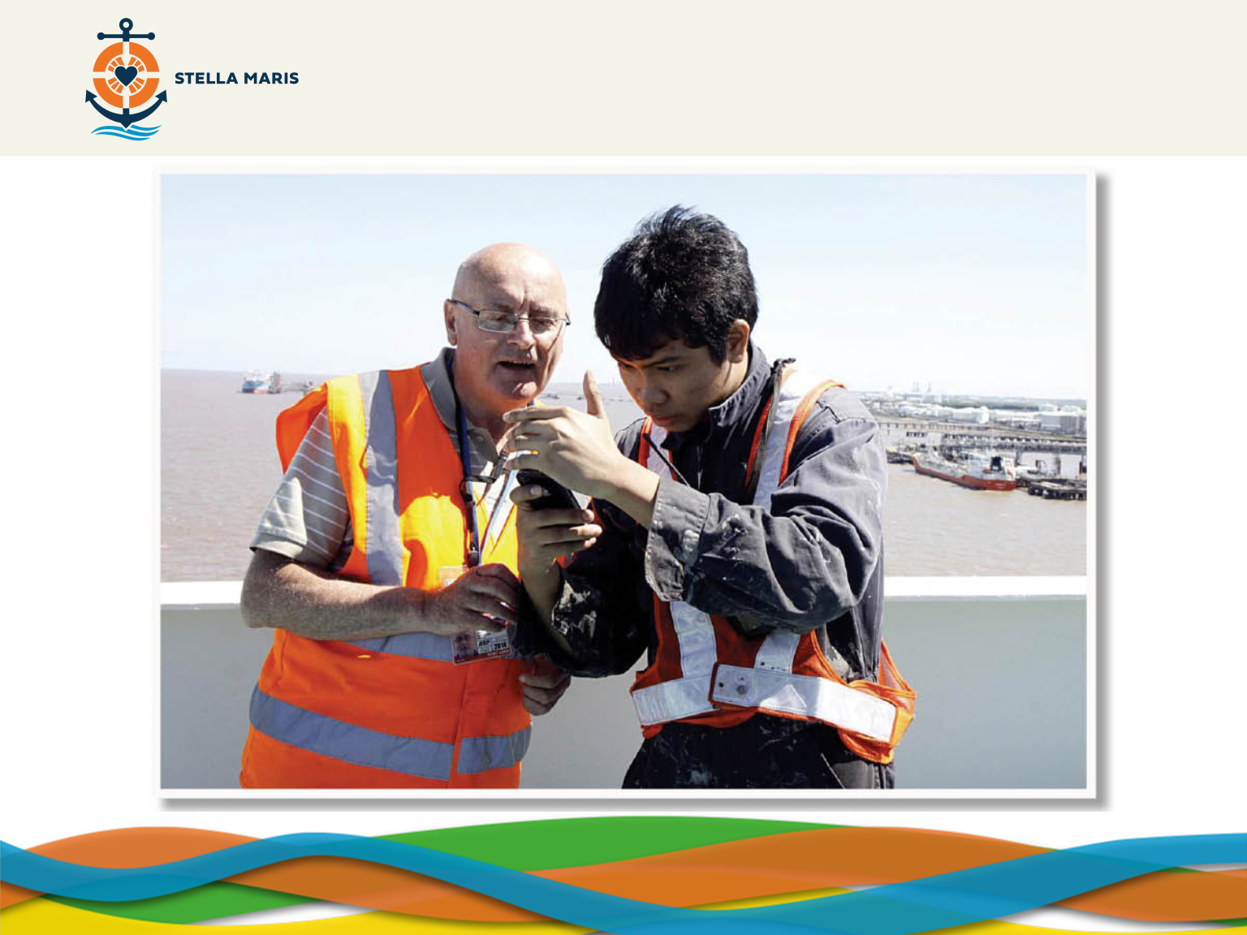


Notes:
Stella Maris chaplains do many things for seafarers. They help them with whatever they need. They:
(CLICK to make images appear)
Give them a lift to the nearest shop.
What do you think they would like to buy from the shops? (All the basics like toothbrush, toothpaste, deodorant etc, newspapers and magazines)
(CLICK to make photo appear)
Talk to them and understand that they miss home.
(CLICK to make photo appear)
Help them make phone calls home and send emails or letters home.
Why do you think the seafarers appreciate this so much? (Because they are away from their families for many months at a time and when the ship it is in port is often the only chance they have to speak to the people they miss so much.)

Slide 14
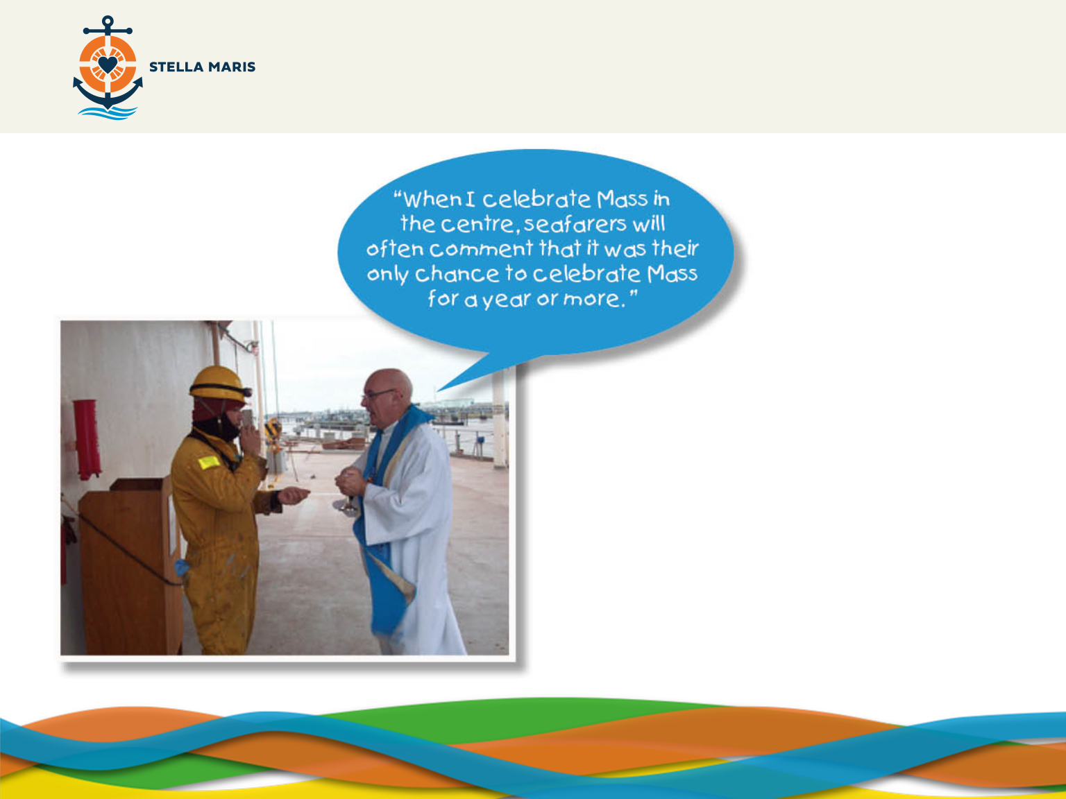
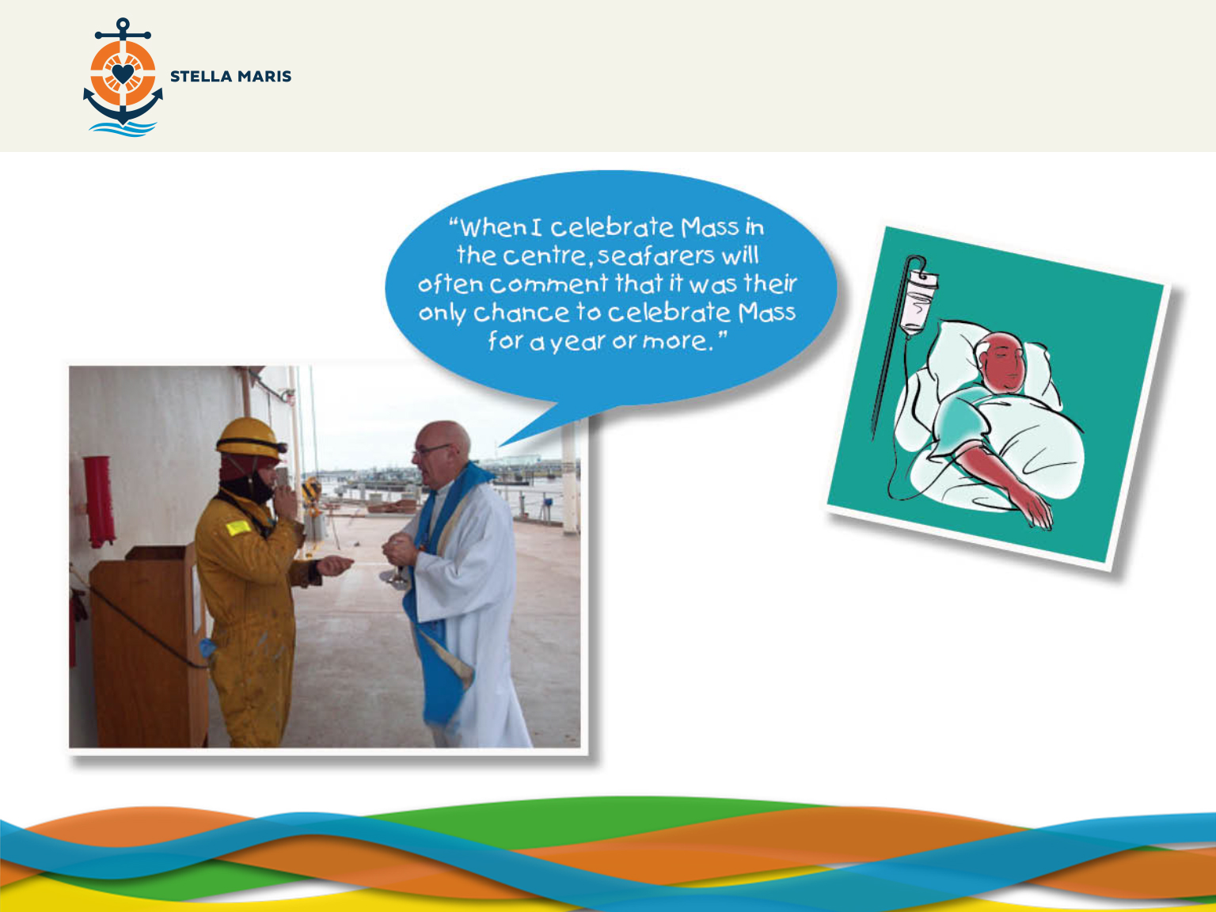
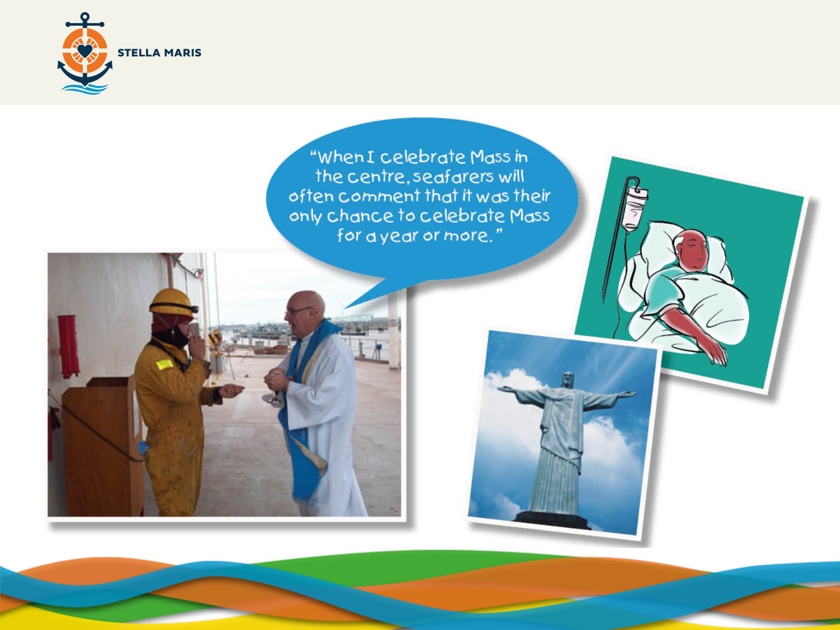
Notes:
Arrange to say Mass for the seafarers or hear their confessions.
(CLICK)
Visit them in nearby hospitals when they are sick.
(CLICK)
Remind them that God is with them, that God loves them even when they are sad or lonely.
What do you think you would most appreciate out of all the things the chaplains do for the seafarers? (Lift to shops, talk, help phoning home, Mass, Confessions, visit when sick and remind them God is with them.)
The chaplains who visit seafarers on their ships and help them practically and spiritually are very similar to St Peter Claver who helped the slaves.
So, we have seen how chaplains use their talents and work hard helping seafarers.
Who gives them the strength and joy to keep visiting ships day after day to help seafarers?
Take feedback
Possible answers include St Peter Claver or other chaplains. The teacher should guide the children to the answer ‘Jesus’.

Slide 15
Notes:
The chaplains find inspiration in Jesus and choose to respond by following their call to help the seafarers.

Slide 16
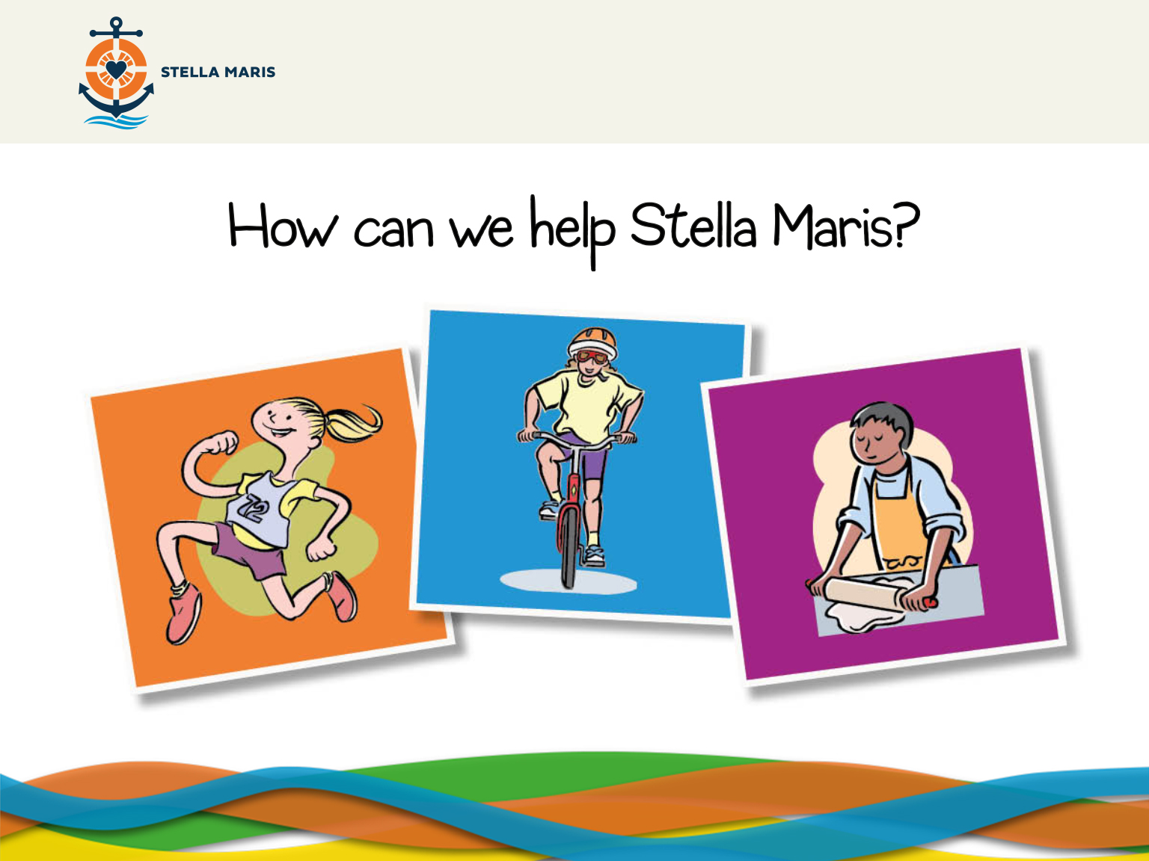
Notes:
The chaplains are very important because without them the seafarers wouldn’t have the support that they need when they go on long journeys away from their families.
How can we help Stella Maris?
Take answers directly from children.
Other suggestions:
Doing a sponsored walk/run/cycle
Example: A lady called Carolyn Lewis undertook a fantastic fundraising effort to purchase Mi-Fi units for seafarers’ use (with them seafarers will be able to have internet access when they dock on port so they can talk to their families thousands of miles away). In 2013 she completed the Brighton marathon, the Petersfield Ups & Downs Cyclerace and the Great South Run.
- Baking Sale – Donate homemade cakes to sell
- Non-uniform Day – Pay a pound to wear normal clothes to school
-Pray for Stella Maris, all of their chaplains and all the seafarers in the world.

Slide 17
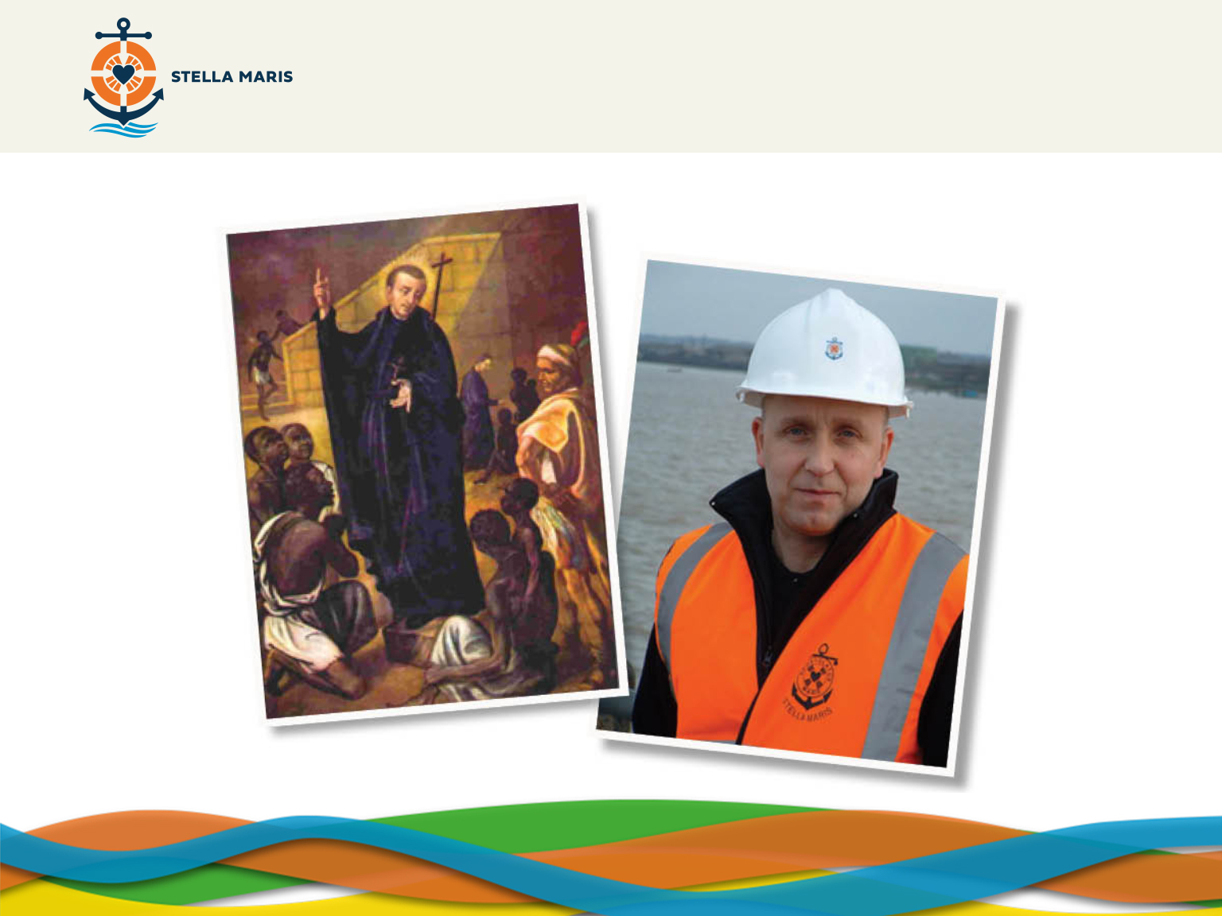
Notes:
We can help Apostleship of the Sea in many ways but remember that St Peter Claver started by helping those around him.
ADJECTIVES SHEET (APPENDIX 2)
(Part 1)
I’m going to give you a piece of paper with a picture of St Peter Claver and a chaplain from Stella Maris. Before, we looked at some adjectives that describe St Peter Claver. Now I would like you to write your own list of words which you think describe St Peter Claver and words which you think describe the Stella Maris chaplains. When you have done this write down which of these characteristic you would most like to display in your own lives and how you can do this.
Teacher may give an example: St Peter Claver and chaplains are generous with their time. I want to be more generous with my time as I often want to do things for myself and not help others. At playtime, I’m going to make more of an effort to look out for people in the playground who are looking lonely and see if they’d like to play.
Take feedback.
(Part 2)
We have thought about some great things that we can do, but let’s not forget about our talents. Talents are things we are naturally good at and these are given to us by God as a gift.
-Write down some of St Peter Claver’s talents and how he used them.
-Write down some of your own talents and how you can use them to help others.
Extension Activity: Write down ideas of what they could do to raise awareness/money for Stella Maris.

Slide 18
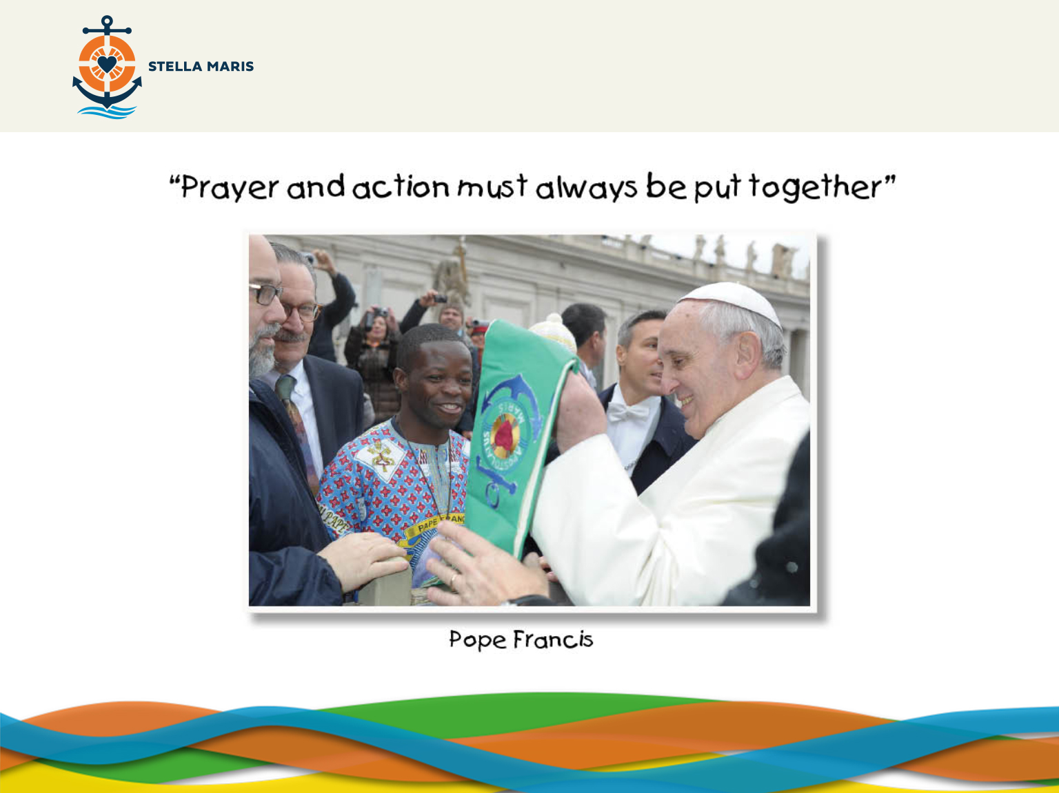
Notes:
MUSIC SUGGESTIONS FOR REFLECTION:
Claire de Lune by Claude Debussy
Prelude E minor by Chopin
The children should bring their completed sheets and sit in a circle and say what qualities they would like to display in their own lives.
We’re now going to pray. Let’s start by making the sign of the Cross. In the Name of the Father and of the Son and of the Holy Spirit, Amen.
Pope Francis says that “Prayer and action must always be put together”.
We want to be more caring, thoughtful and understanding; we want to respond to God’s call to help others, but we need strength from God to reach out like St Peter Claver did when he helped the slaves or like the chaplains do when they help the seafarers.

Slide 19
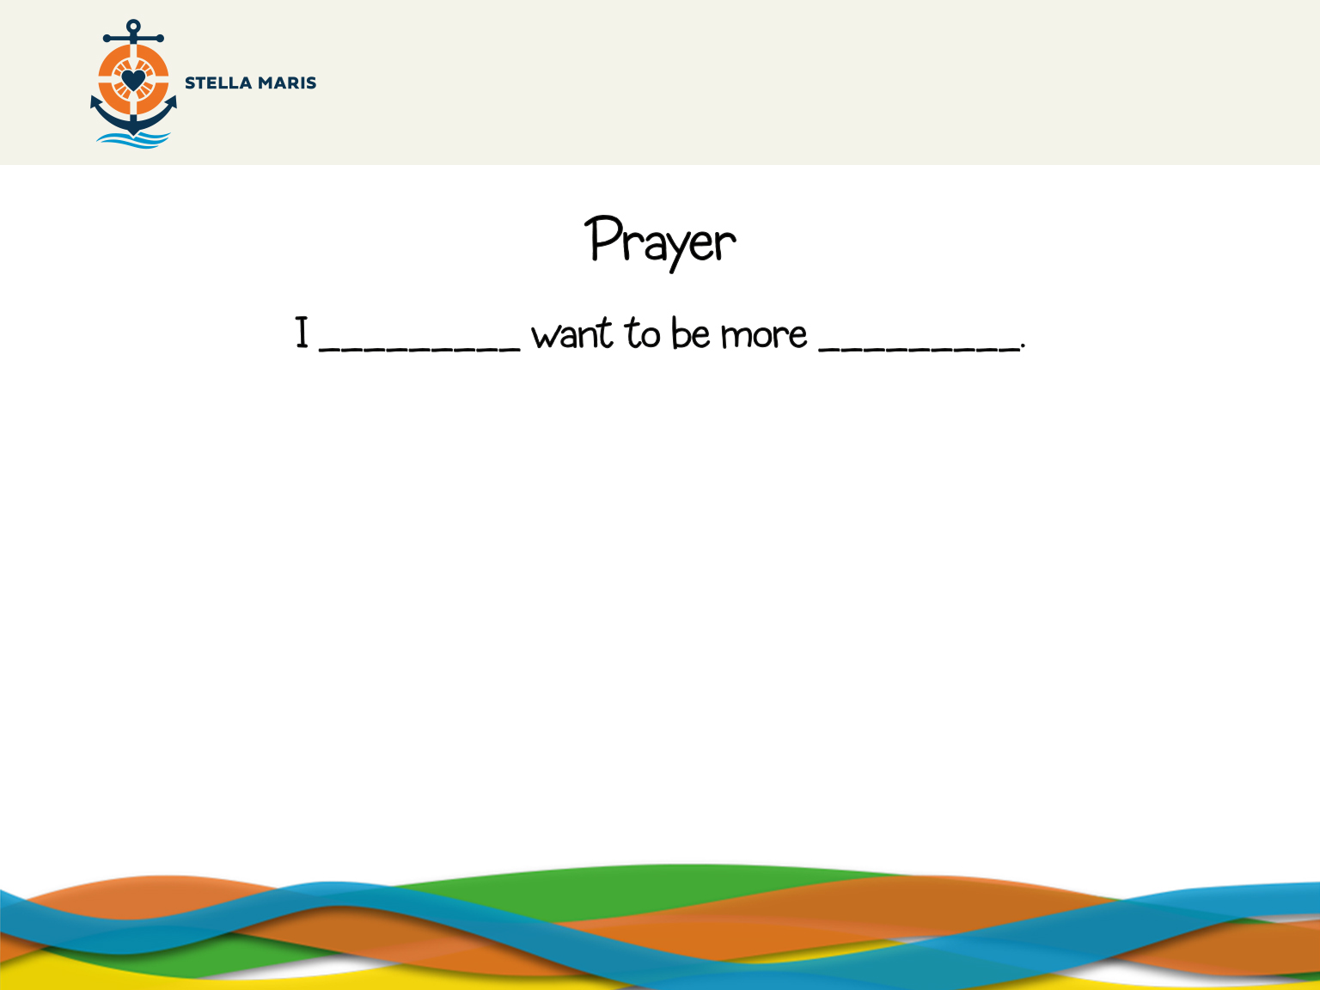
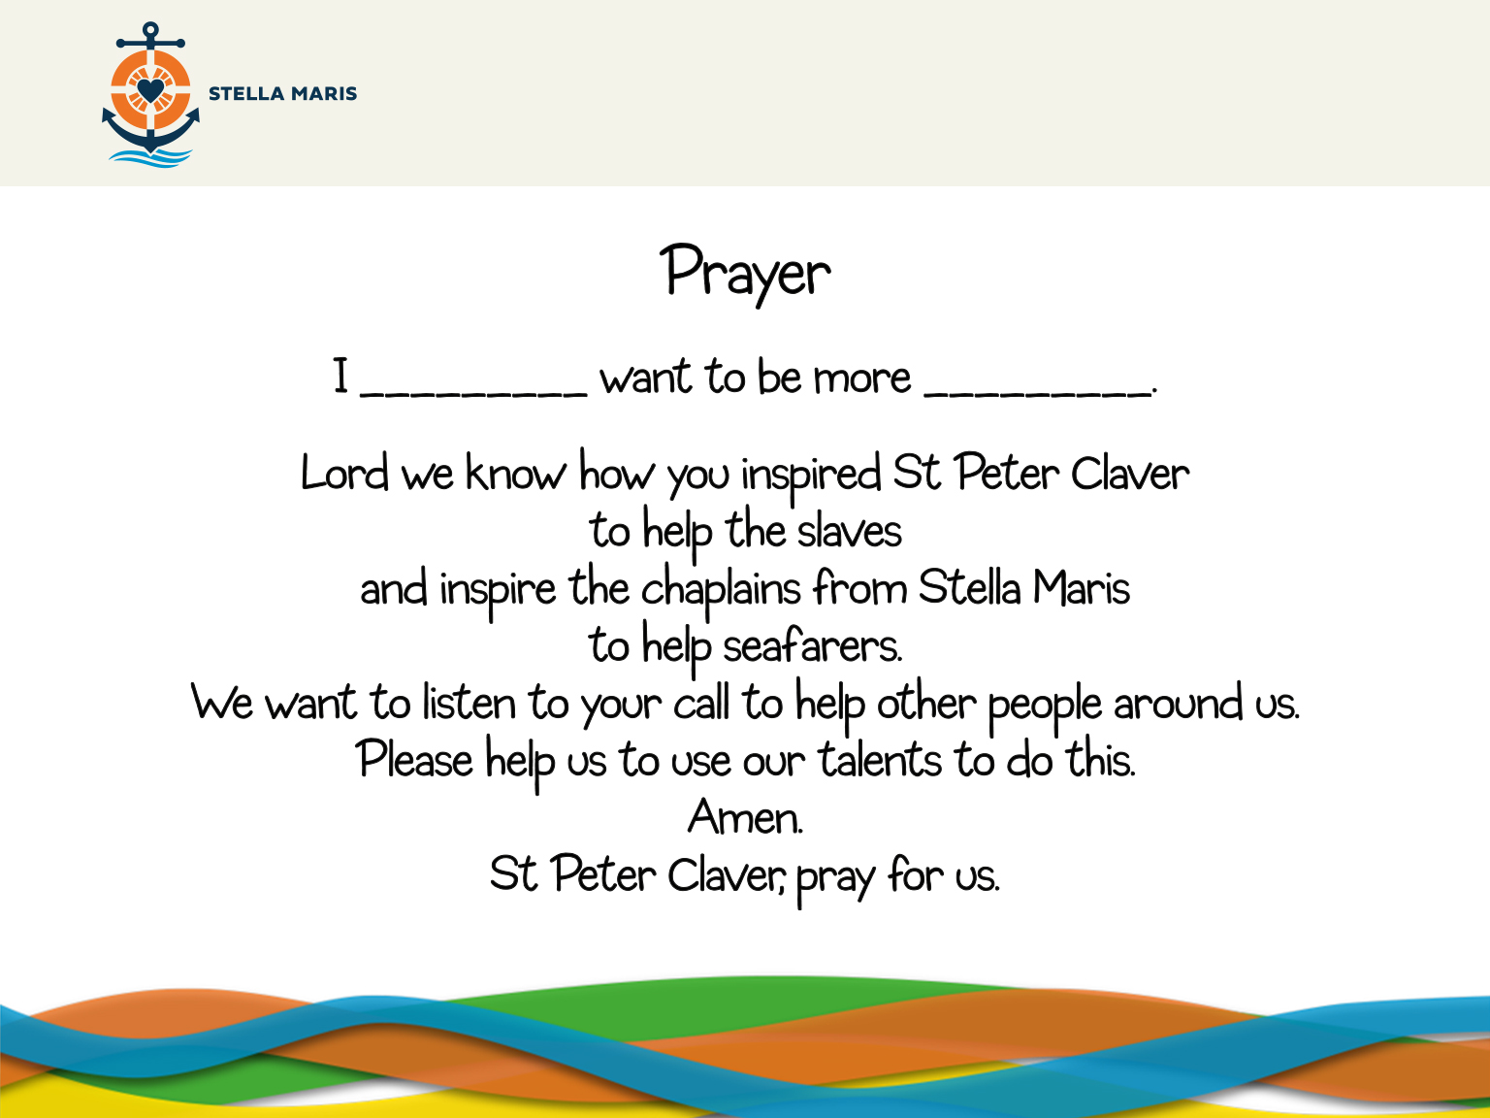
Notes:
In the circle each student will say one by one: “I, Carly, want to be more caring’, “I, John, want to be friendlier”, etc.
And now we all say this prayer together (on screen).
Finish with the sign of the cross. In the Name of the Father and of the Son and of the Holy Spirit, Amen.

Slide 20
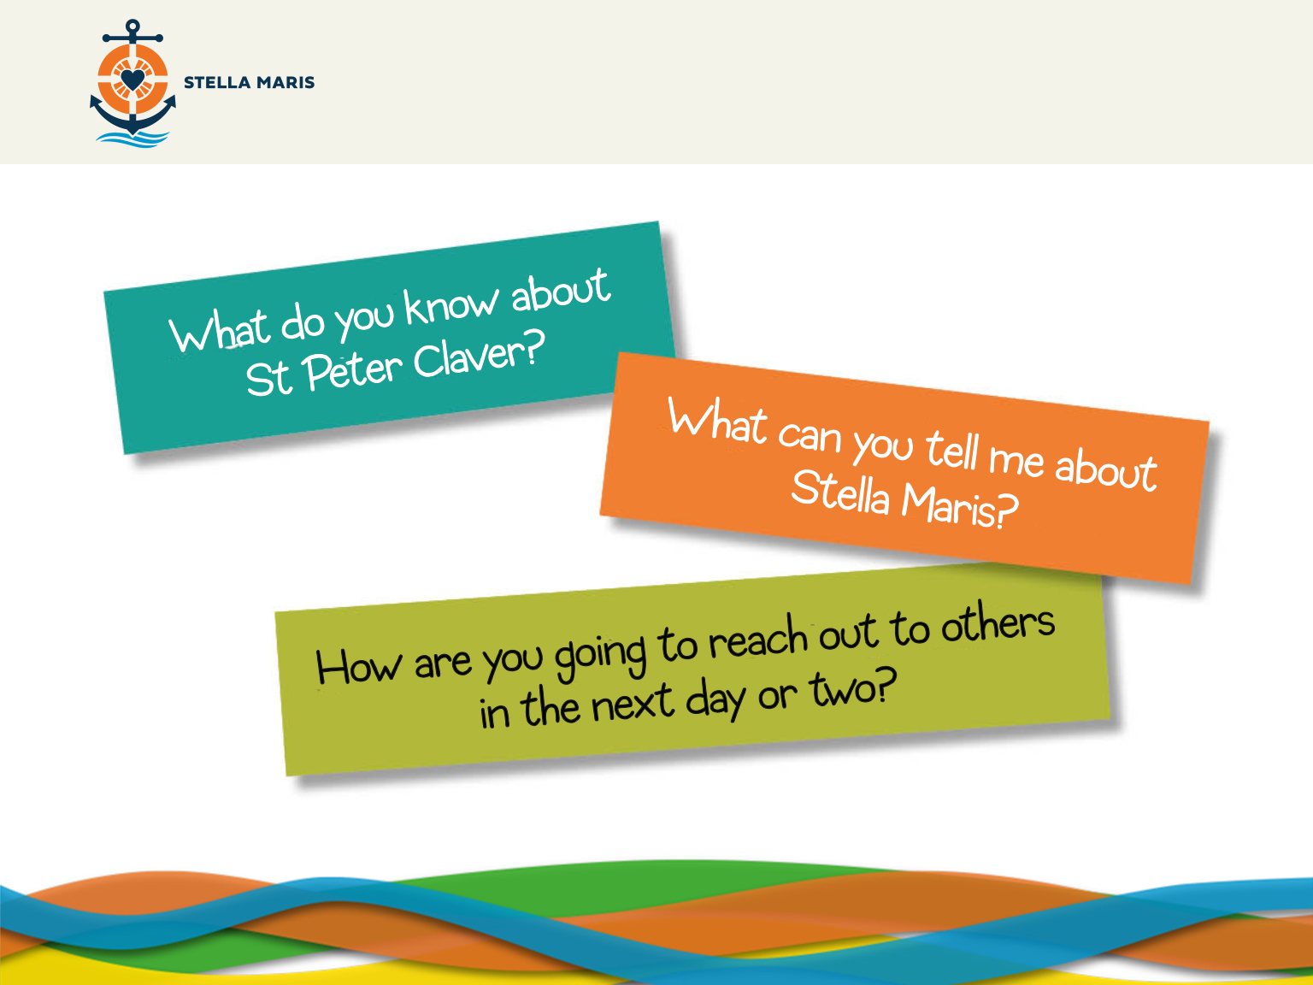
Notes:
Quick feedback on the following questions:
What do you know about St Peter Claver? (I can explain that St Peter Claver was called by God to take care of the material and spiritual needs of slaves)
What can you tell me about Stella Maris? (I can describe how Stella Maris responds to the call of God by helping seafarers.)
How are you going to reach out to others in the next day or two? (I can describe ways that I will respond to my Christian call to reach out to others in love, care, friendliness, kindness and generosity.)

Slide 21
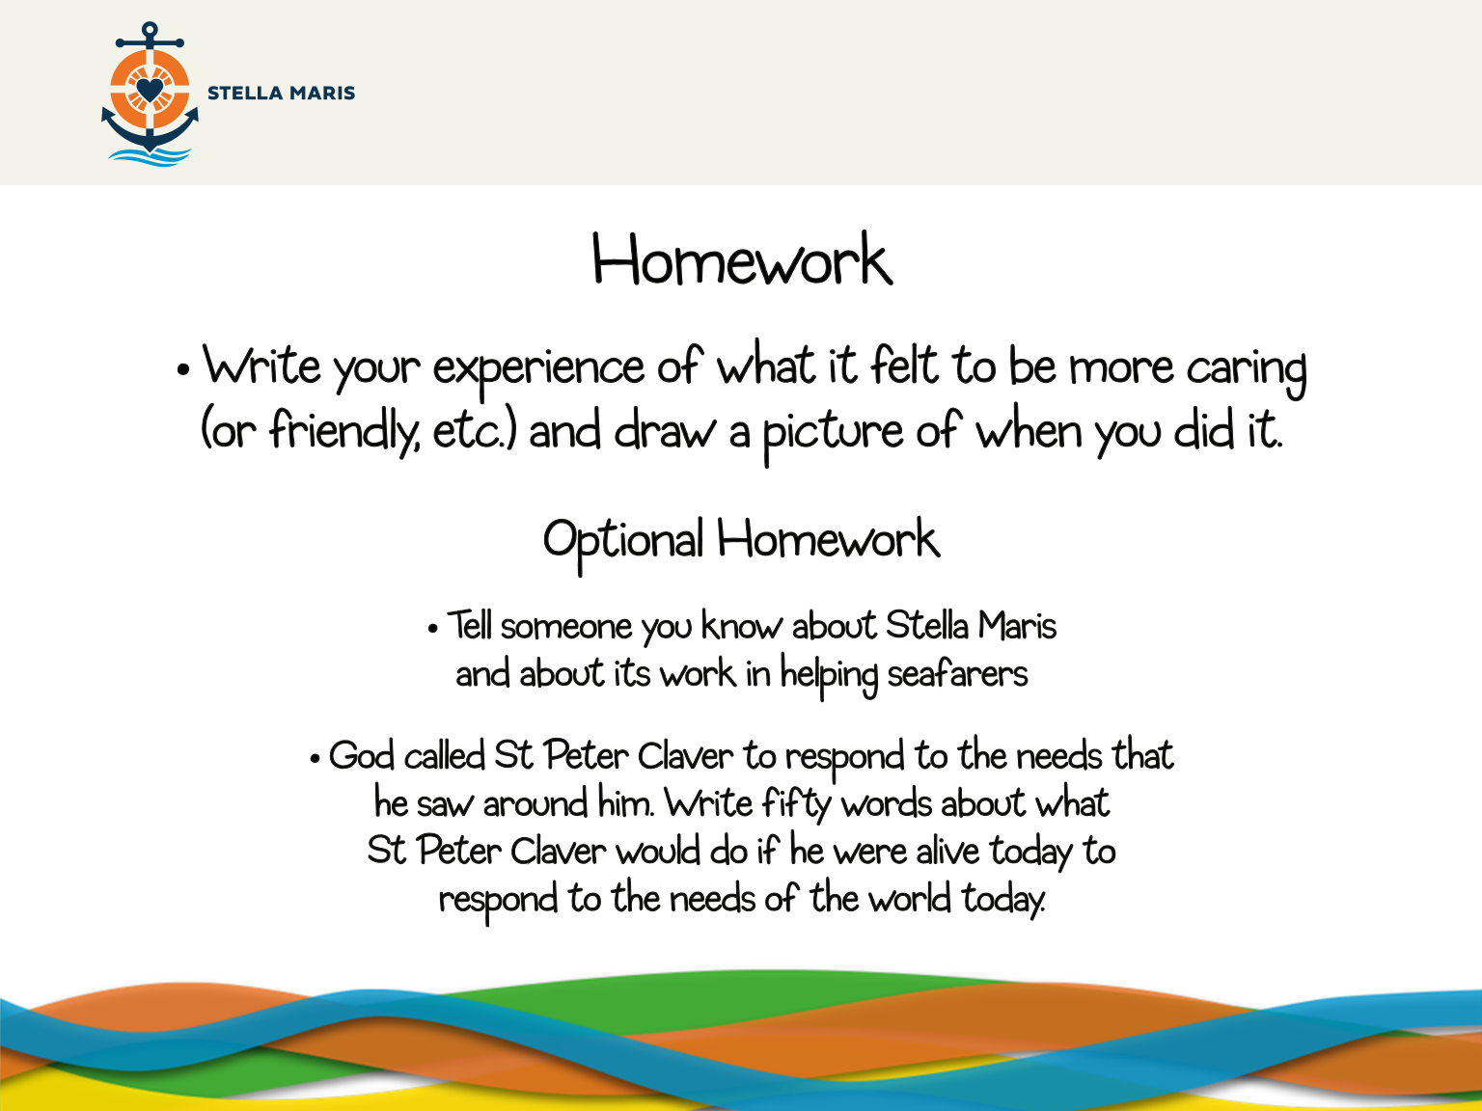
Notes:
Write your experience of what it felt to be more caring (or friendly, etc.) and draw a picture of when you did it.
OPTIONAL HOMEWORK
Tell someone you know about Stella Maris and about their work in helping seafarers
God called St Peter Claver to respond to the needs that he saw around him. Write fifty words about what St Peter Claver would do if he were alive today to respond to the needs of the world today.

